Slide 1
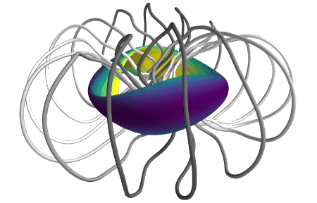
Stellarator optimization Where do these shapes come from?
Alan Kaptanoglu – alankaptanoglu@nyu.edu, New York University
Matt Landreman – mattland@umd.edu, University of Maryland
Notes:
https://www.youtube.com/watch?v=CJ_OBoEs3uU

Slide 2
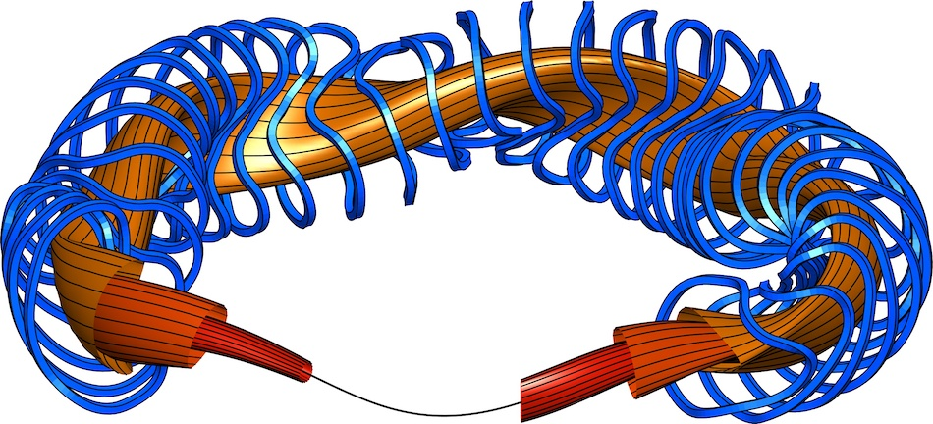
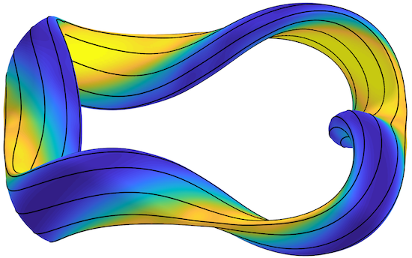
Outline
Optimization in general
Optimization for good flux surfaces
Quasi-axisymmetry, quasi-helical symmetry, and quasi-isodynamic
Optimization for stability & turbulence
Coil optimization: current potential and filament methods

Slide 3
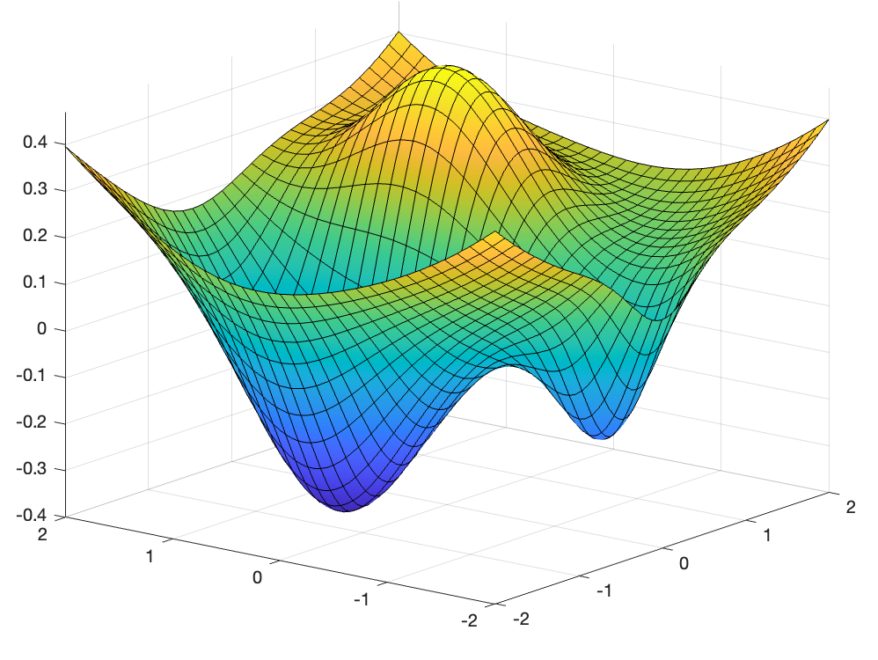
Optimization is a general technique with many applications
(a.k.a. “objective function”, “loss function”)
Two important ideas:
If f has multiple minima, we say it is “nonconvex”.
Most of optimization is basically “gradient descent” – move in the -∇f direction with some step size ⍺.
Local
minimum
Global minimum
Notes:
f = @(x,y) x.*exp(-x.^2-y.^2)+(x.^2+y.^2)/20;
f = @(x,y) x.*exp(-x.^2-(y-0.5).^2)+(x.^2+y.^2)/20-0.3*exp(-4*((y+1.5).^2+x.^2));
fsurf(f,[-2,2])
set(gcf,'color','w')

Slide 4
Optimization is a general technique with many applications
(a.k.a. “objective function”, “loss function”)
(Optional) Can add constraints:
Local
minimum
Common trick: turn “hard constraint” into “soft constraint”: minimize[f(x) + w|g(x)|²]
Global minimum
Notes:
f = @(x,y) x.*exp(-x.^2-y.^2)+(x.^2+y.^2)/20;
f = @(x,y) x.*exp(-x.^2-(y-0.5).^2)+(x.^2+y.^2)/20-0.3*exp(-4*((y+1.5).^2+x.^2));
fsurf(f,[-2,2])
set(gcf,'color','w')

Slide 5
Optimization is a general technique with many applications
(a.k.a. “objective function”, “loss function”)
(Optional) stochastic optimization to control for random perturbations:
Notes:
f = @(x,y) x.*exp(-x.^2-y.^2)+(x.^2+y.^2)/20;
fsurf(f,[-2,2])
set(gcf,'color','w')

Slide 6
Why do we need optimization at all?
Most nuclear fusion devices are planned to be (quasi) steady-state, so to first-order, they are designed as an MHD equilibrium.
There are lots of physical quantities (nested flux surfaces, rotational transform, quasi-symmetry, linear growth rates, …) we want to prescribe/extremize to achieve a very effective nuclear fusion device, but these quantities are determined by the equilibrium MHD equations: J x B = ∇p
However, the solution to these equations depend on boundary conditions. Thus, one of the big advantages of stellarators is that the 3D shape of the plasma can be designed to achieve these goals.

Slide 7
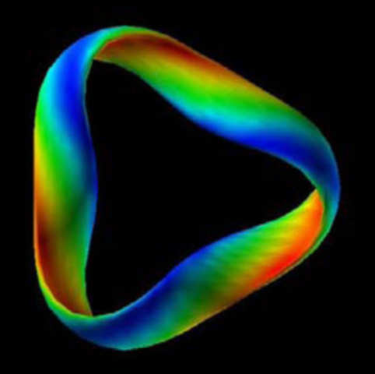
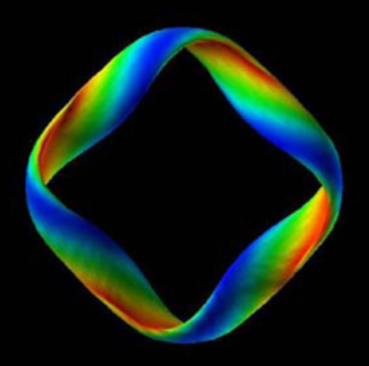
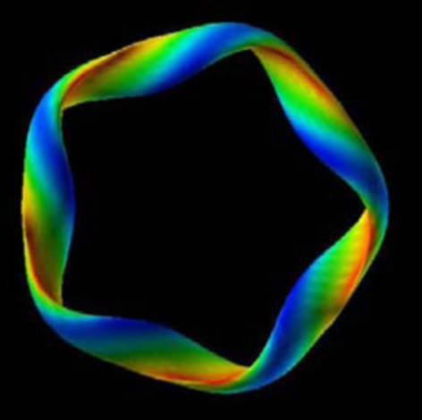
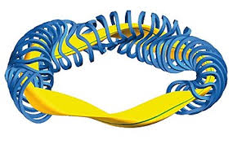
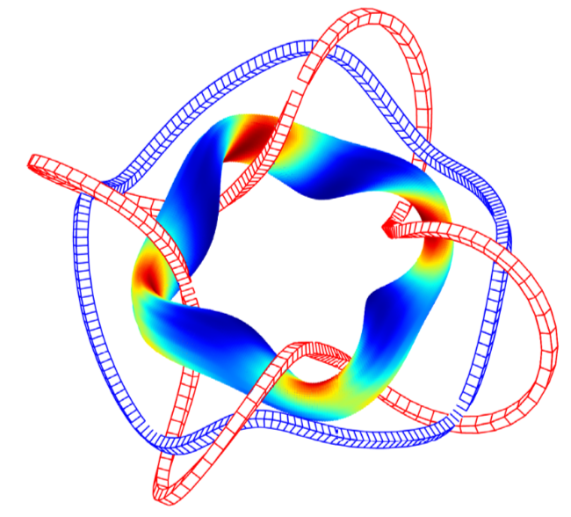
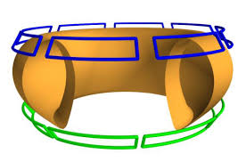
Some stellarator parameters are integers. These are mostly optimized by hand.
Number of “field periods”.
Number of coils.
NFP=3
NFP=4
NFP=5
Do coils link the plasma poloidally, helically, or not at all?
Do B contours link the torus toroidally (QA), helically (QH), or poloidally (QI)?
Notes:
KuBoozer_2011_NF_v51_p013004 New classes of quasi-helically-symmetric stellarators.pdf
Yamaguchi_2019_NF_59_104002 QI vacuum field with helical coils.pdf

Slide 8
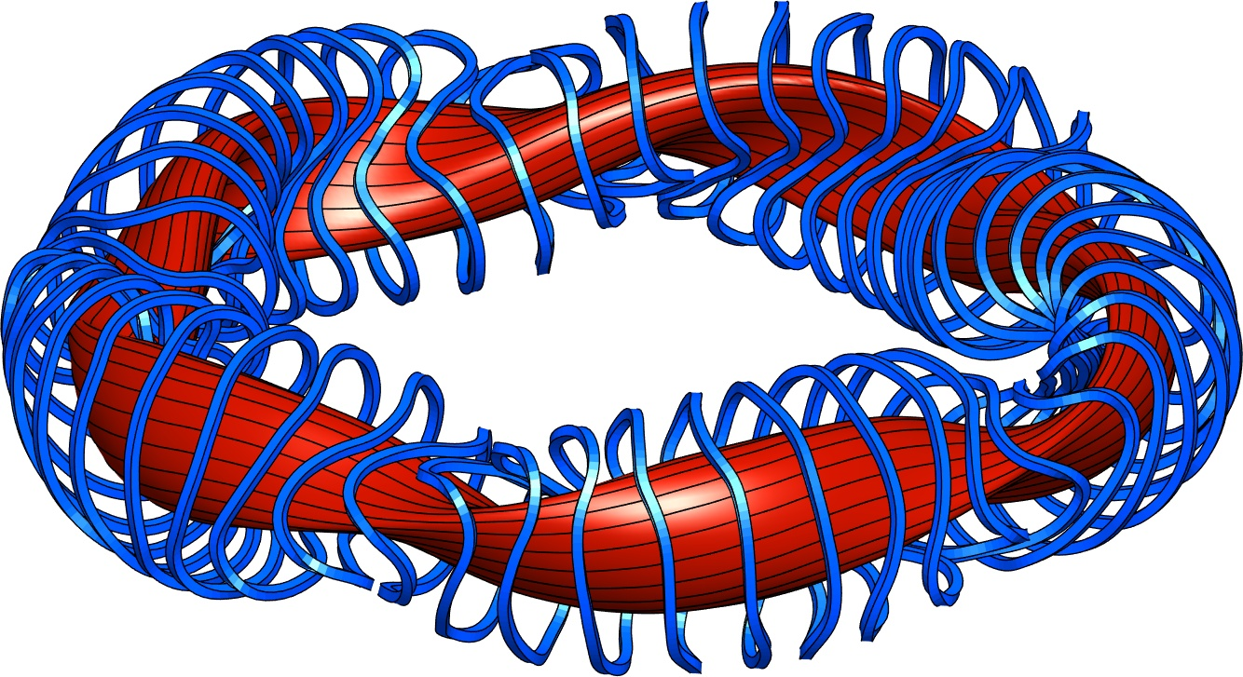
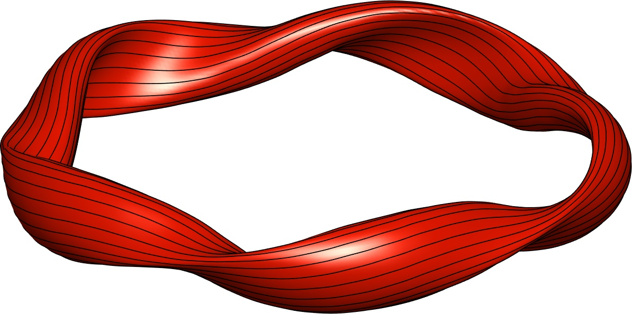
There are several possible choices of parameter space to optimize in

Slide 9
Most transport-optimized stellarators have used 2 sequential optimization stages
Parameters = shape of boundary toroidal surface. Objective = physics (confinement, stability, etc.)
Parameters = coil shapes. Objective = error in B on boundary shape from stage 1.
Shape of a toroidal boundary surface (+ pressure & current vs r inside, & total B flux) determines B everywhere inside:
Notes:
m20200814_01_W7XIllustrationWithCoils

Slide 10
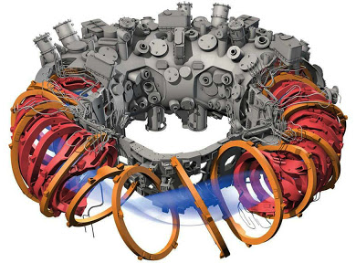
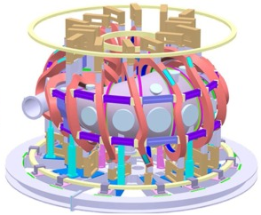
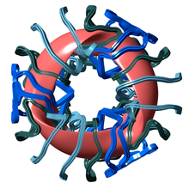
Most transport-optimized stellarators have used 2 sequential optimization stages
Parameters = shape of boundary toroidal surface. Objective = physics (confinement, stability, etc.)
Parameters = coil shapes. Objective = error in B on boundary shape from stage 1.
W7-X (Germany)
CFQS (China), under construction
NCSX (Princeton)
Notes:
m20200814_01_W7XIllustrationWithCoils

Slide 11
Outline
Optimization in general
Optimization for good flux surfaces
Quasi-axisymmetry, quasi-helical symmetry, and quasi-isodynamic
Coil optimization: current potential and filament methods

Slide 12
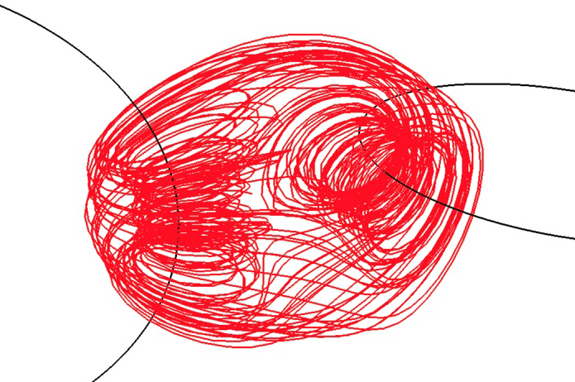
One goal of stellarator optimization is having field lines lie on surfaces.
Chaotic (volume-filling) B field lines would allow inside & outside to mix even without cross-B drift.
BAD
Magnetic field lines
Hosoda, PRE (2009)
GOOD
Magnetic surfaces
Notes:
m20160131_DartmouthTorusFigure.m

Slide 13
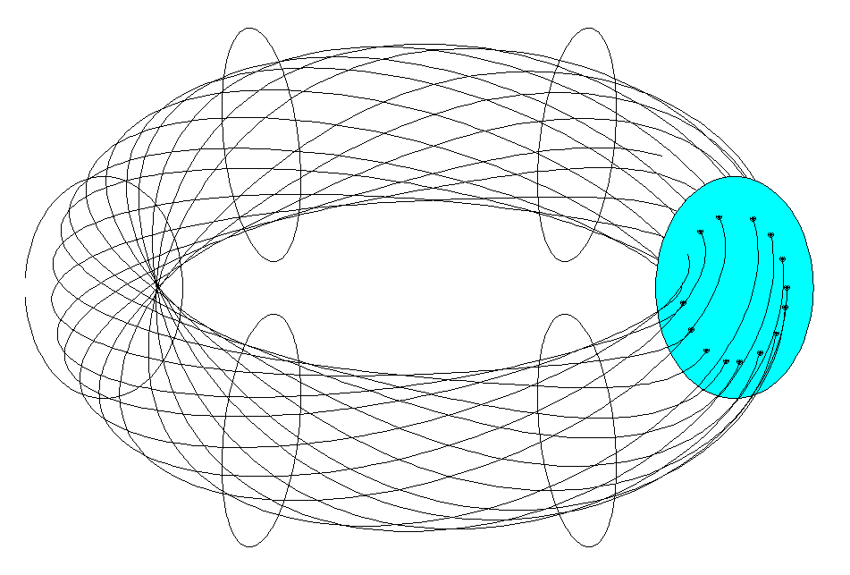
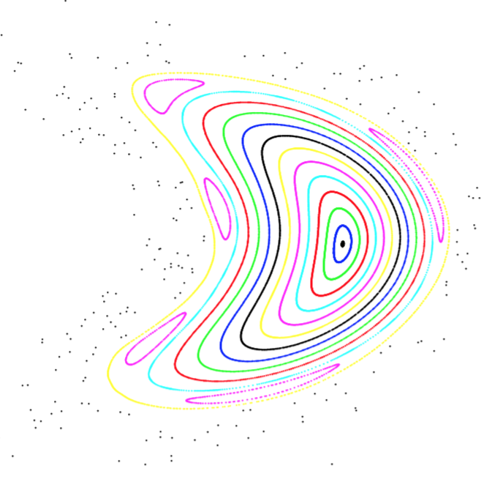
One goal of stellarator optimization is having field lines lie on surfaces.
Magnetic surfaces (a.k.a flux surfaces) can be visualized with a “Poincare plot”:
Good
Not so good
Islands, where ι is rational
Chaos
J P Kremer,
PhD thesis, Columbia

Slide 14
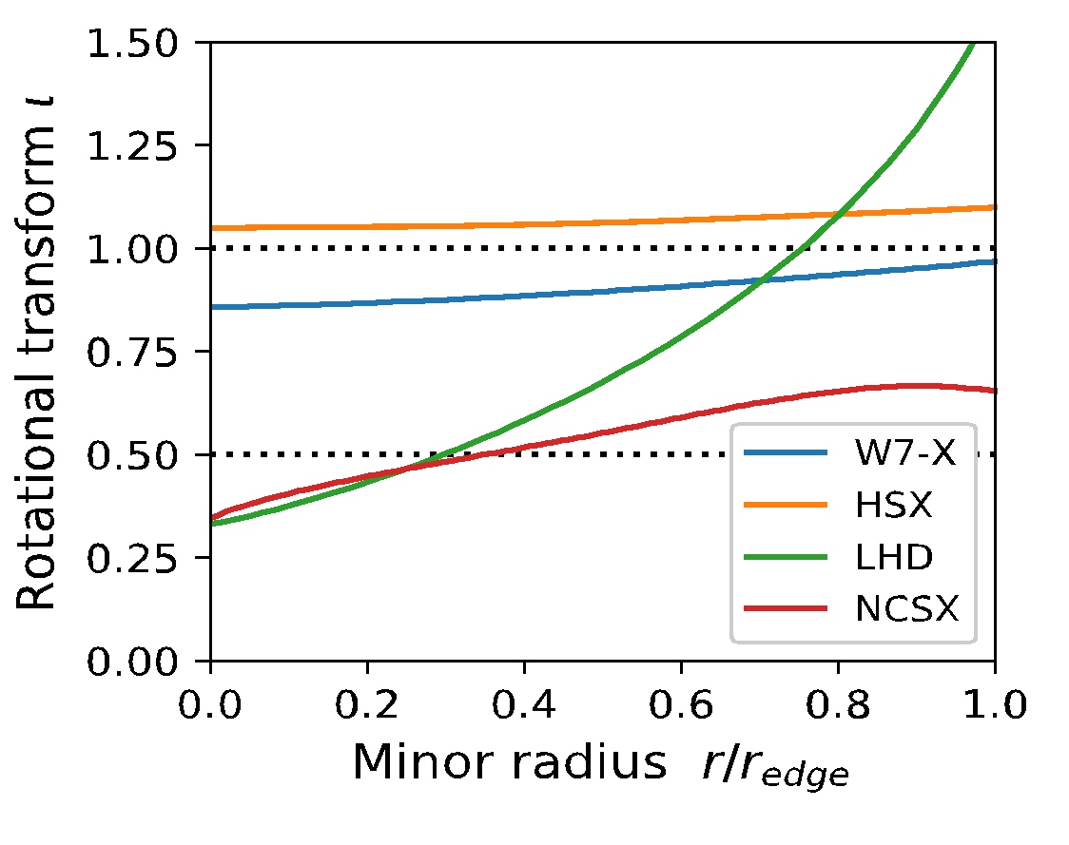
How much rotational transform do you want?
Avoid rationals like ι = 1 or ½: islands form there.
So, maybe want low “magnetic shear” = |∇ι|.
Or, maybe want high magnetic shear since it makes islands thin. (width ∝ |∇ι|^{-1/2})
Islands
Larger ι means:
Thinner orbits, so better confinement.
B changes less due to plasma current. (Higher “equilibrium β limit”.)
But, more complicated coils.
Notes:
20200812-01-plotIotaProfiles.pdf

Slide 15
Outline
Optimization in general
Optimization for good flux surfaces
Quasi-axisymmetry, quasi-helical symmetry, and quasi-isodynamic
Coil optimization: current potential and filament methods

Slide 16
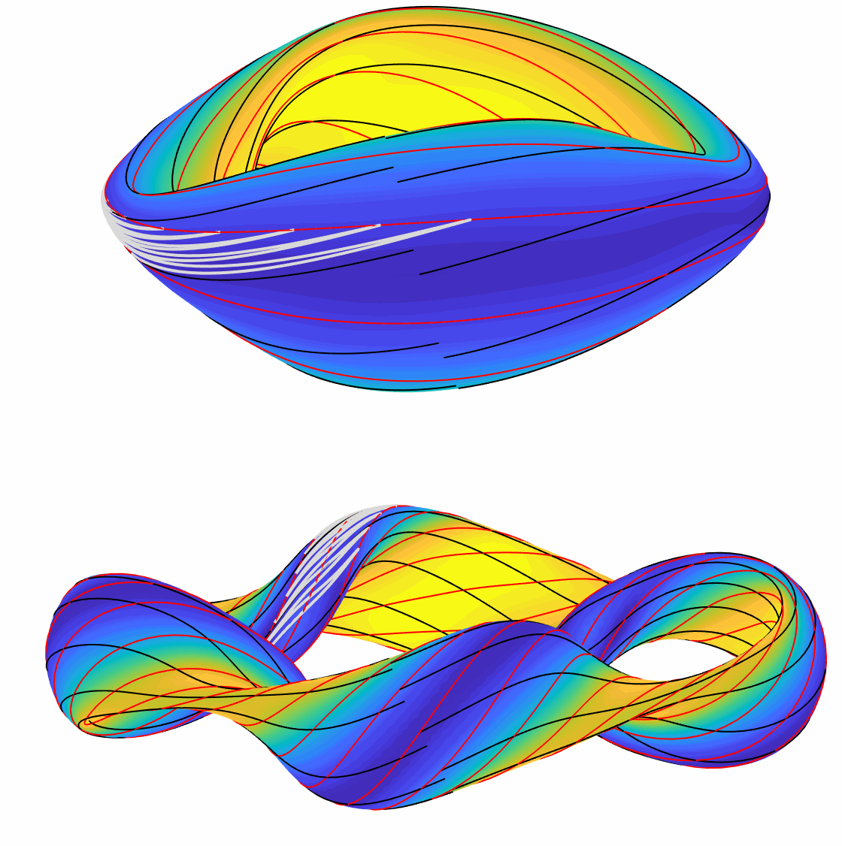
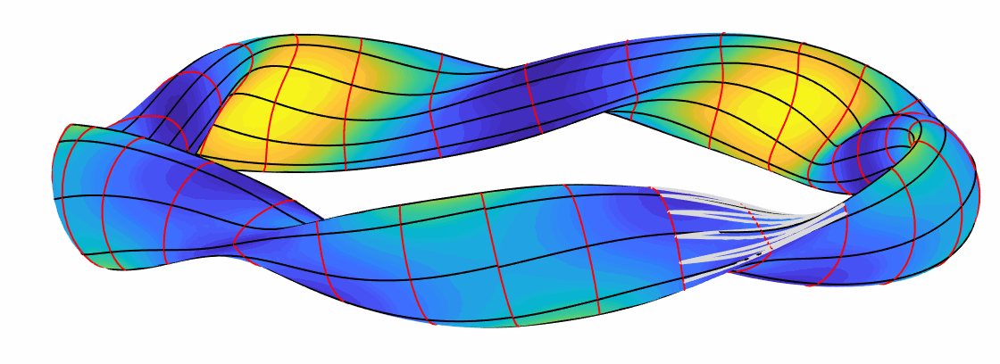
For low neoclassical transport, recent stellarators have come in 3 flavors
Trapped particles should drift toroidally, helically, or poloidally on a surface.
B contours on a surface have the same topology as these drifts.
Toroidal: “QA” = Quasi-axisymmetric
Field lines
|B| contours (slightly idealized)
Trapped particle
Helical: “QH”= Quasi-helically symmetric
Poloidal: “QI”= Quasi-isodynamic
Notes:
m20200812_02_3TypesOfOptimizedStellarator_gif.m

Slide 17
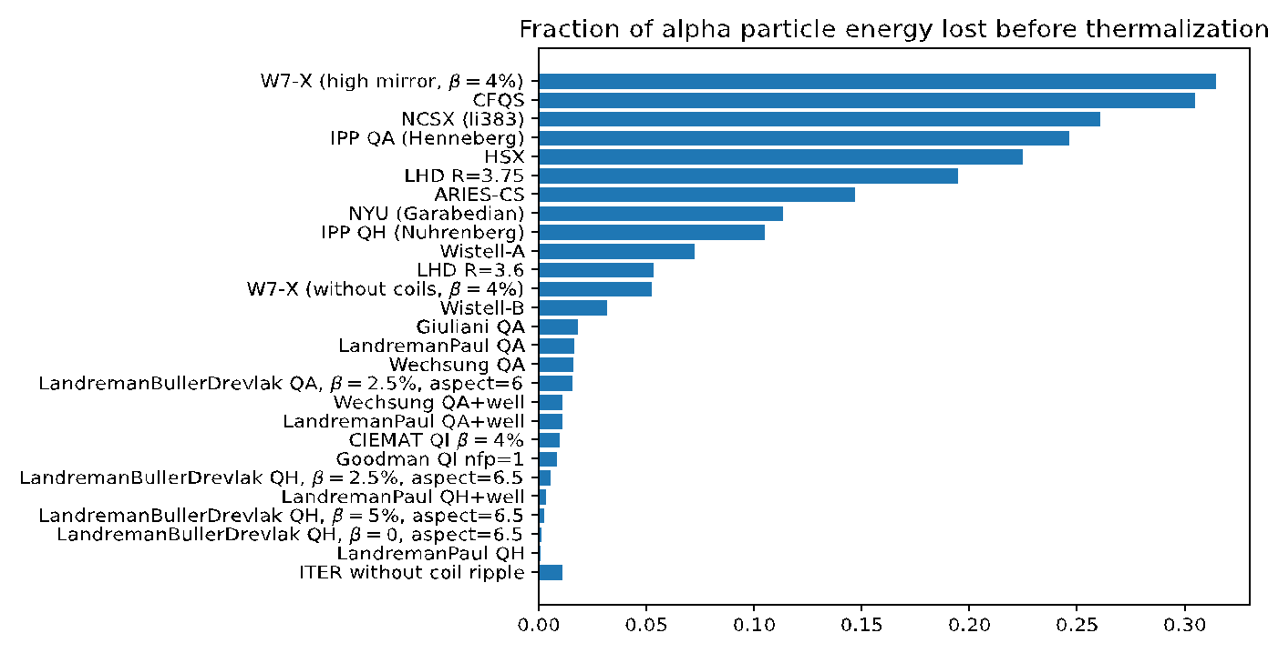
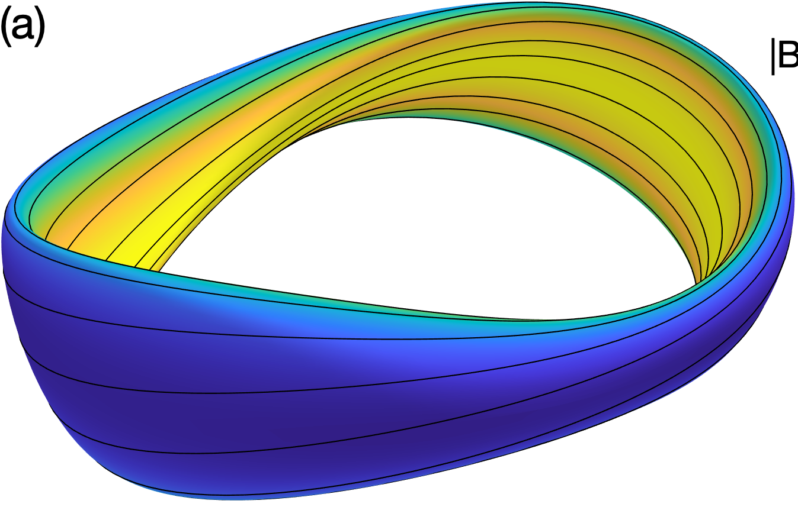
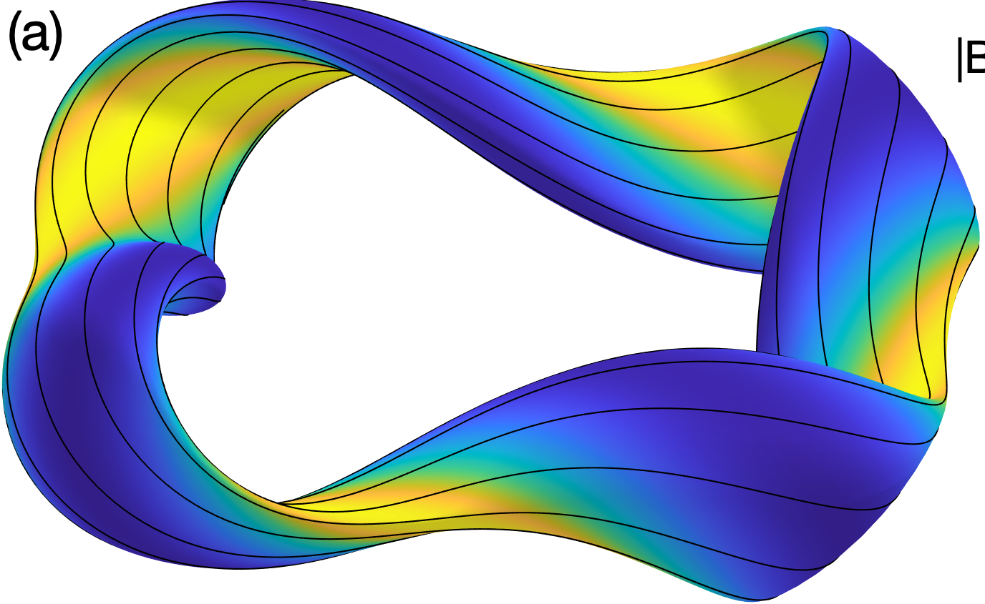
There has been great progress recently in optimizing stellarator neoclassical confinement
Trajectories of fusion-produced distribution of alpha particles followed in many magnetic configurations, all scaled to reactor size and |B|:
Since 2021
Fraction of alpha-particle energy lost before thermalization
Landreman et al, Phys Plasmas (2022).

Slide 18
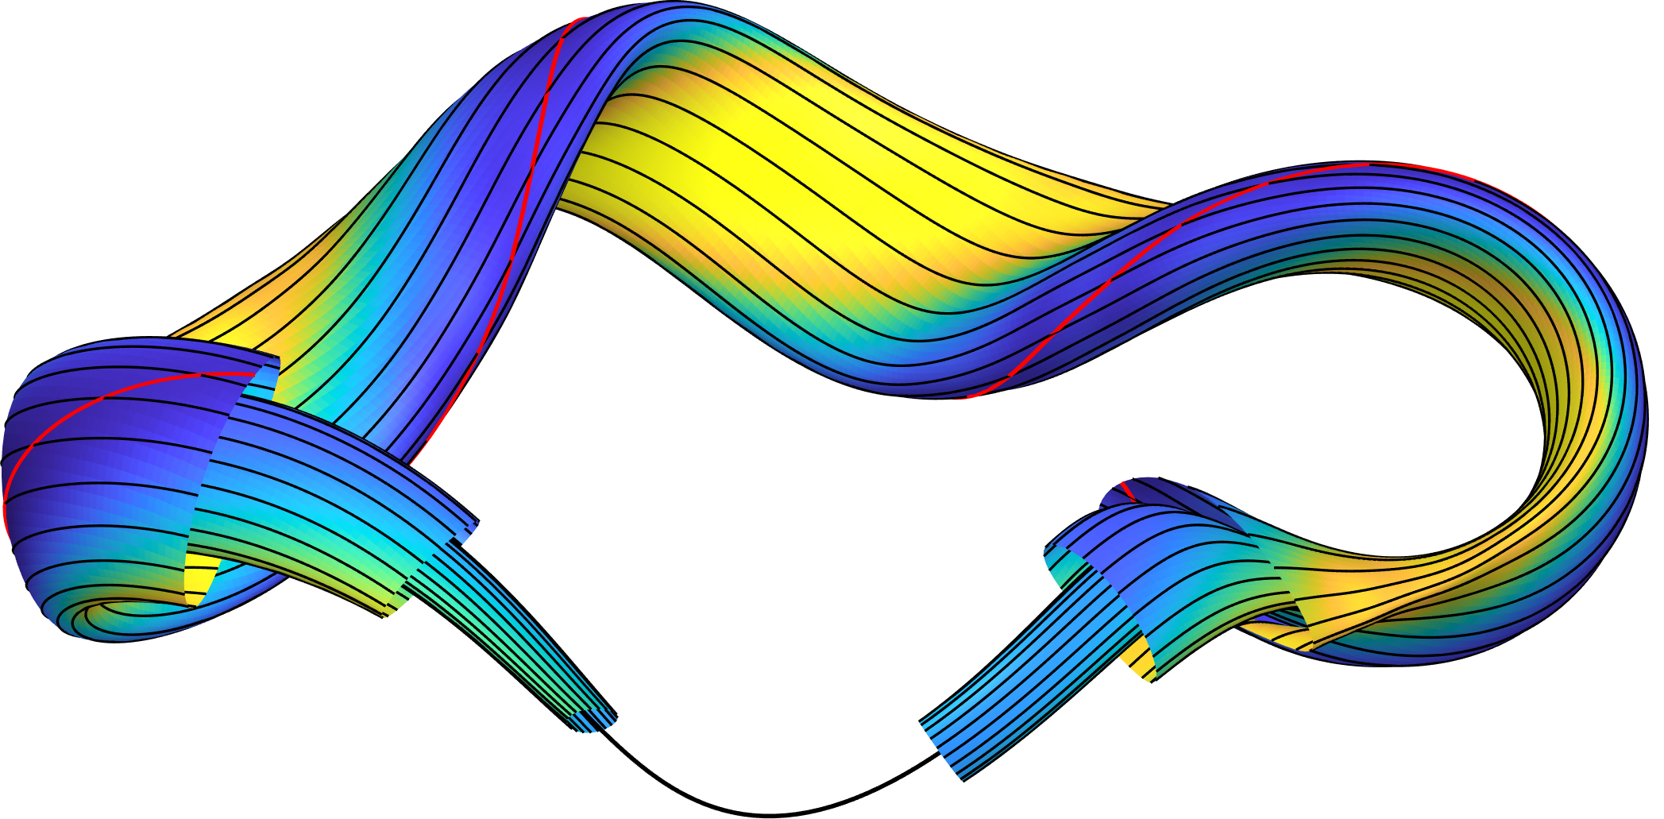
The parameter space for stage-1 optimization is typically a set of Fourier amplitudes for the boundary surface in cylindrical coordinates
𝜃
Magnetic field lines
Parameterization of boundary surface:
Notice there are (2M+1)(2N + 1) optimization variables (free parameters)

Slide 19
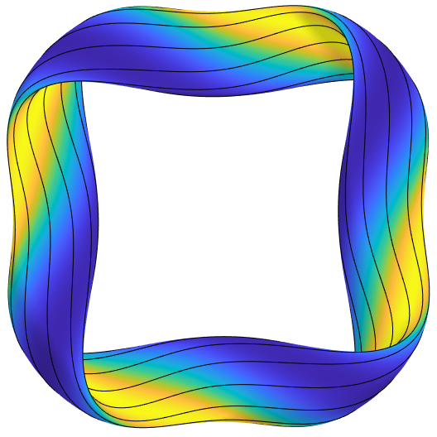
Quasisymmetry is a sufficient (though not necessary) condition for confinement, & a useful surrogate
𝜃
Magnetic field lines
B = B(s, 𝜃 − N 𝜑)
𝜑
“Boozer angles”
Constant s = normalized toroidal flux
Objective:
e.g.
N = 4
here
For quasi-axisymmetry,
N = 0.
For quasi-helical symmetry,
N is the number of field periods,
Boundary aspect ratio

Slide 20
So what is the explicit optimization problem?
Inputs:
Problem is very nonconvex with lots of “bad” shapes– need to regularize it, e.g. with “Fourier continuation”
Need a MHD equilibrium code like VMEC or DESC for this step!
for N in {1, 2, …, 5}
for M in {1, 2, …, 5}

Slide 21
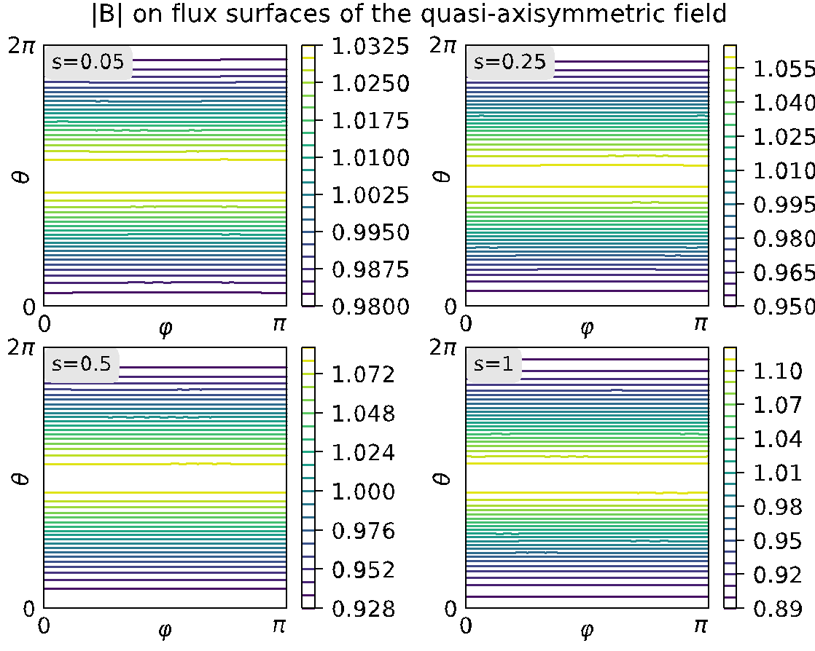
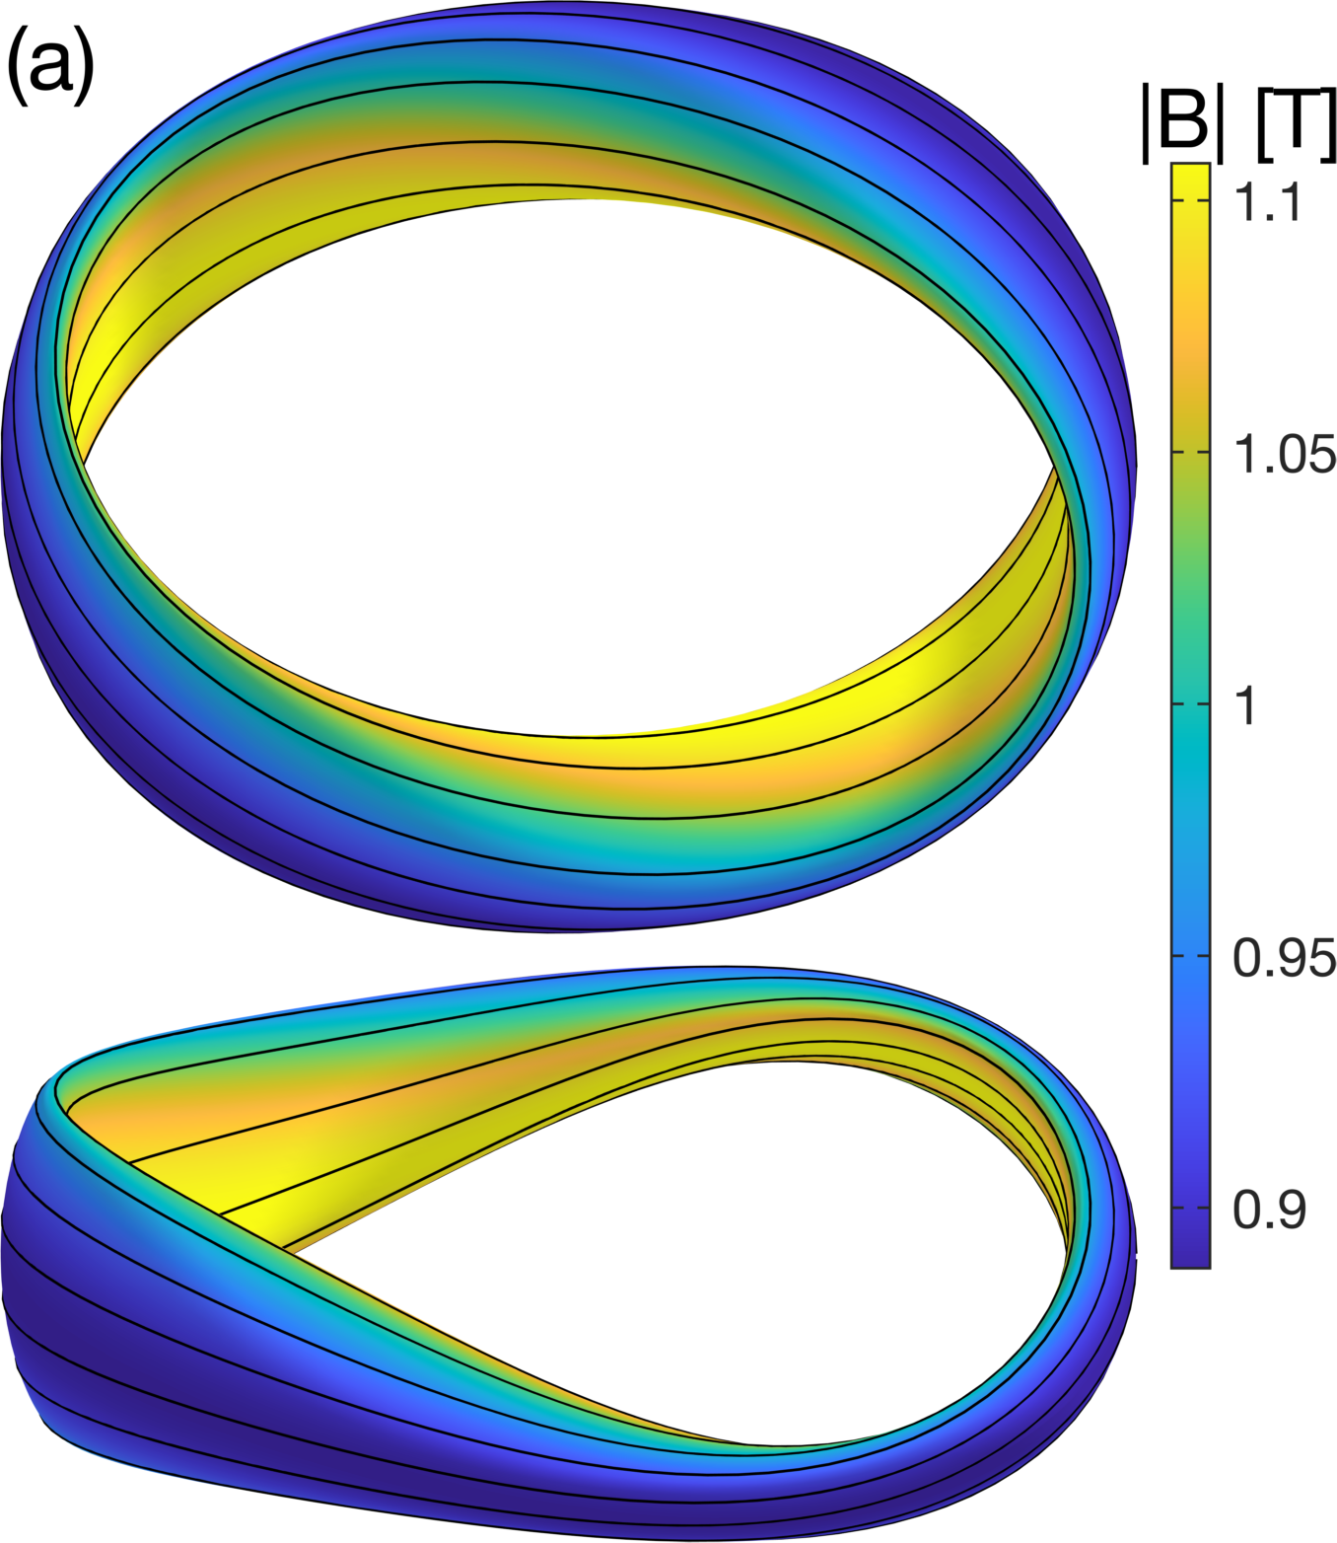
Example of quasi-axisymmetry optimization
ML & Paul, Phys Rev Lett (2022)

Slide 22
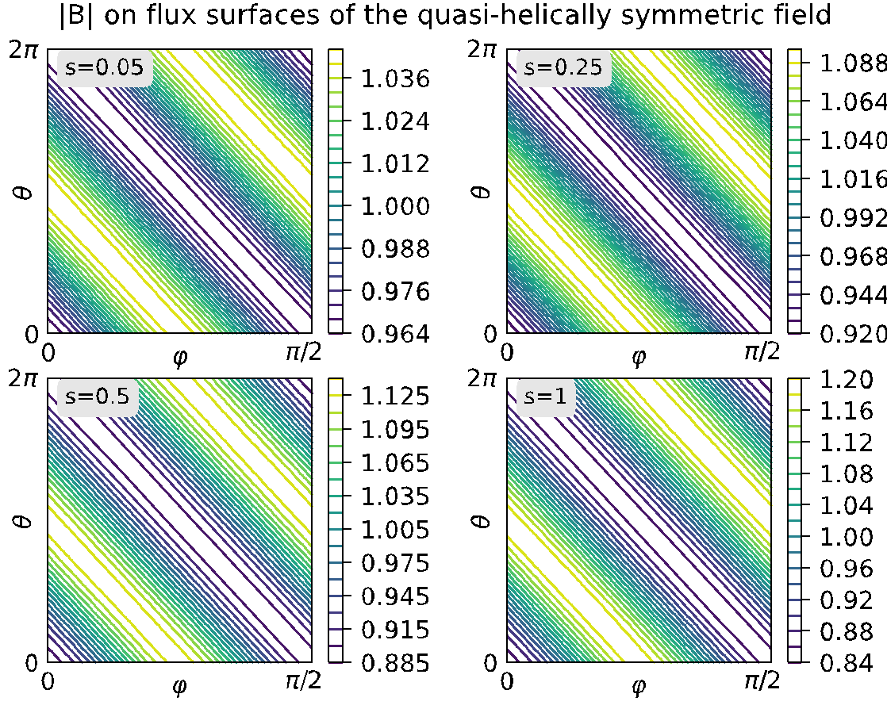
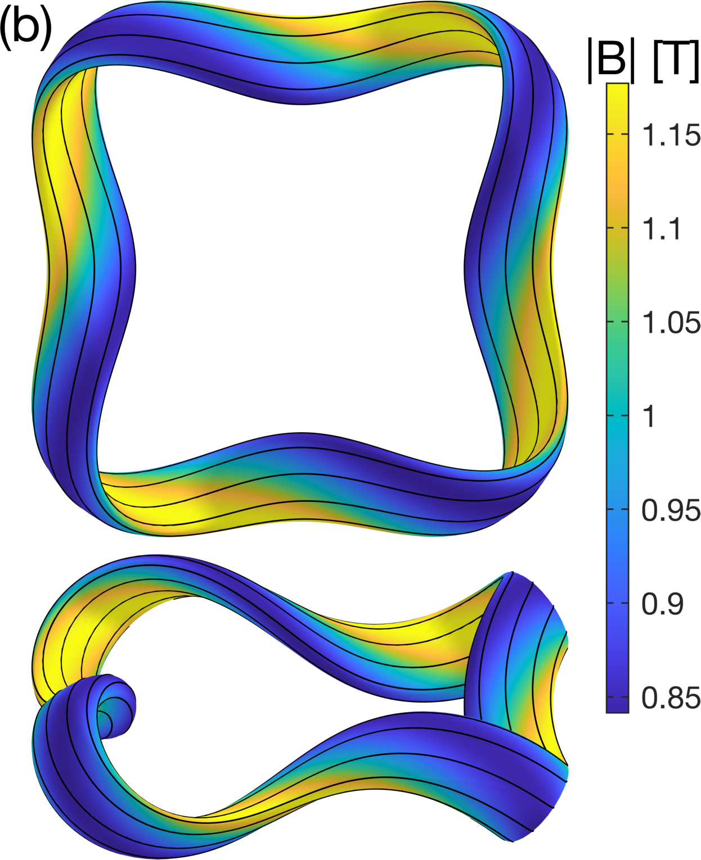
Example of quasi-helical symmetry optimization
ML & Paul, Phys Rev Lett (2022)

Slide 23
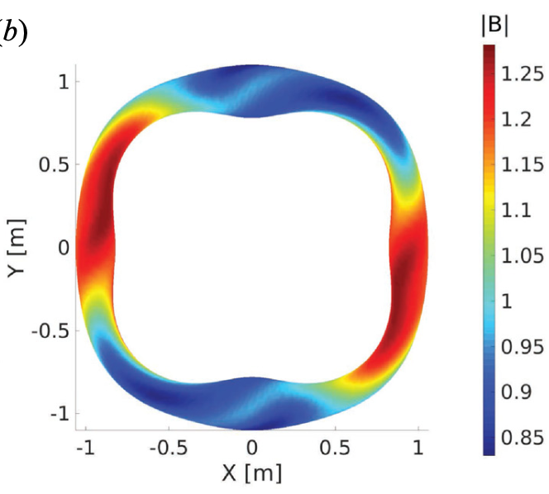
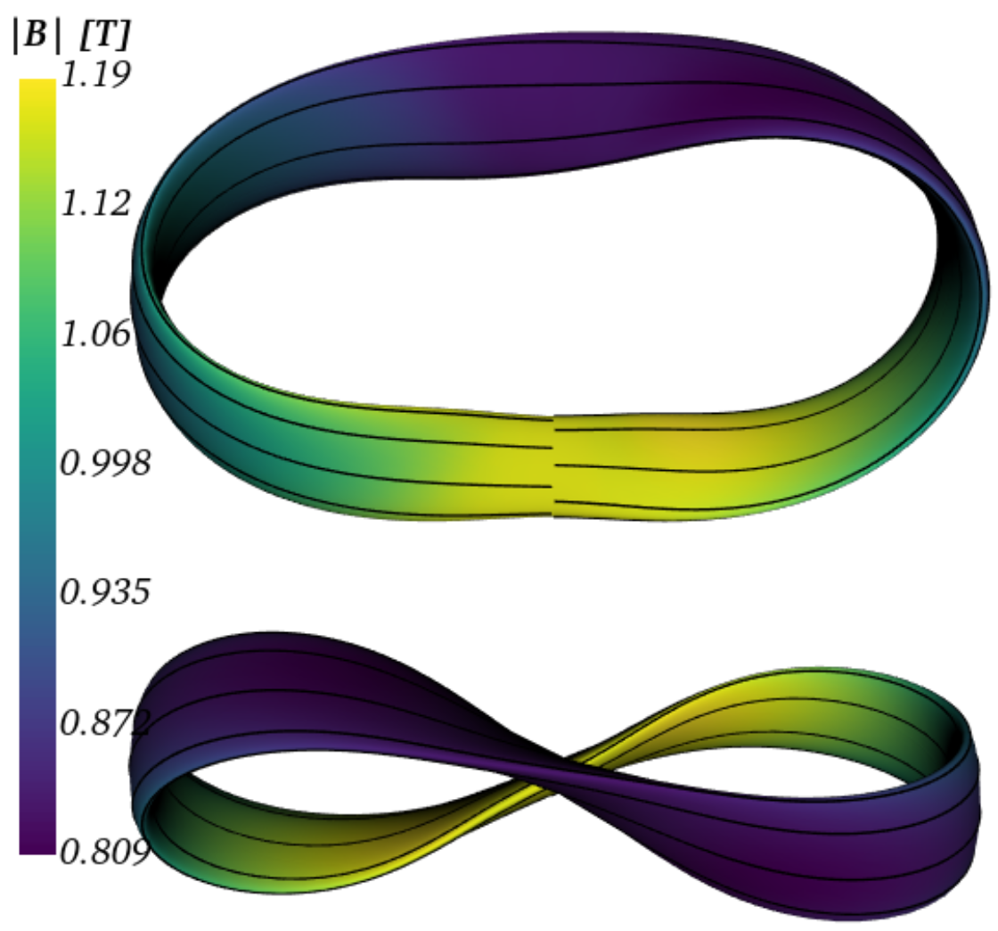
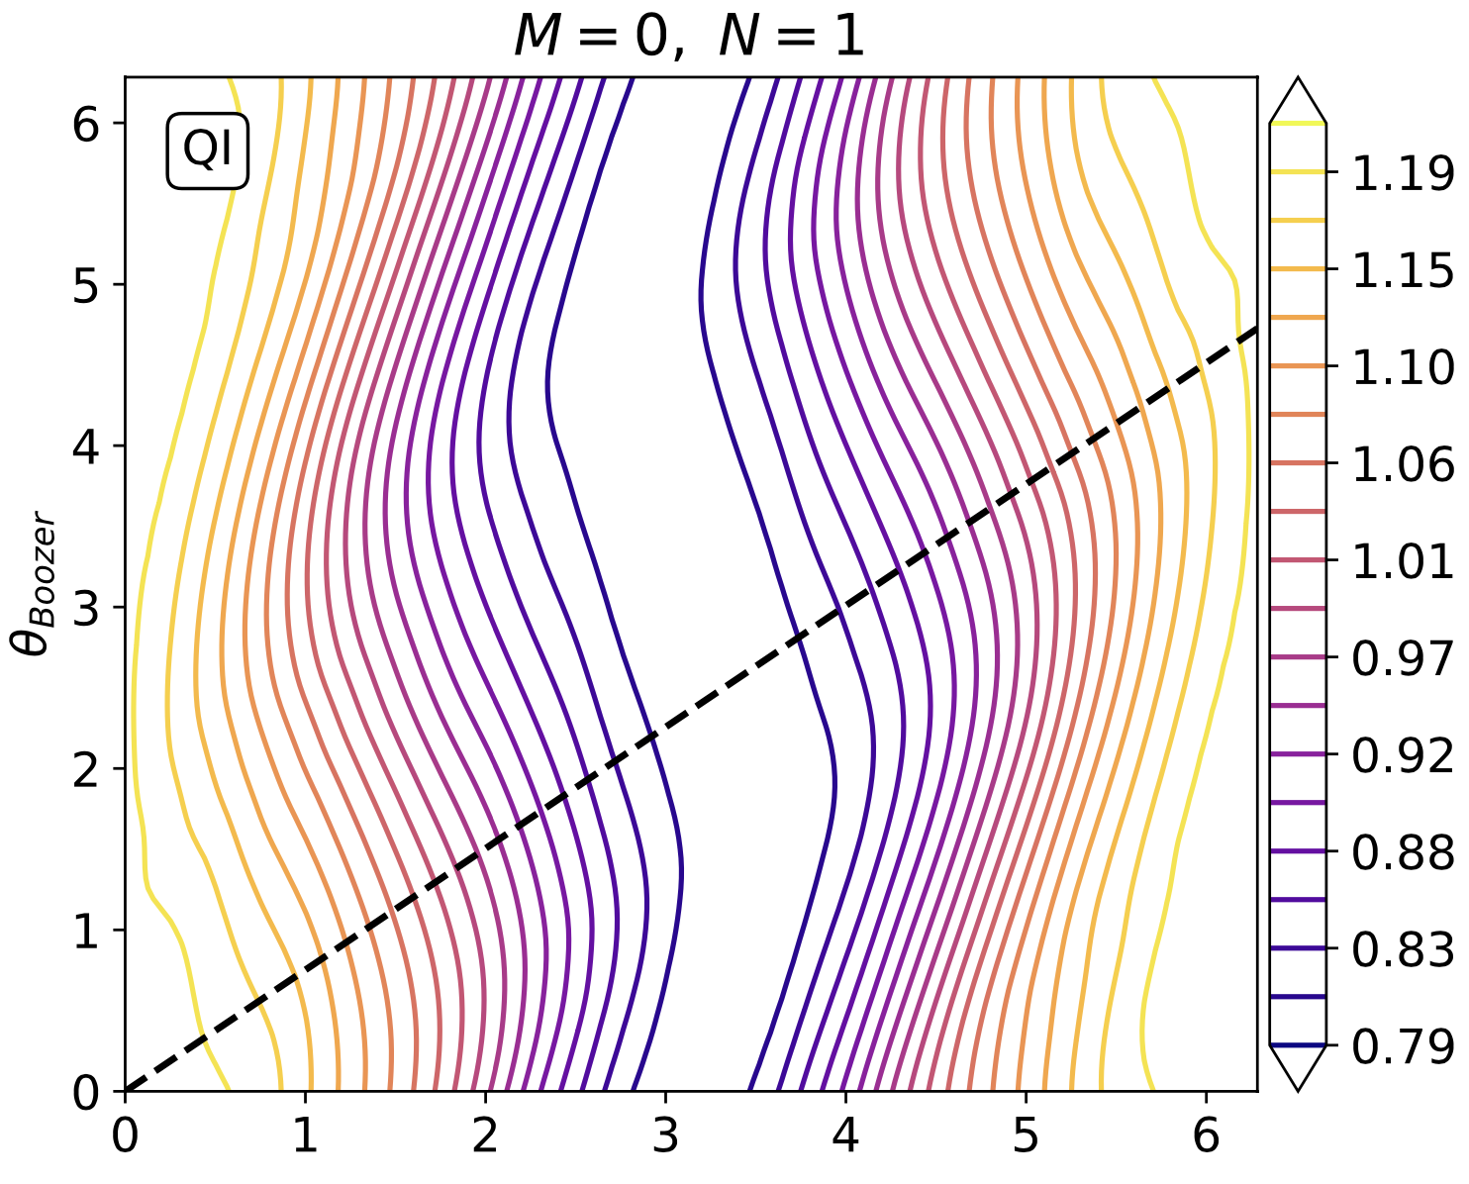
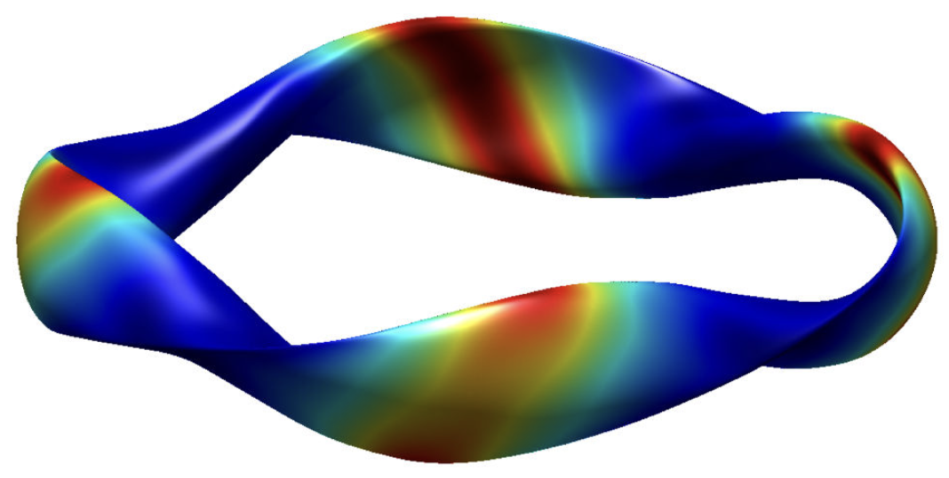
There has been similar recent progress in finding quasi-isodynamic configurations
Jorge et al (2022)
Mata et al (2022)
Goodman et al (2023)
Dudt et al (2023)
Sanchez et al (2023)

Slide 24
Outline
Optimization in general
Optimization for good flux surfaces
Quasi-axisymmetry, quasi-helical symmetry, and quasi-isodynamic
Coil optimization: current potential and filament methods

Slide 25
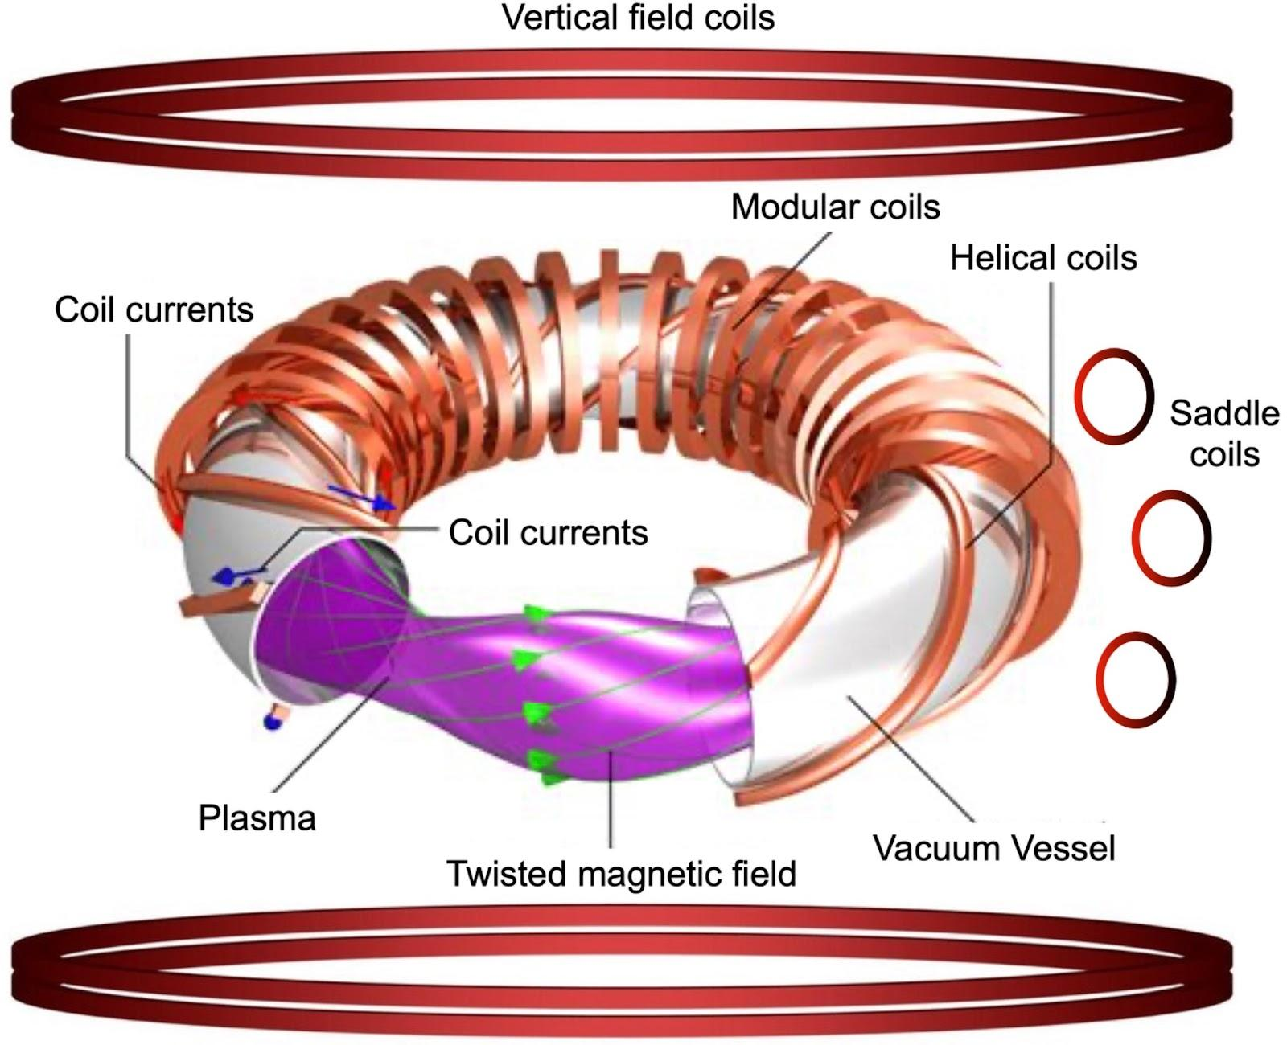
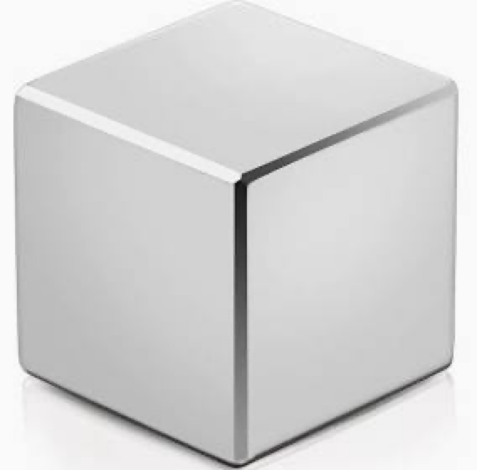
Stellarator designs can use a myriad of different current sources…
(Dipole
coils)
Permanent magnets

Slide 26
Stellarator coil design is “inverse magnetostatics”
Inverse magnetostatics: Given a desired magnetic field on a compact surface S or volume V, how to find current sources that produce that field?
Examples: Design magnetic fields for laboratory experiments (e.g. plasma physics, biology, particle physics), industrial applications (e.g. MRI), etc.
Degrees of freedom: number, location, shape, strength of current sources.
Example magnetostatic optimization problem
Biot-Savart Law for current source of volume V’

Slide 27
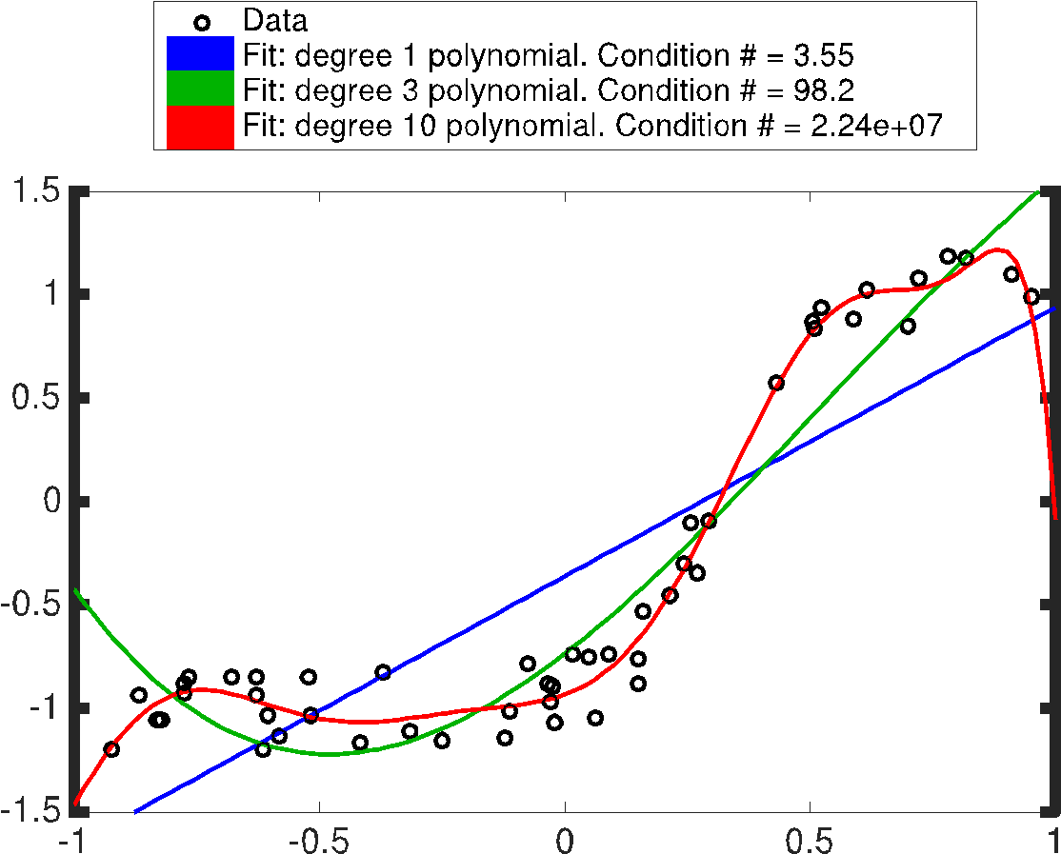
Finding coils that produce a given B is analogous to fitting data with a polynomial
As polynomial degree increases, fit is closer to data but less ‘regular’.
Polynomial degree is the ‘regularization parameter’.

Slide 28
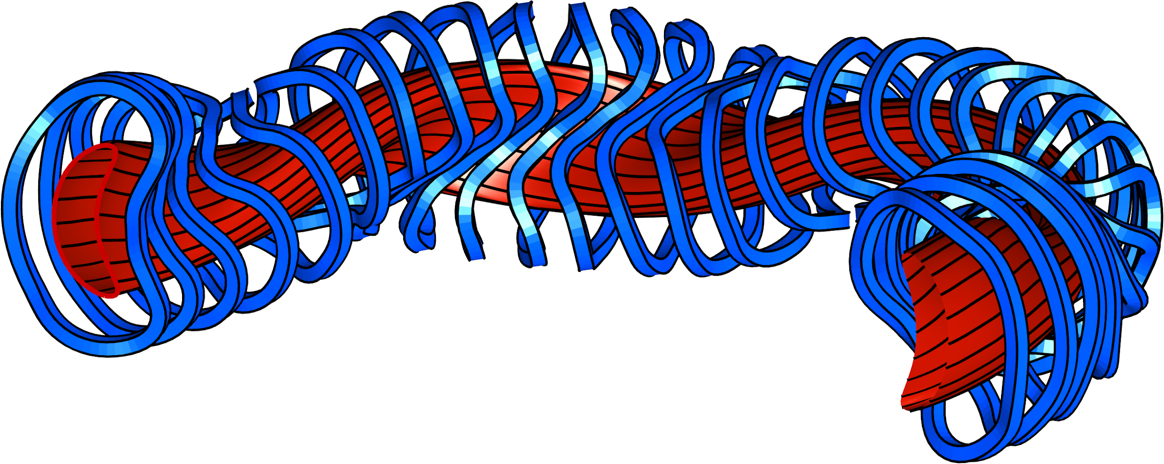
Calculating the currents that produce a given B is an “ill-posed inverse problem”: solution is not unique.
Actually a good thing:
There is a lot of freedom in coil design
Some kind of ‘regularization’ is needed to exclude solutions like this:
Notes:
Figure created using m20160506_01_W7X_illustrationForBDISTRIBTalk.m

Slide 29
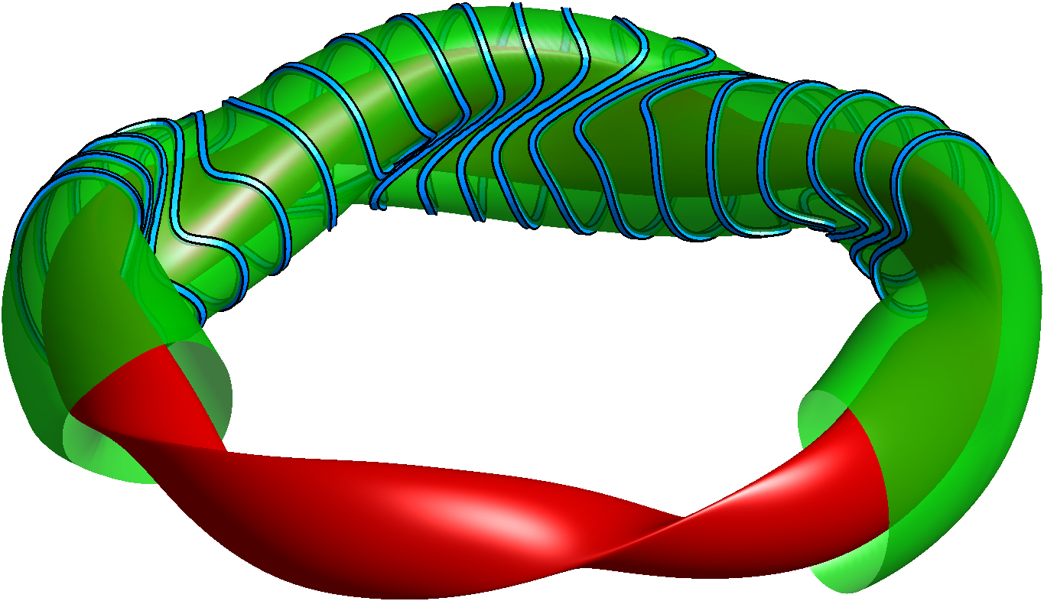
Current potential methods: NESCOIL & REGCOIL
Regcoil: Consider sheet current on a “coil winding surface”
ML, Nuclear Fusion (2017).
Surface current
“current potential”
Normal to winding surface
Plasma
surface
Coil
surface
B field error
Coil complexity
Regularization parameter
Cons:
Neglects ripple from discrete coils.
Coils can’t move in 3rd dimension.
Notes:
m20221031_01_plot_regcoil_coils_and_surfaces.png

Slide 30
In stage-2 coil optimization, there is a trade-off between field accuracy and coil simplicity
High regularization λ:
Simpler coils
but large field error
Low regularization λ:
Complicated coils
but small field error

Slide 31
Filament coil optimization
Zhu, Hudson, et al, Nuclear Fusion (2018).
Assume plasma shape has already been optimized, so target B field is known.
Coils represented as space curves.
Design variables: Fourier modes of Cartesian components.
Objective:
Match target B
Regularization
Does account for B ripple from discreteness of coils.
Non-convex, so there are multiple local minima. Need good initial guess.
Often in practice we use “Fourier continuation” again.

Slide 32
Summary: there is lots of freedom in the shape of a stellarator plasma
and coils, which can be used to achieve many objectives
Large volume of good magnetic surfaces (not islands & chaos)
Enough rotational transform
Plasma pressure & current doesn’t modify B too much, i.e. maximum plasma pressure is not too low.
Buildable coil shapes: low curvature, large clearances
Magnetohydrodynamic (MHD) stability
Good confinement of particle trajectories
Low neoclassical transport
Low turbulent transport

Slide 33
Open questions for stellarator optimization
How best to combine coil and plasma design?
How to find designs that tolerate errors in coil shape/position?
How to avoid getting stuck in little local minima? How to find global optima?
How to optimize for expensive & noisy objectives (turbulence & fast-particle confinement)?
How to balance multiple competing objectives?
How to optimize coil topology?
How to find configurations that are flexible?
Good confinement for different plasma pressures.
Ability to tune physics properties by changing coil currents.

Slide 34
More resources
Introductory papers:
Imbert-Gerard, Paul, & Wright, https://arxiv.org/abs/1908.05360
Helander, http://dx.doi.org/10.1088/0034-4885/77/8/087001
Summer schools:
https://hiddensymmetries.princeton.edu/summer-school/summer-school-2020/schedule
https://hiddensymmetries.princeton.edu/summer-school/summer-school-2019/schedule
https://gss.pppl.gov/2021/
https://suli.pppl.gov/2022/course/index.html
https://suli.pppl.gov/2021/course/index.html
https://suli.pppl.gov/2020/course/index.html
https://suli.pppl.gov/2019/course/index.html
Open-source software:
https://github.com/PrincetonUniversity/STELLOPT
https://desc-docs.readthedocs.io/
https://simsopt.readthedocs.io/
https://github.com/landreman/regcoil
https://gitlab.com/wistell/StellaratorOptimization.jl

Slide 35
Extra slides

Slide 36
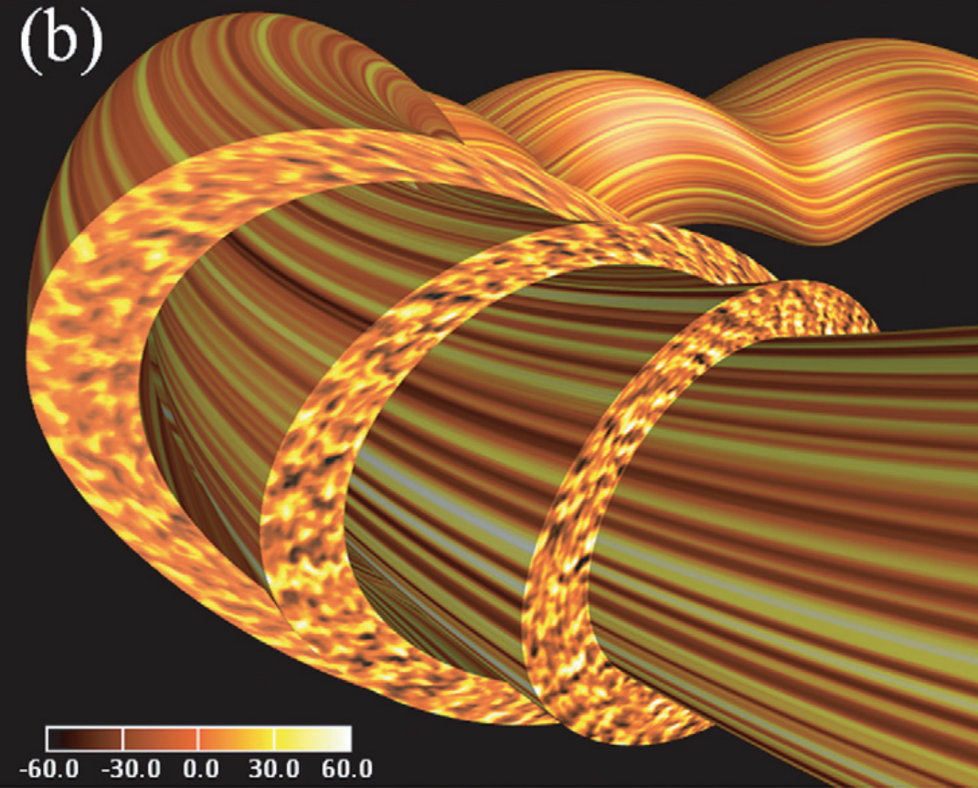
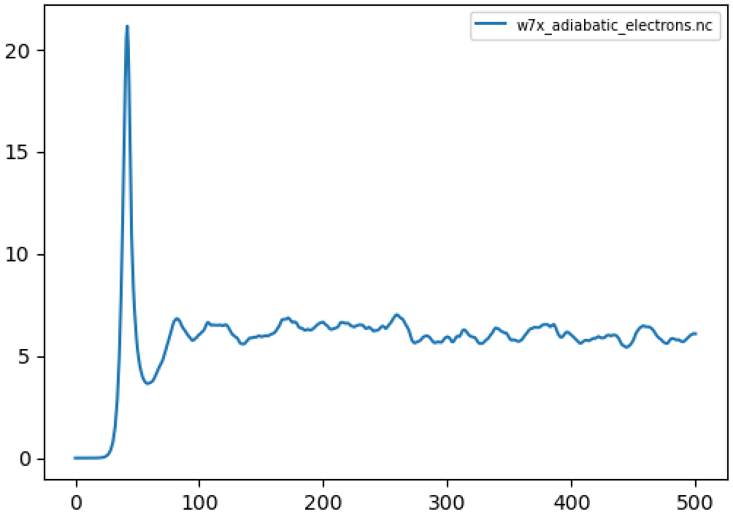
Optimization for reduced turbulence has mostly used simplified proxies in the cost function
Turbulent heat flux (code units)
Time (normalized)
Nunami 2017

Slide 37
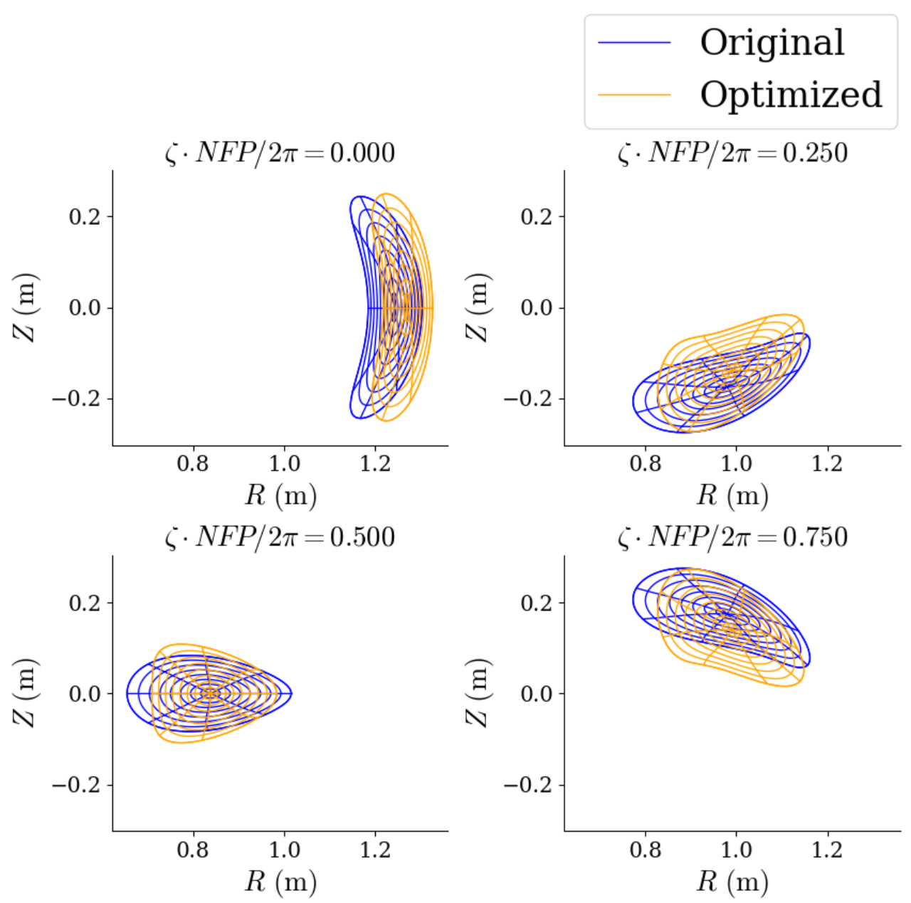
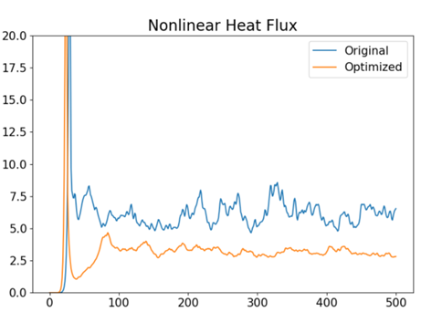
The first optimizations with nonlinear turbulence calculations in the objective are becoming possible
By Patrick Kim (was a Maryland undergraduate, now at Princeton!)
time

Slide 38
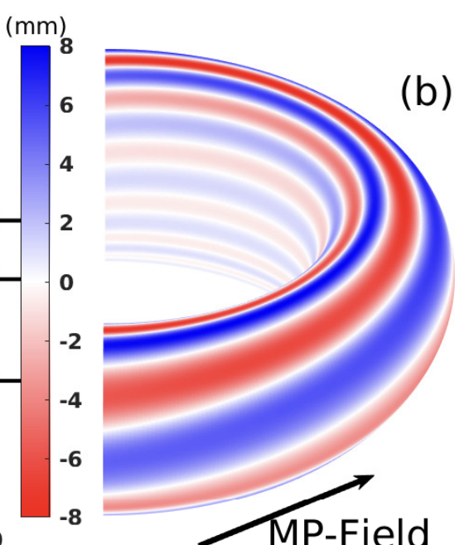
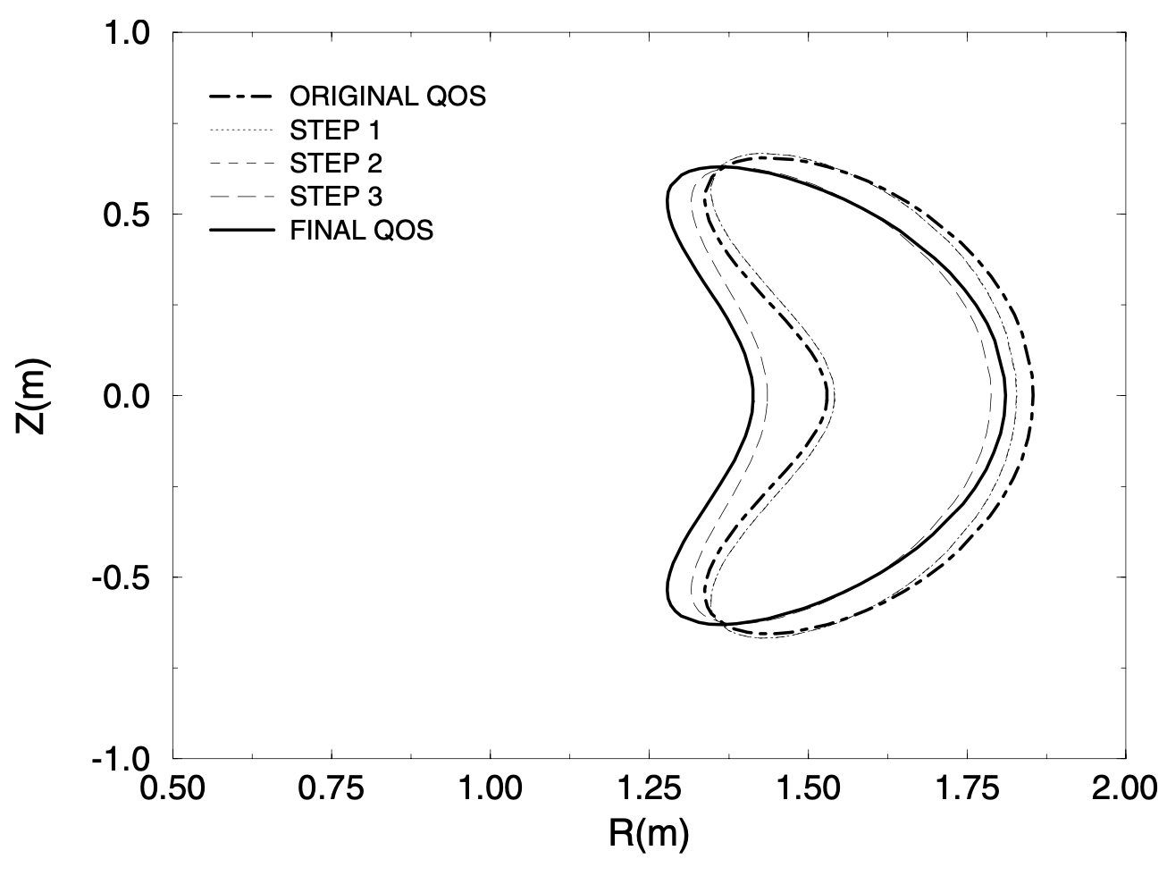
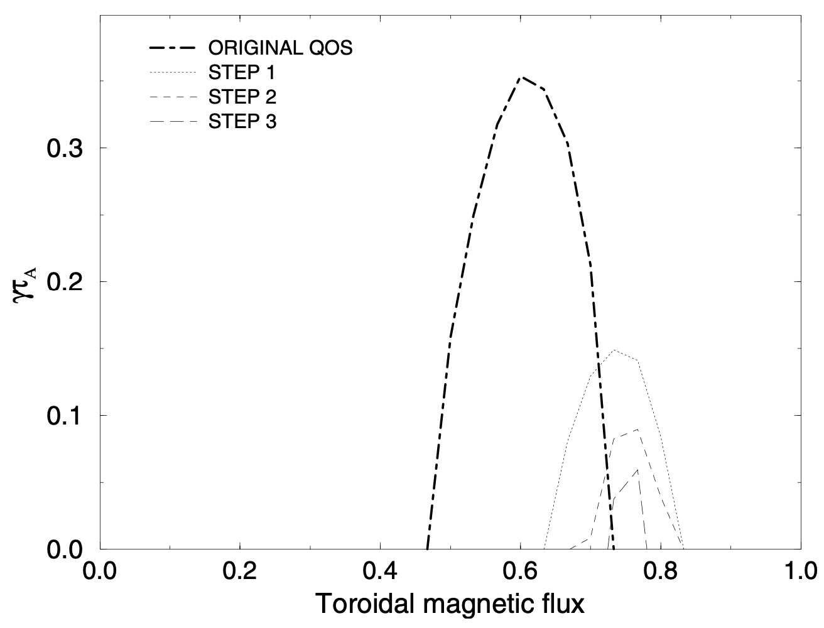
Stellarator geometry can be optimized for MHD stability
Types of MHD stability calculations, in increasing complexity:
Magnetic well & Mercier’s criterion (interchange)
Ballooning modes (short wavelength ⟂ to B)
Finite wavelength (everything)
Cote et al, (2019)
Growth rate of ballooning modes
(minor radius)
Sanchez et al, Plasma Phys. Control. Fusion (2000)

Slide 39
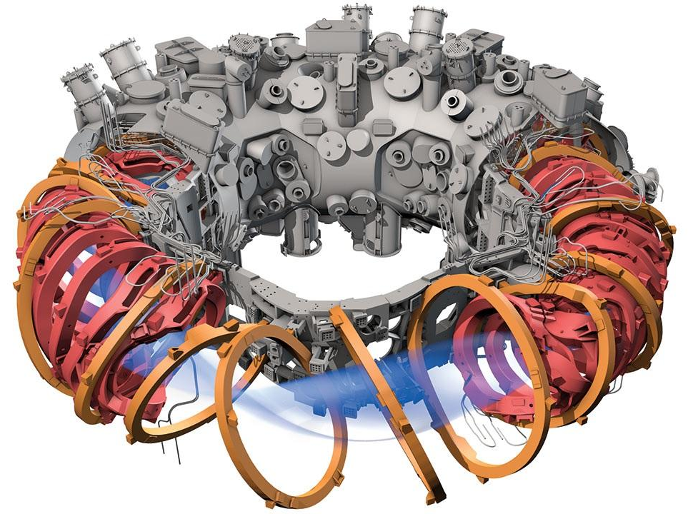
Pros and cons of using modular superconducting coils
Magnet fields are all nonlinear in the optimization variables (the coils shapes).
Machining complex superconducting coils can be very expensive.
Support structures are complicated and tight tolerances are required.
Easy to build in holes and diagnostic ports and optimization problem is unchanged.
Coils operate with power supplies, require significant cooling, generate magnetic ripple
Coil field strength limited only by large magnetic forces, can be exposed to high fields.
Can put coils behind neutron shield (or blanket) and can be turned off.
Can trivially generate a toroidal magnetic flux.

Slide 40
Pros and cons of using permanent magnets
Magnet fields are all linear in the optimization variables (the dipole vectors).
Permanent magnets are very cheap compared to machining complex superconducting coils.*
Support structures can be 3D printed and assembled at remarkably low cost.
Easy to build in holes and diagnostic ports and optimization problem is unchanged.
Magnets operate without power supplies, require minimal cooling.
Magnets limited to ~ 1 Tesla, demagnetize if exposed to high field strengths,
Cannot withstand neutron bombardment and cannot be turned off.
Still need some basic coils to generate a toroidal magnetic flux.
*~10$ per magnet, so ~10⁴ - 10⁵ magnet designs are quite inexpensive.

Slide 41
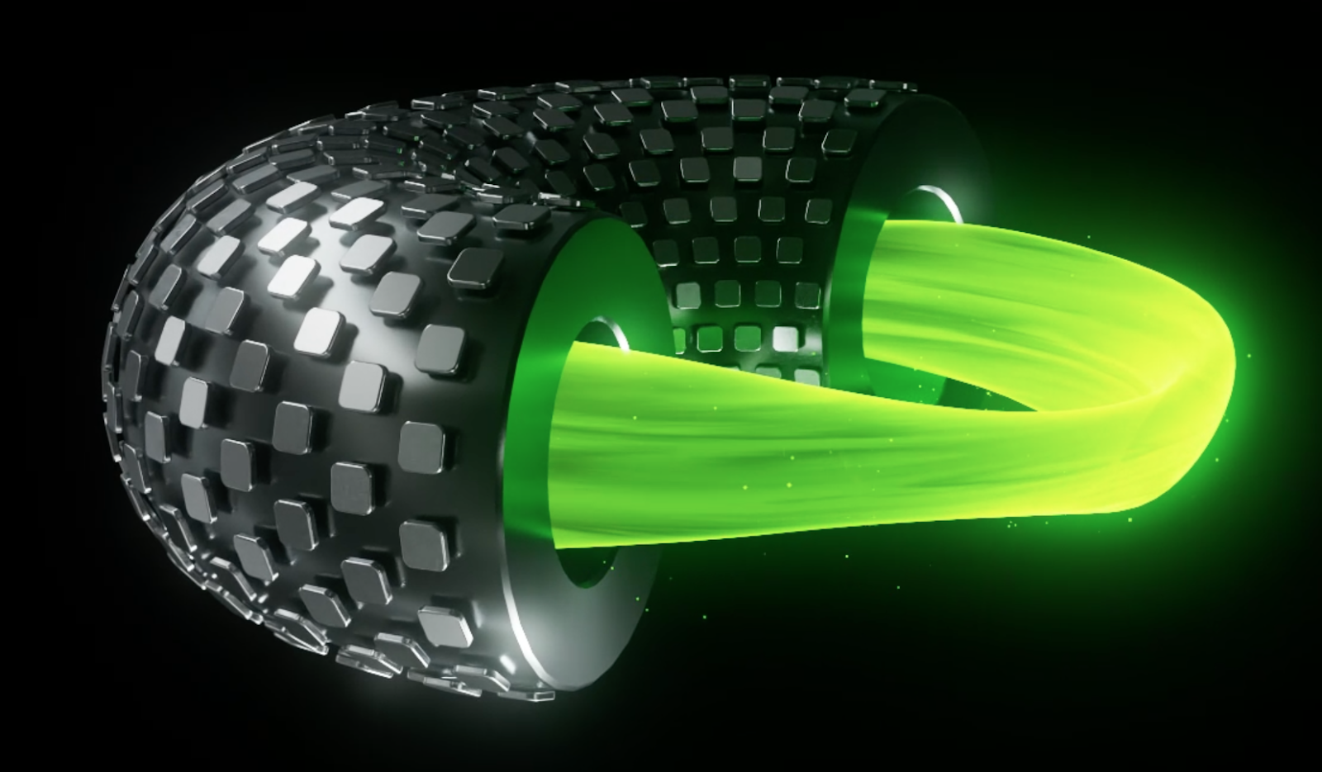
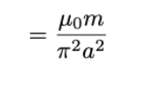
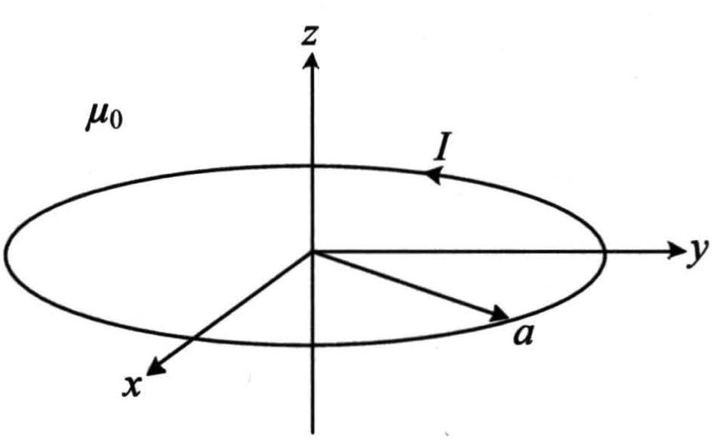
Pros and cons of using a dipole array (DA)
Magnet fields are all linear in the optimization variables (the current strengths).
DA coils are very cheap compared to machining complex superconducting coils.
Support structures are relatively simple and low cost.
Easy to build in holes and diagnostic ports and optimization problem is unchanged.
Coils operate with power supplies, require cooling.
DA field strength limited only by large magnetic forces, can be exposed to high field strengths.
Can put DA behind neutron shield (or blanket) and can be turned off.
Still need some basic TF coils to generate a toroidal magnetic flux.
https://thea.energy/

Slide 42
Pros and cons of using superconducting tiles (STs)
Magnet fields are not linear in the optimization variables.
STs are very cheap compared to machining complex superconducting coils.
Support structures can be 3D printed and assembled at low cost.
Easy to build in holes and diagnostic ports and optimization problem is unchanged.
STs operate without power supplies, require some cooling.
DA field strength limited only by large magnetic forces, can be exposed to high field strengths.
Can put DA behind neutron shield (or blanket) and can be turned off (sort of!).
Still need some basic coils to generate a toroidal magnetic flux + induce ST currents.
Flux of B through ST must vanish, so currents are induced in the ST to cancel any external field.
Bromberg, L., et al. Fusion Science and Technology 60.2 (2011): 643-647.

Slide 43
Optimization for reduced turbulence has mostly used simplified proxies in the cost function
NCSX (unoptimized)
NCSX (unoptimized)
Turbulent heat flux (code units)
optimized
optimized
optimized
Time (normalized)
Mynick et al, Physical Review Letters (2010)

Slide 44
Pros and cons of the 3 classes
QA:
+ Lowest aspect ratio
+ Fewest coils, largest clearances
+ Large bootstrap current increases iota
- Wider orbits mean worse confinement
- Large current may contribute to MHD instability
QH:
+ Extremely good confinement
+ Can build on experience with HSX
- Seems to require high aspect ratio and many coils
? Intermediate bootstrap current between QA and QI
QI:
+ Low bootstrap current means high robustness to different pressure profiles
+ Can use island divertor
+ Can build on experience from W7-X
- Seems to require high aspect ratio and many coils
- Optimization is generally trickier

Slide 45
Perhaps the first type of stellarator optimization was to achieve good flux surfaces
Reproduction of Cary & Hanson (1986) by Rogerio Jorge
Unoptimized
Optimized
Z [m]
Z [m]
R [m]
R [m]
Parameter space x = Fourier modes of coil shapes. Cost function f = square of “Greene’s residue”

Slide 46
Optimization for good flux surfaces continues to be a principle behind recent stellarators
CTH:
(Compact Toroidal Hybrid, at Auburn)
CNT (Columbia Non-neutral Torus):
Optimize expected volume over possible coil position errors
Pedersen (2004), Hammond (2016)

Slide 47
Reminder: the ∇B and curvature drifts make confinement challenging
Particle trajectory
Guiding center trajectory
Magnetic field line
Ions drift up: they are not confined!
Notes:
m20230807_01_illustrationOfGuidingCenterDrift.m – flip horizontally

Slide 48
Mirror force: particles are pushed away from regions of high |B|
Ion trajectory
B field lines
v×B force has slight 🡺 component
A few particles with very small v|| = v⋅B “bounce” and are “trapped” in low-|B| regions.
|B|
Notes:
m20200812_02_orbitsInATokamak.m

Slide 49
Flux surfaces are not enough: Trapped particles are not confined without a further condition like “quasisymmetry” or “omnigenity”
In general: trapped particles do not sample the whole surface, so cross-field drift does not average to 0.
⟹ Large neoclassical transport.
Su et al (2020)
One solution is quasisymmetry: make B(r, 𝜃, 𝜑) = B(r, M𝜃−N𝜑) for special angles 𝜃, 𝜑.
B
Symmetry direction
⟹ Conserved quantity.
⟹ Drift averages to 0.

Slide 50
Lemma: deeply trapped particles move so |B| is constant
Deeply trapped particles
Distance along a field line

Slide 51
For low neoclassical transport, recent stellarators have come in 3 flavors
Trapped particles should drift toroidally, helically, or poloidally on a surface.
B contours on a surface have the same topology as these drifts.
Toroidal:
E.g., particles with v||=0
move along a constant-B contour:
Helical:
Poloidal:
Notes:
https://commons.wikimedia.org/wiki/File:Torus_illustration.png

