Slide 1


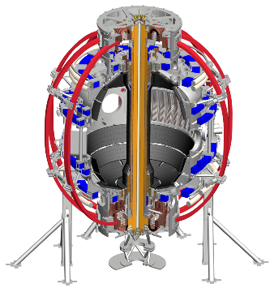






“Advances in core spectroscopy”
Impurities in the core of burning plasmas: PFCs, radiation, stability, transport and diagnostic challenges
Luis F. Delgado-Aparicio et al.
Princeton Plasma Physics Laboratory (PPPL)
Princeton University, PPPL, 08/14/2018

Slide 2


Outline
Magnetically confined fusion (MCF) plasmas and the Z-challenge
Z-studies
Radiation and the need of spectroscopy?
Novel x-ray diagnostics
Summary

Slide 3
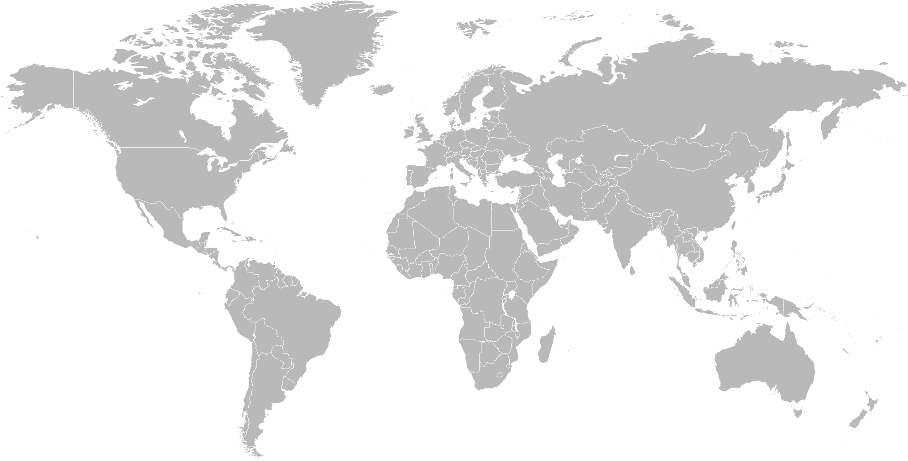
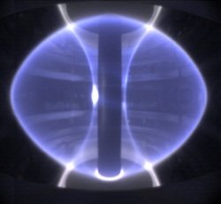
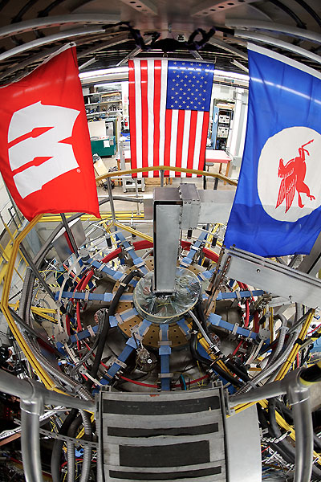
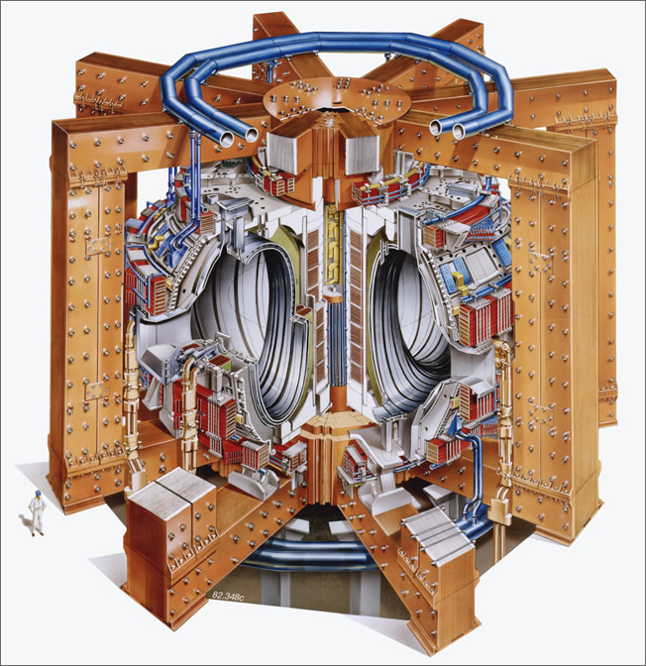
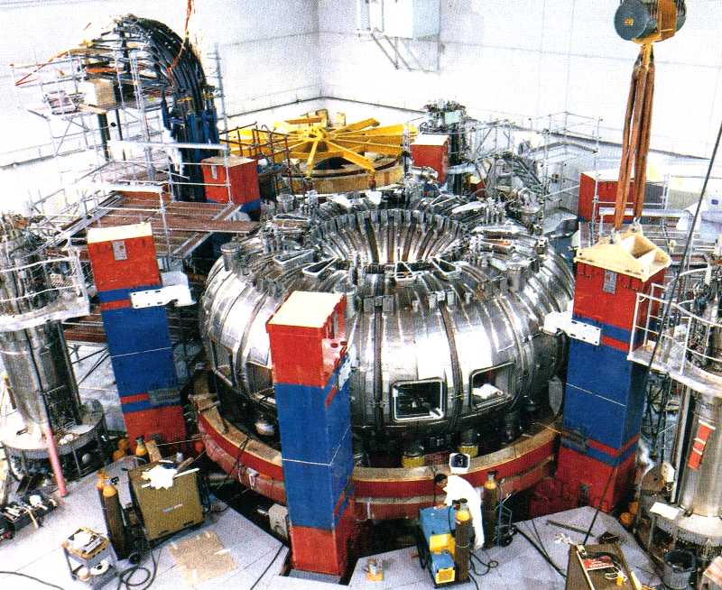
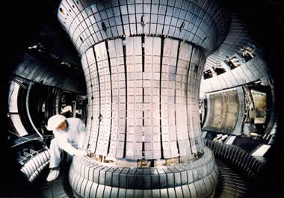
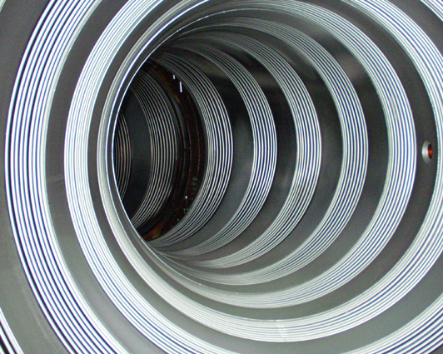
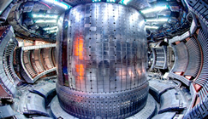
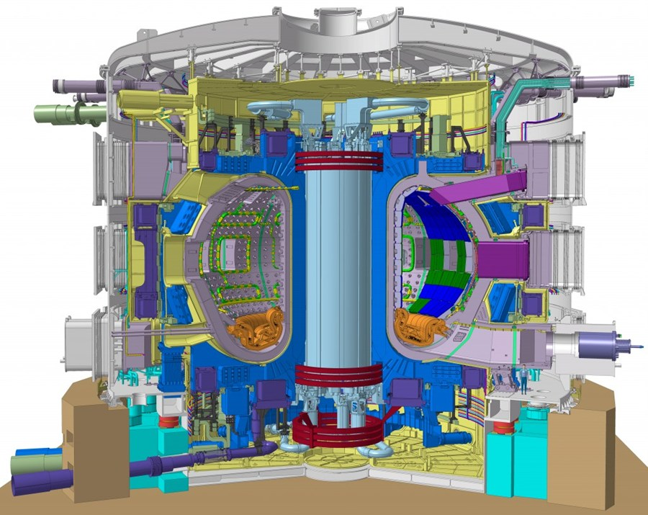
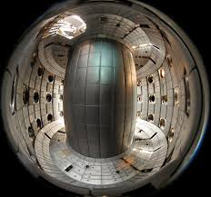
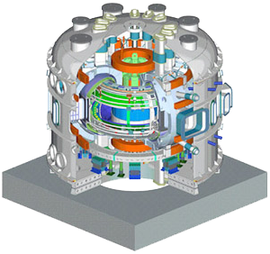
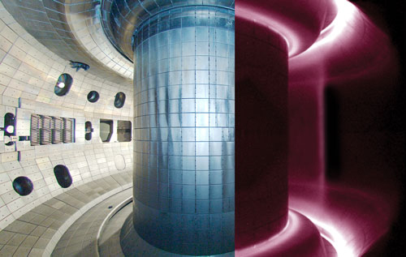
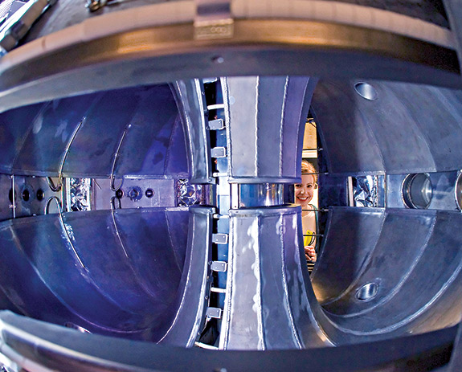

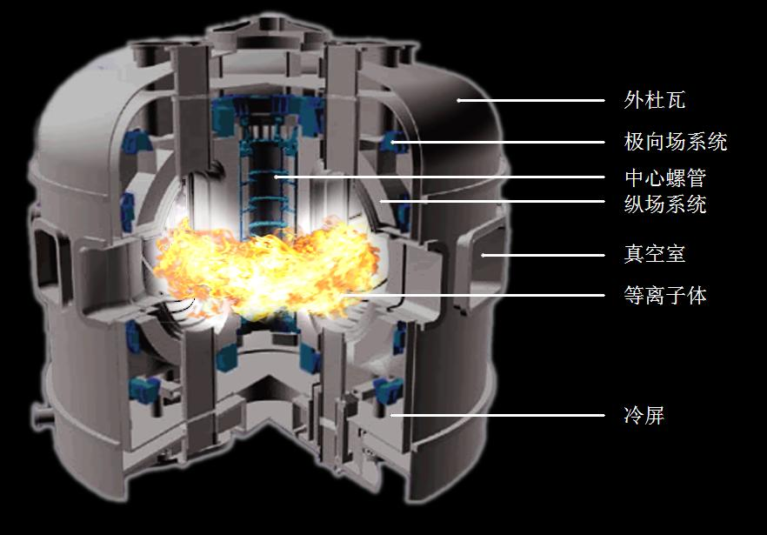
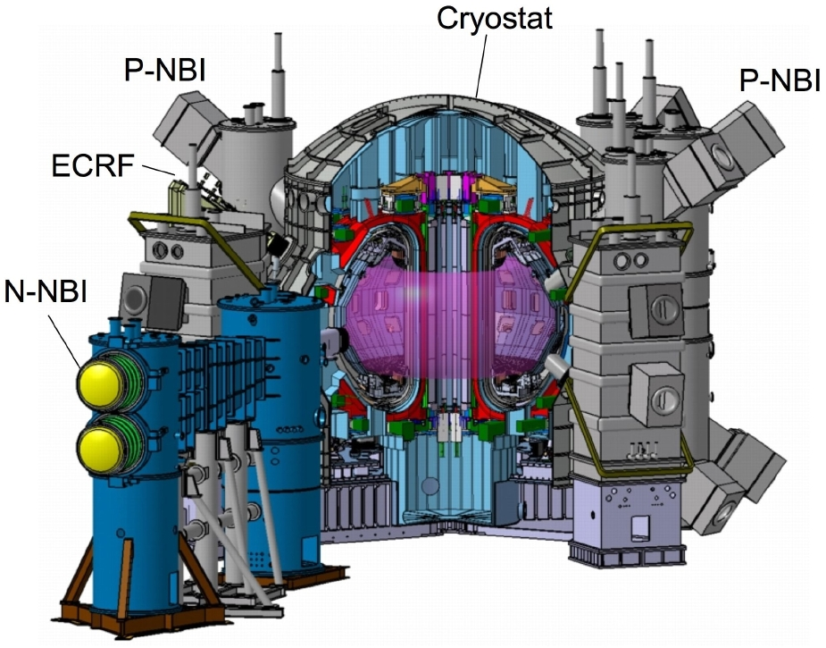
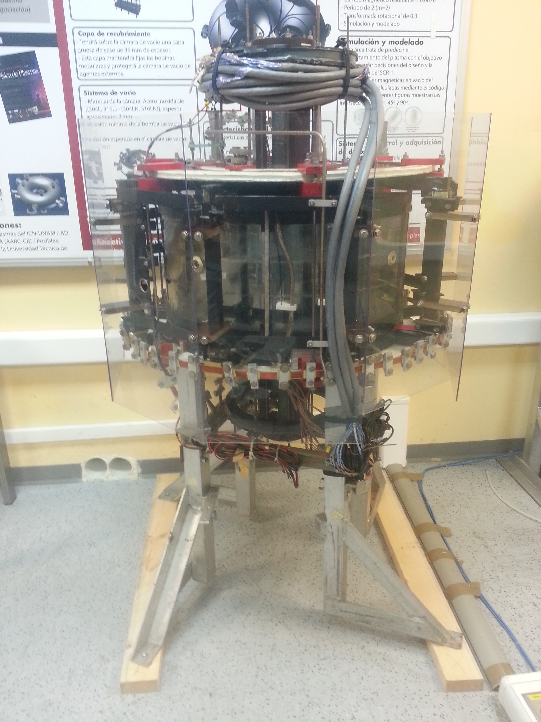
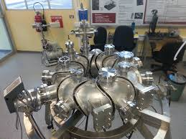
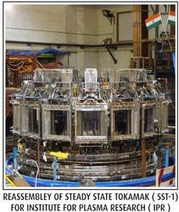
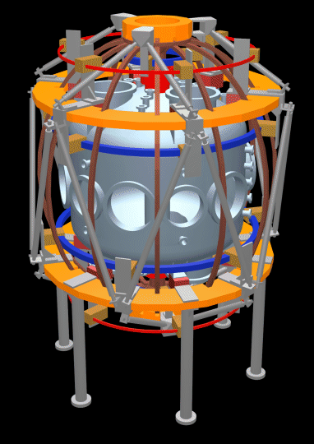

Tokamaks (and stellarators) around the world study different plasma parameters and shapes
MAST
Pegasus
Asdex U
Alcator C-Mod
T10
K-Star
DIII-D
LTX
NSTXU
Tora
Supra
TCV
JET
ITER
EAST
JT-60SA
Medusa
ETE
SST-1
*Plus many
more

Slide 4
ITER will be the first time we have net energy (more energy OUT than IN)
ITER is a collaboration between USA, EU, China, Japan, Korea, India and Russia
It’s expected to produce 500MW of power using 50MW to run…this is the 1st time in history where P_{out}>P_{in}
First plasmas expected by ~ 2025
Many challenges ahead!
The Z-challenge?
(low-Z vs high-Z)
ITER

Slide 5
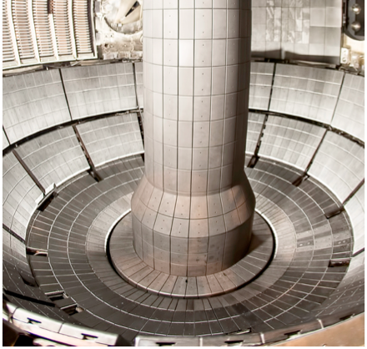
The low-Z (Li, Be, C, B) vs high-Z (Fe, Mo, W) plasma facing component (PFC) challenge
Both low- & high-Z materials are currently being used for the PFCs, but each has technological hurdles.
Low-Z materials:
Typically have higher erosion rates
Their injection into the main chamber will result in an increase of Z_{eff} and collisionality (ν_{e,Z}).
H-, D- & T-retention is a difficult issue!
Augment of Z_{eff} will lead to:
Reduce fuel purity (n_{D}/n_{e}) and reactivity (S_{n}∝n_{D}² or n_{D}n_{T}).
But contributing less to radiated power density: P_{rad}=n_{e}n_{D}L_{D}+n_{e}n_{C}L_{c}+Σn_{e}n_{Z}L_{Z}
MAST, CCFE,
Oxfordshire, UK
NSTX-U @ PPPL, Princeton University, Princeton, NJ
Li, B
& C

Slide 6
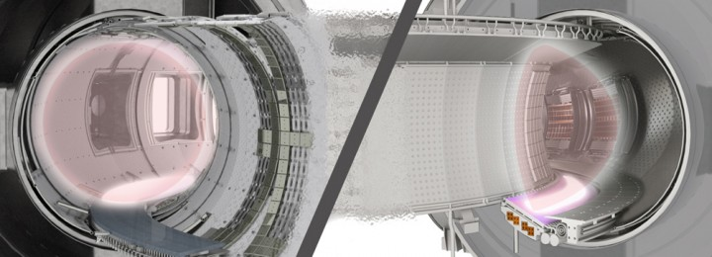
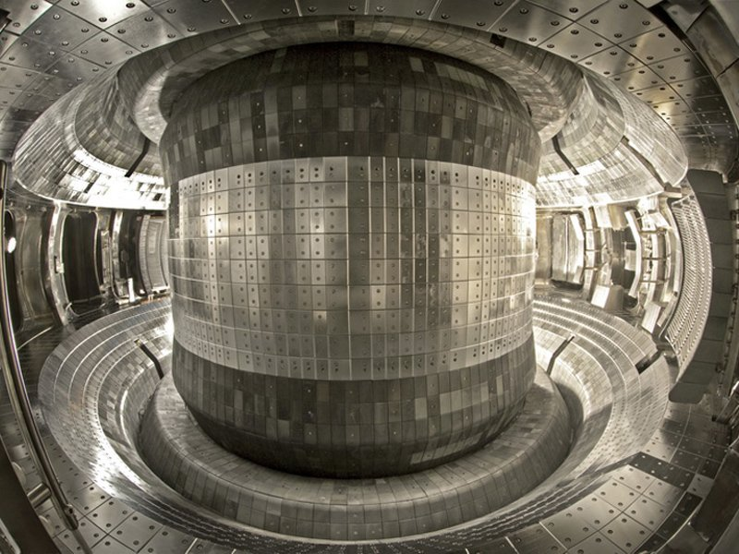
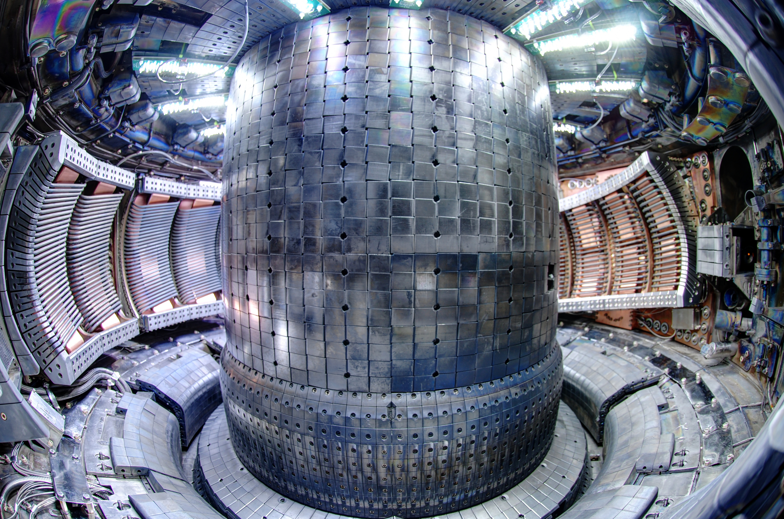
The low-Z (Li, Be, C, B) vs high-Z (Fe, Mo, W) plasma facing component (PFC) challenge
Conversely, high-Z materials have good properties as a PFCs:
Low H/D/T retention.
High-heat tolerance (e.g. high melting points)
Low erosion (sputtering) rates.
Small contribution to Z_{eff}:
Z_{eff}=n_{D}/n_{e}+36n_{C}/n_{e}+Σ(n_{Z}/n_{e})Z²
However, if high-Z impurities accumulate to any substantial level:
Exponentially enhance the radiation power losses (∝Z⁴).
Reduce the heating efficiency and modifying the overall power balance.
High-n_{Z}/n_{e} can lead to radiation collapse
Tore Supra/WEST in France
C
W
EAST in China
C
Mo
W
C-Mod in Cambridge, MA, USA
Mo

Slide 7
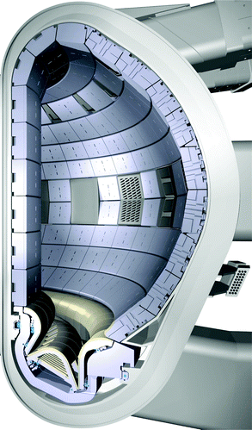
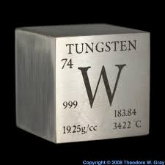

Present and future tokamaks deal with the difficulties associated with metallic walls
Mo & TZM
Low-Z
Boron (fully stripped)
Carbon (fully stripped)
Medium-Z
Argon (He- and H-like)
High-Z
Molybdenum (Ne-like)
C-Mod (MIT), WEST (France),
JET (UK),
ASDEX (DE), EAST(China) have metallic PFCs
Nominal 5-7 year plan steps for implementation of high-Z wall in NSTX-U
ITER will have Be & W PFCs

Slide 8
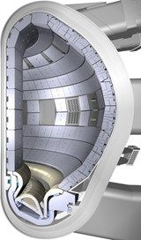
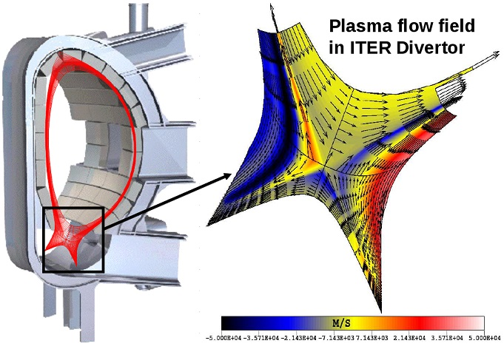
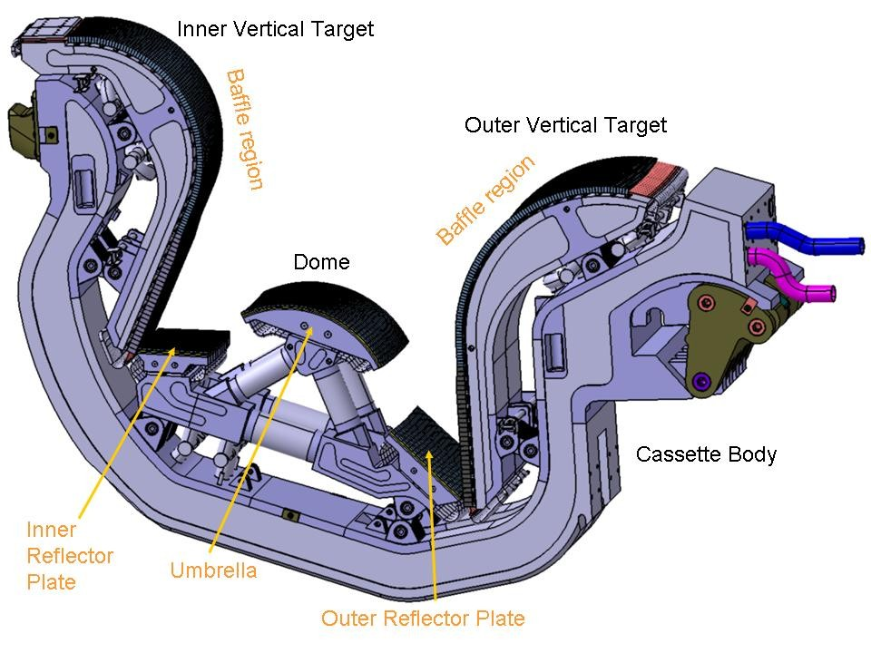
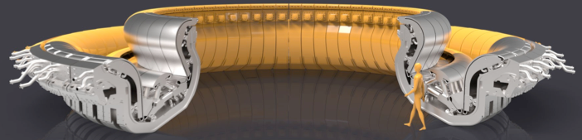
With the help of detailed simulations ITER decided on a wall with low- and high-Z PFCs
Simulations of plasma flows and plasma-wall interaction have had a decisive influence on the design of ITER wall.
Be
W
Edge localized modes (ELMs) and disruptions can impact integrity of divertor cassettes

Slide 9
Summary 1: Its is important to understand, tailor and control Z-transport & accumulation
Understanding the sources, transport/confinement of high-Z impurities is crucial to ITER success:
- Degradation of energy confinement
- Impurity-induced macroscopic instabilities
- Fuel dilution
Controlling Z-transport to avoid accumulation in the core is necessary to achieve and maintain high fusion performance.
STUDY: - Neoclassical transport
- Turbulent-induced transport
- Effect of RMPs!
For the near future: Novel diagnostics should become an essential part of a control algorithm coupled to physics & engineer actuators for minimizing impurity accumulation in tokamaks (diagnostic development in-line with OFES mission).
Be
W

Slide 10
Outline
Magnetically confined fusion (MCF) plasmas and the Z-challenge
Z-studies
Radiation and the need of spectroscopy?
Novel x-ray diagnostics
Summary

Slide 11
Outline
Examples of Z-studies:
Transport & asymmetries
Core stability
Density-limit

Slide 12
Outline
Examples of Z-studies:
Transport & asymmetries
Core stability
Density-limit

Slide 13
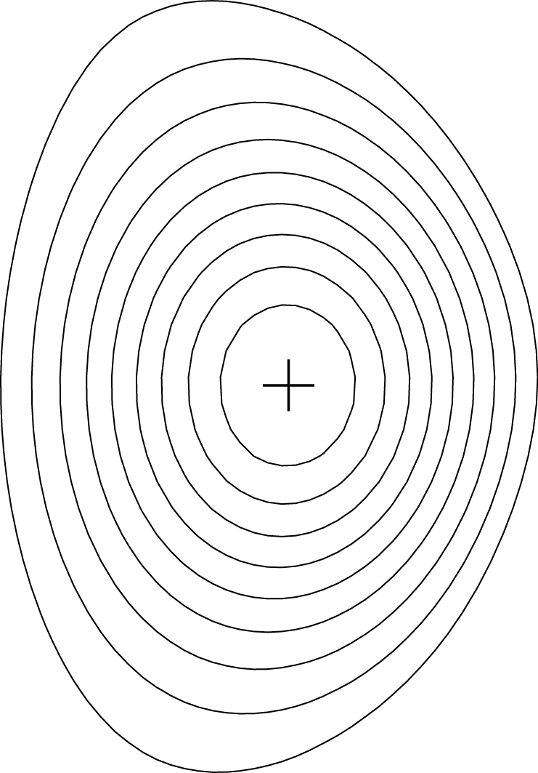

Impurity transport can be complicated but now its much simpler than before (using modern diagnostics + codes)
Conventional transport equations (Z)
Degree of Z-peaking:
Impurity transport studies require:
Adequate radial COVERAGE (0<r/a<1)
Adequate radial and time resolution
(Δr/a~1/20, Δt~1-5 ms)
Charge-state density resolution: f(T_{e}) (measure emissivity from several n_{Z}’s)
Filter vs photon-energy resolution & coverage
Ability to discern between between symmetric and asymmetric phenomena: (r) vs (r,θ)
Spend less time on 2D tomography and do physics!
outwards
inwards
SOURCE

Slide 14
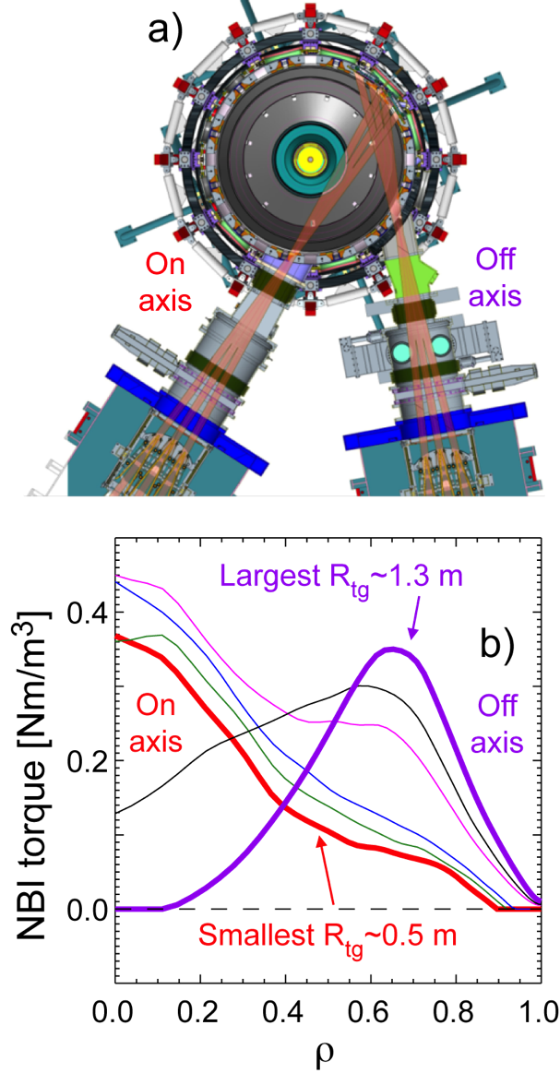
New “smart” diagnostics are needed to study impurity transport and density asymmetries
L. F. Delgado-Aparicio, et. al., RSI, 85, 11D859, (2014).
L. F. Delgado-Aparicio, et. al., to be submitted, NF, (2018).
NSTX-U
(r)
(r,θ)

Slide 15
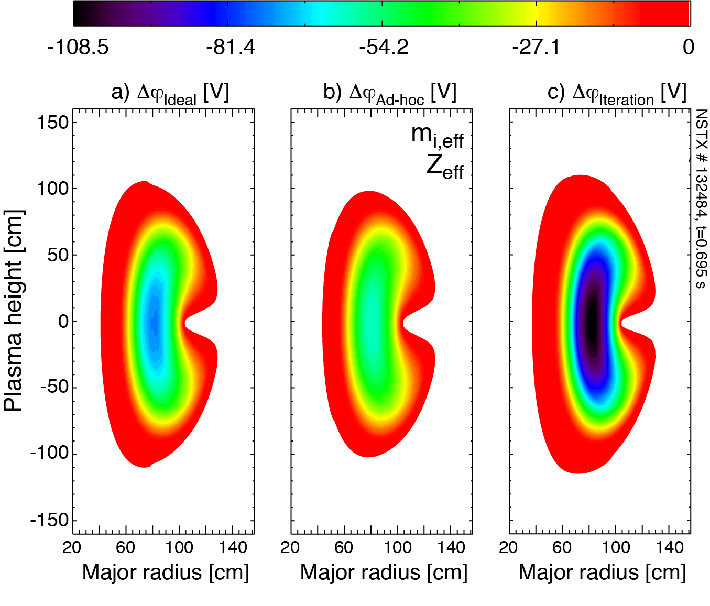
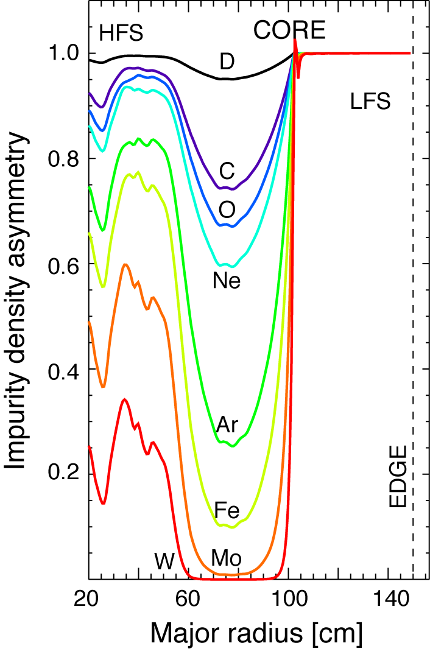
Solutions for electrostatic potential (ΔΦ) and impurity density show in/out asymmetries
Impurity ion density in/out asymmetries
2D solution for electrostatic potential

Slide 16
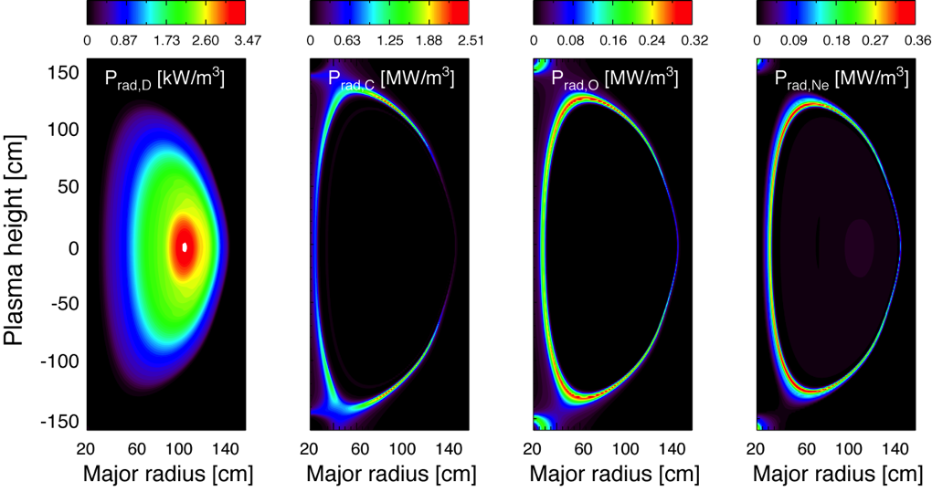
Core bremsstrahlung emission from main ion and fully stripped low-Z impurities is small

Slide 17
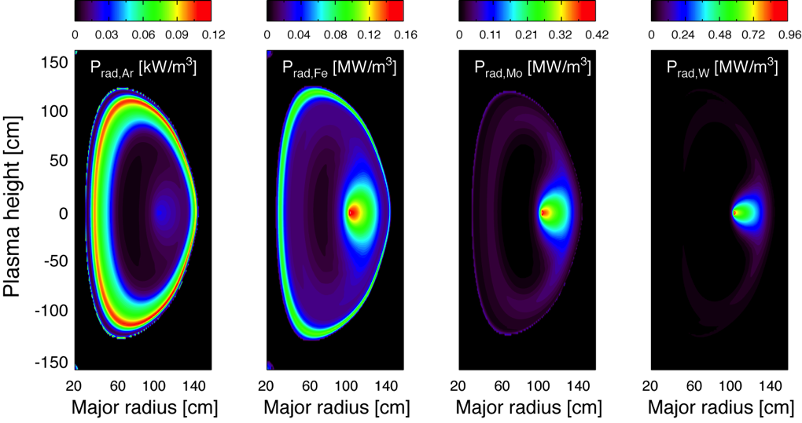
Core radiation from medium- to high-Z will be affected by centrifugal forces in NSTX-U

Slide 18
Outline
Examples of Z-studies:
Transport & asymmetries
Core stability
Density-limit

Slide 19
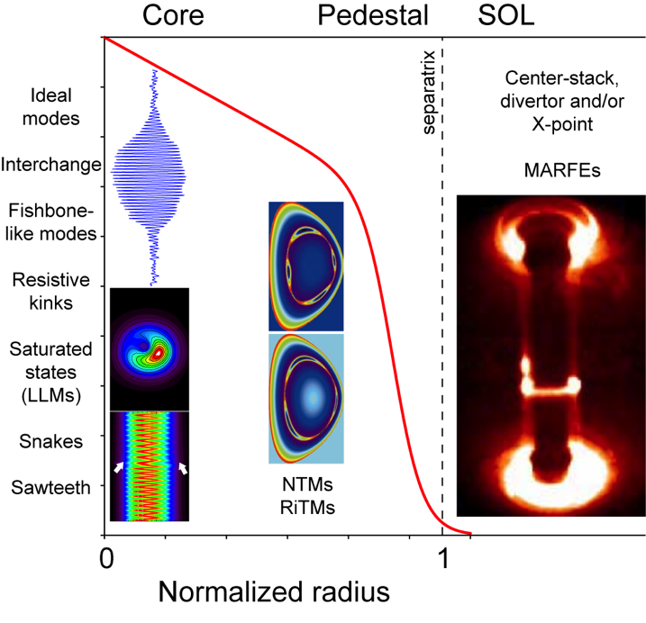
Large family of macroscopic instabilities can be affected by Z-charge and radiation effects
High-Z impurities can degrade core confinement and can be the cause also of radiative density limit disruptions
Core (1/1) modes
0<r/a<0.5
Mid-radius (m/n) modes
0.3<r/a<0.9
Edge
0.9<r/a<1.1

Slide 20
Large family of macroscopic instabilities can be affected by Z-charge and radiation effects
High-Z impurities can degrade core confinement and can be the cause also of radiative density limit disruptions
Core (1/1) modes
0<r/a<0.5
Mid-radius (m/n) modes
0.3<r/a<0.9
Edge
0.9<r/a<1.1

Slide 21
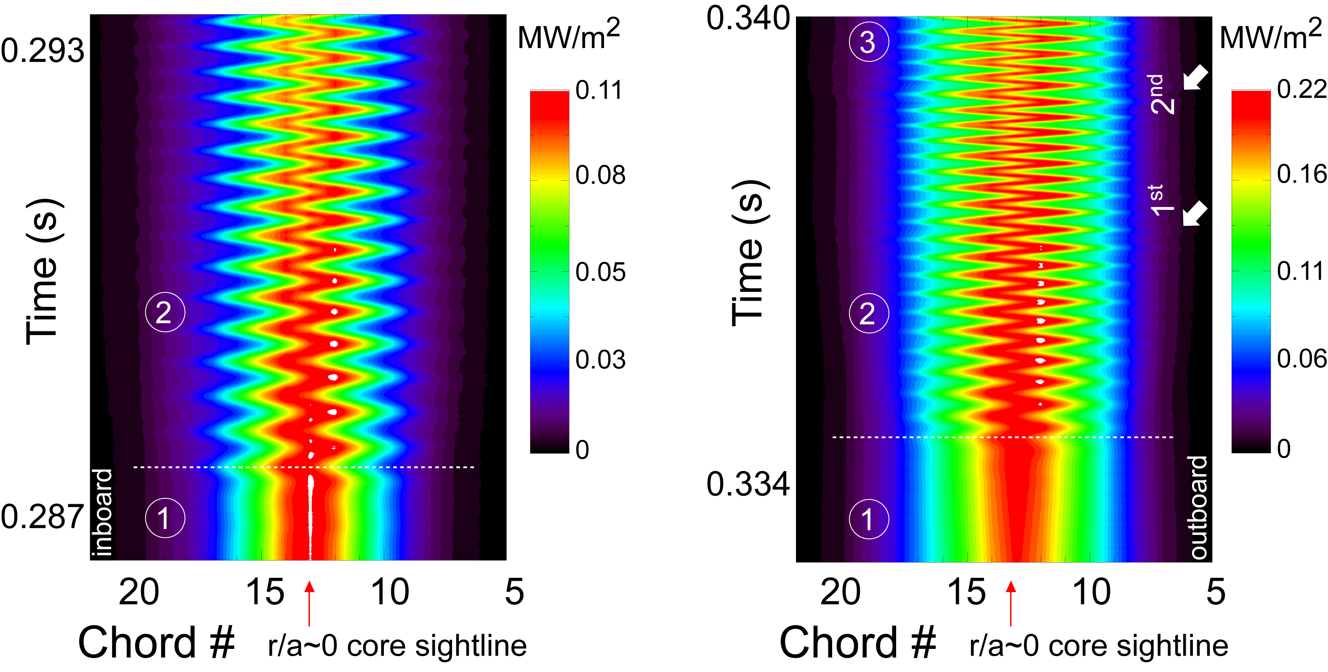
Long-lived saturated modes are routinely observed on a number of diagnostics
Saturated mode after impurity
accumulation
Saturated mode after accumulation
+ injection
saturated state
LLM
sawteeth
Notes:
SXR brightness shows initial kink-like deformation of the central plasma column

Slide 22
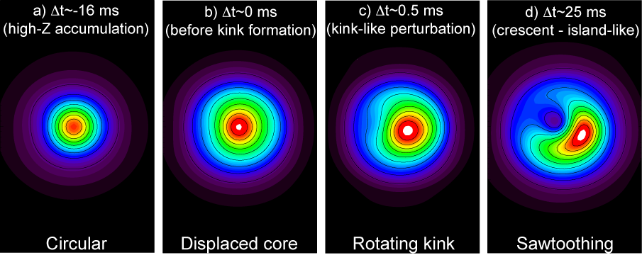
Stages resemble an ideal internal kink & magnetic island produced by a resistive (1,1) mode
Co-exist with multiple sawtooth crashes
L. Delgado-Aparicio, et al., RSI’12, PRL’13, NF’13
L. Sugiyama, PoP’14

Slide 23
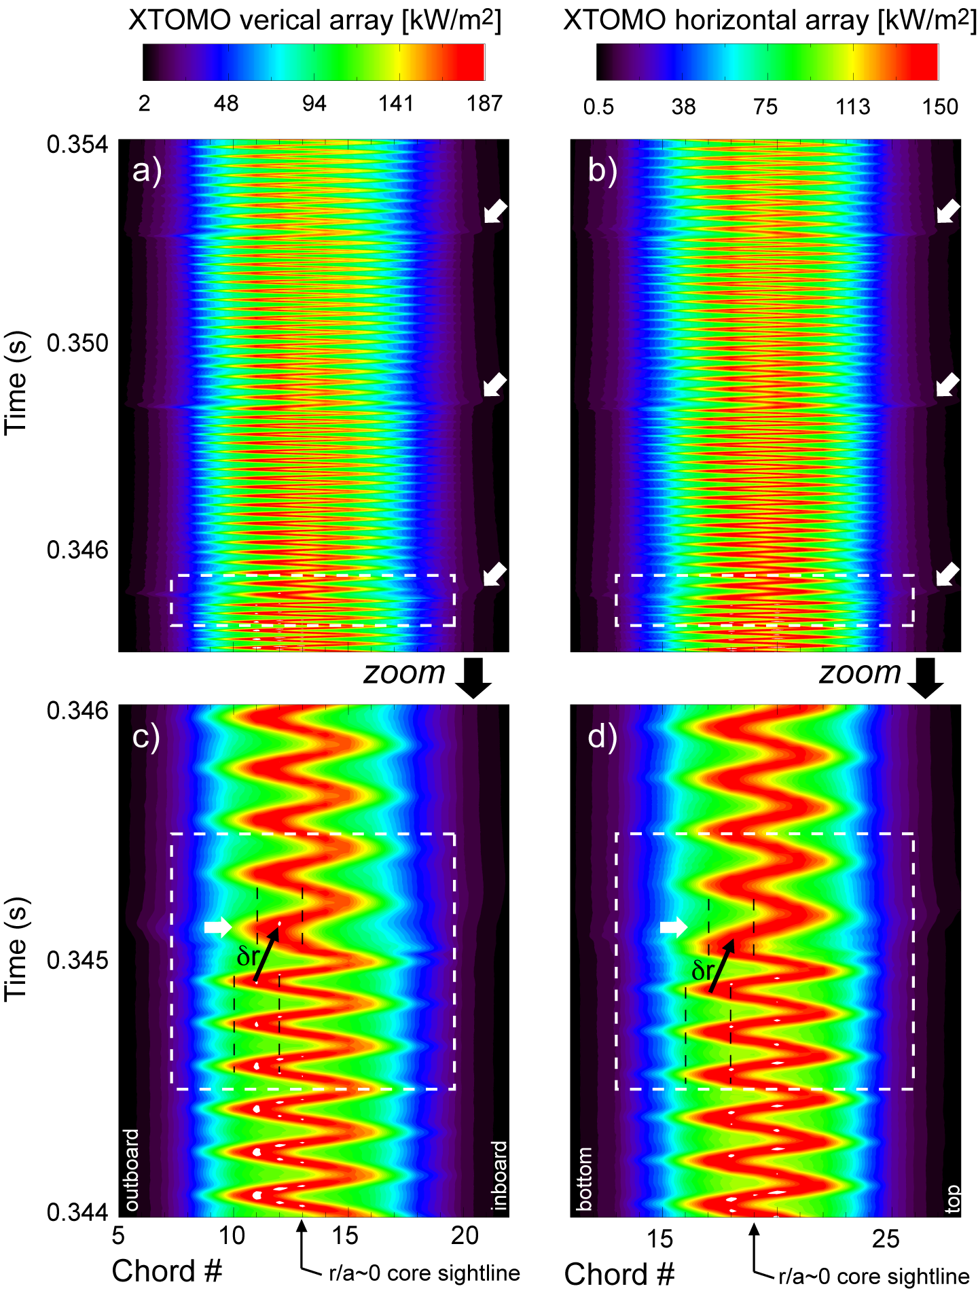
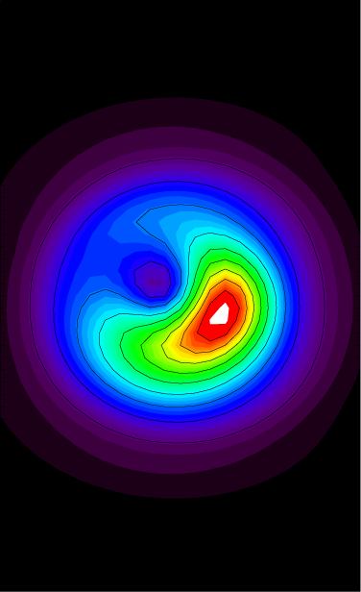
…surprisingly resilient to sawtooth crashes !
τ_{snake}~190 μs & τ_{sawtooth}~3.66 ms
⇒ ~ 20 snake periods.
Crashes may cause a transient reduction of r_{q=1} (δr₁≲1 cm).
And a reduction of the v_{φ}
During the crash the small circular core moves rapidly outwards to the edge of the crescent radius.
Snake density is nearly untouched by thermal crash + heat pulse.

Slide 24
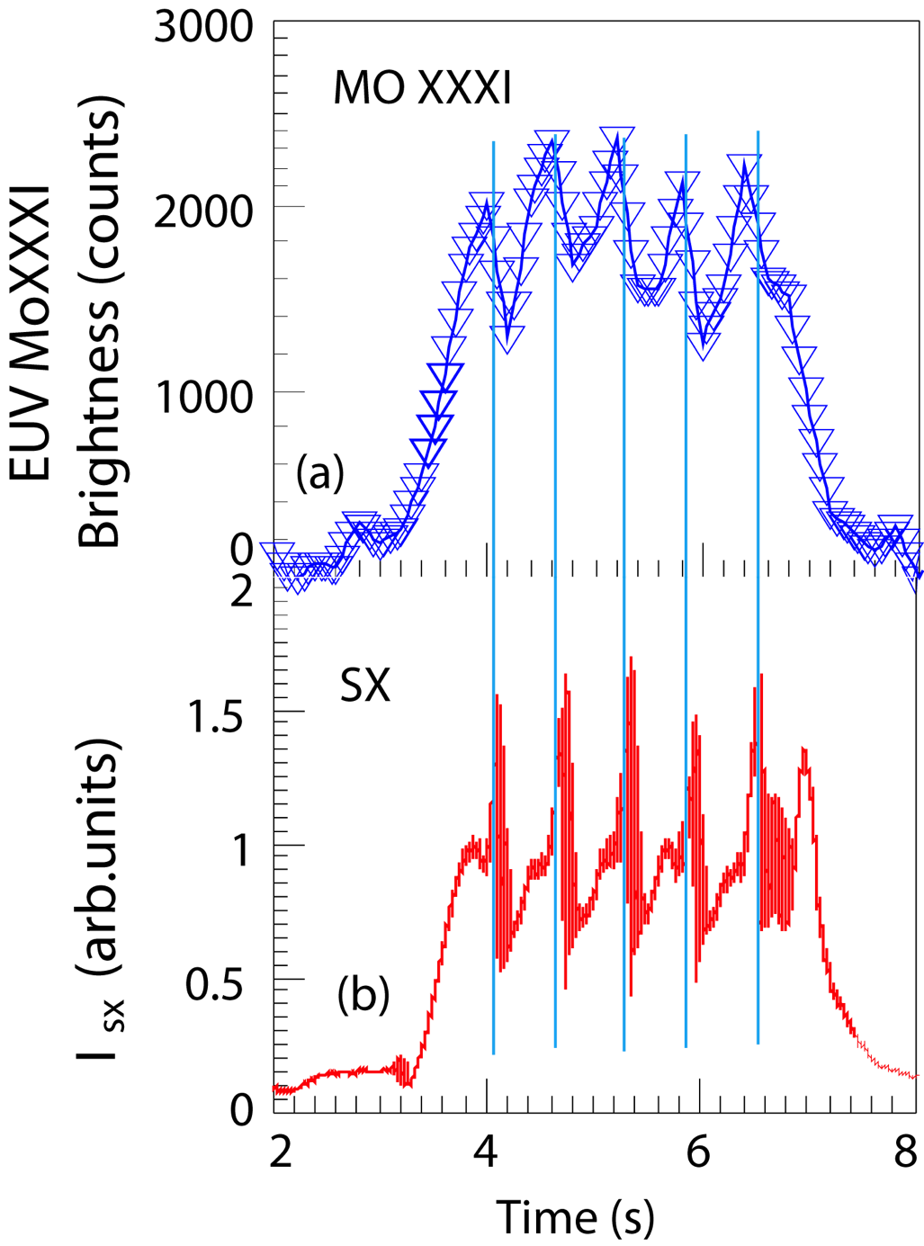
Repetitive saturated modes are observed in long-pulse tokamaks with metal PFCs
Repetitive Z-modes have implications for ITER H-mode sustainability since available heating power is only slightly above the H-mode power threshold.
Li-Qing Xu et al.
CPL’14
Challenges
ITER (r_{q=1}~a/2)
Reduce the effects on fast ions, J, q ⇒S_{n}, dilution, impurity peaking
Develop active control tools
MHD control (heating vs CD vs torque)
Z-control (transport vs ELMs vs 3D)
Experiments in NSTX-U/DIII-D/EAST

Slide 25
Outline
Examples of Z-studies:
Transport & asymmetries
Core stability
Density-limit

Slide 26
Large family of macroscopic instabilities can be affected by Z-charge and radiation effects
High-Z impurities can degrade core confinement and can be the cause also of radiative density limit disruptions
Core (1/1) modes
0<r/a<0.5
Mid-radius (m/n) modes
0.3<r/a<0.9
Edge
0.9<r/a<1.1

Slide 27
High-Z impurity radiation can contribute cooling causing TMs to grow larger & faster
The interior region of an island contains impurities.
Island interior is shielded from any auxiliary heating being shunted around by heat conduction parallel to the B-lines.
Impurities radiate, cooling the island interior, causing it to grow faster and larger in comparison to the impurity-free cases.
Radiation (≠charge) driven islands (a.k.a. radiation-induced tearing modes: RiTMs)
MRE ⇒ onset criterion ⇒ consistent with the empirical scaling of n_{G}=I_{p}/πa²
D. A. Gates and L. Delgado-Aparicio,
Phys. Rev. Letters, 108, 165004, (2012).

Slide 28
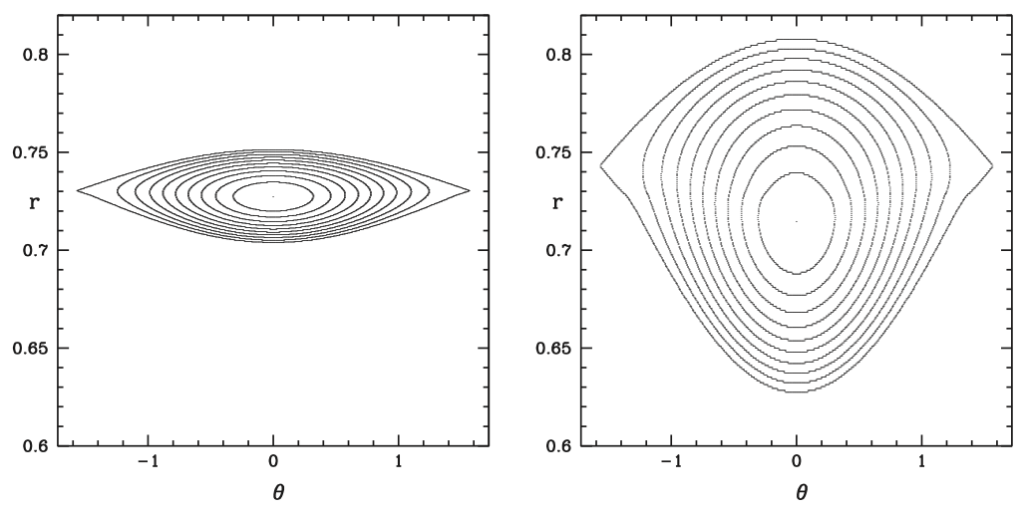
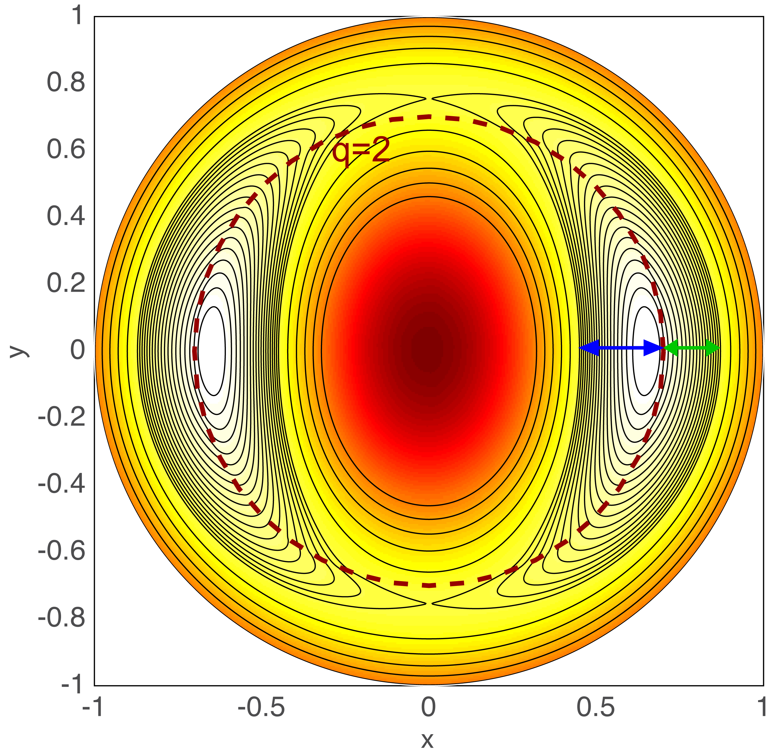

Impurity effects & island asymmetries can be modeled using the extended MRE formalism
3D resistivity with asymmetry adds destabilization term
Simple result of finite-island width in cylindrical geom.
Neither O-point or X-point are on the rational surface.
The width of the inner core-side is larger.
D. P. Brenan, D. Gates,
L. Delgado-Aparicio,
R. White, to be
submitted,
PoP ’17
Q. Teng, D. P. Brennan,
L. Delgado-Aparicio,
D. A. Gates and J. Swerdlow, PoP’16
R. White, D. A. Gates
D. P. Brennan, PoP’15
R. White, D. A. Gates
D. P. Brennan, PoP’15
Symmetric island
Asymmetric island

Slide 29
Impurity effects & island asymmetries can be modeled using the extended MRE formalism
3D resistivity with asymmetry adds destabilization term
Simple result of finite-island width in cylindrical geom.
Neither O-point or X-point are on the rational surface.
The width of the inner core-side is larger.
Some approximations: [(2,1) is the most unstable]
Δ’r_{s}≈-m to Δ’r_{s}>0 …..for m=2
Δ’r_{s}≈ -2m …..for m>2
What about the growth rate C₃?
If C₃<0 => exponential growth => Density-limit DISRUPTION !

Slide 30
Local onset criteria for RiTMs can be reduced to a non-dimensional form similar to n_{G}
Where:
Onset criteria at the rational surface:
Parameterizing
“cleanliness” ?
L. Delgado-Aparicio, D. A. Gates, D. P. Brennan and R. White, to be submitted to PoP, (2018)

Slide 31
Summary 2: Large family of macroscopic phenomena can be affected by charge & radiation
MHD
Core
(1/1)
Mid-radius
(2/1)

Slide 32
Outline
Magnetically confined fusion (MCF) plasmas and the Z-challenge
Z-studies
Radiation and the need of spectroscopy?
Novel x-ray diagnostics
Summary

Slide 33
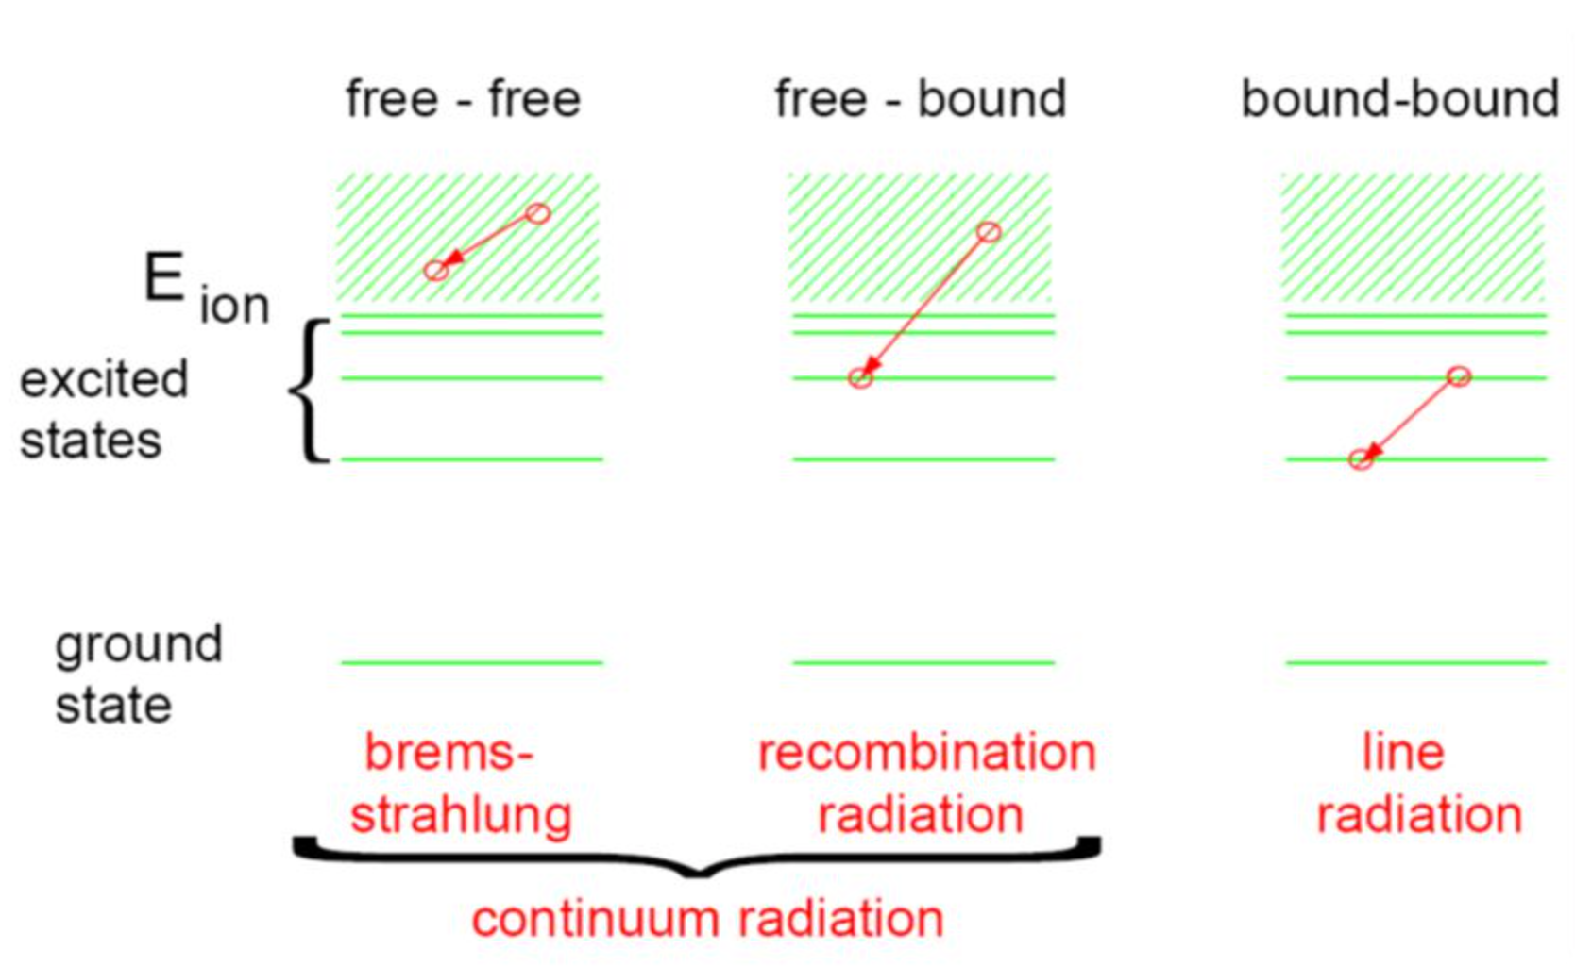
Main radiation mechanisms: Bremsstrahlung (ff), radiative recombination (fb) & line-emission (bb)

Slide 34

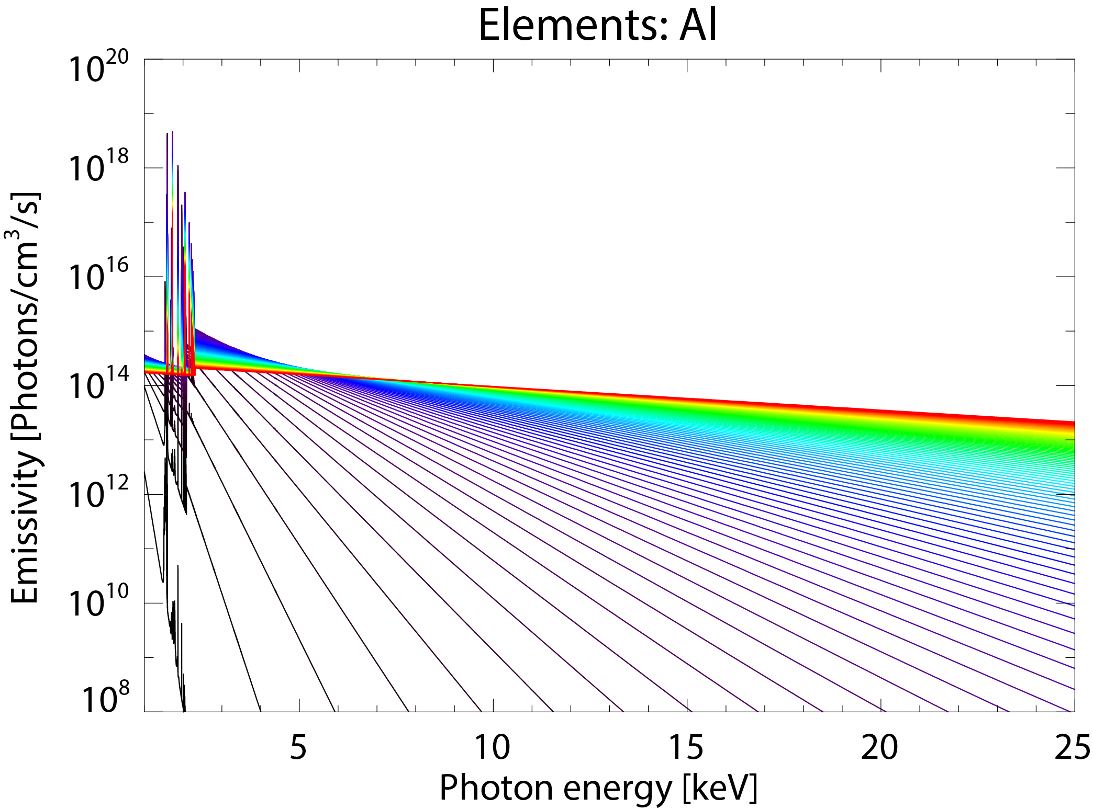
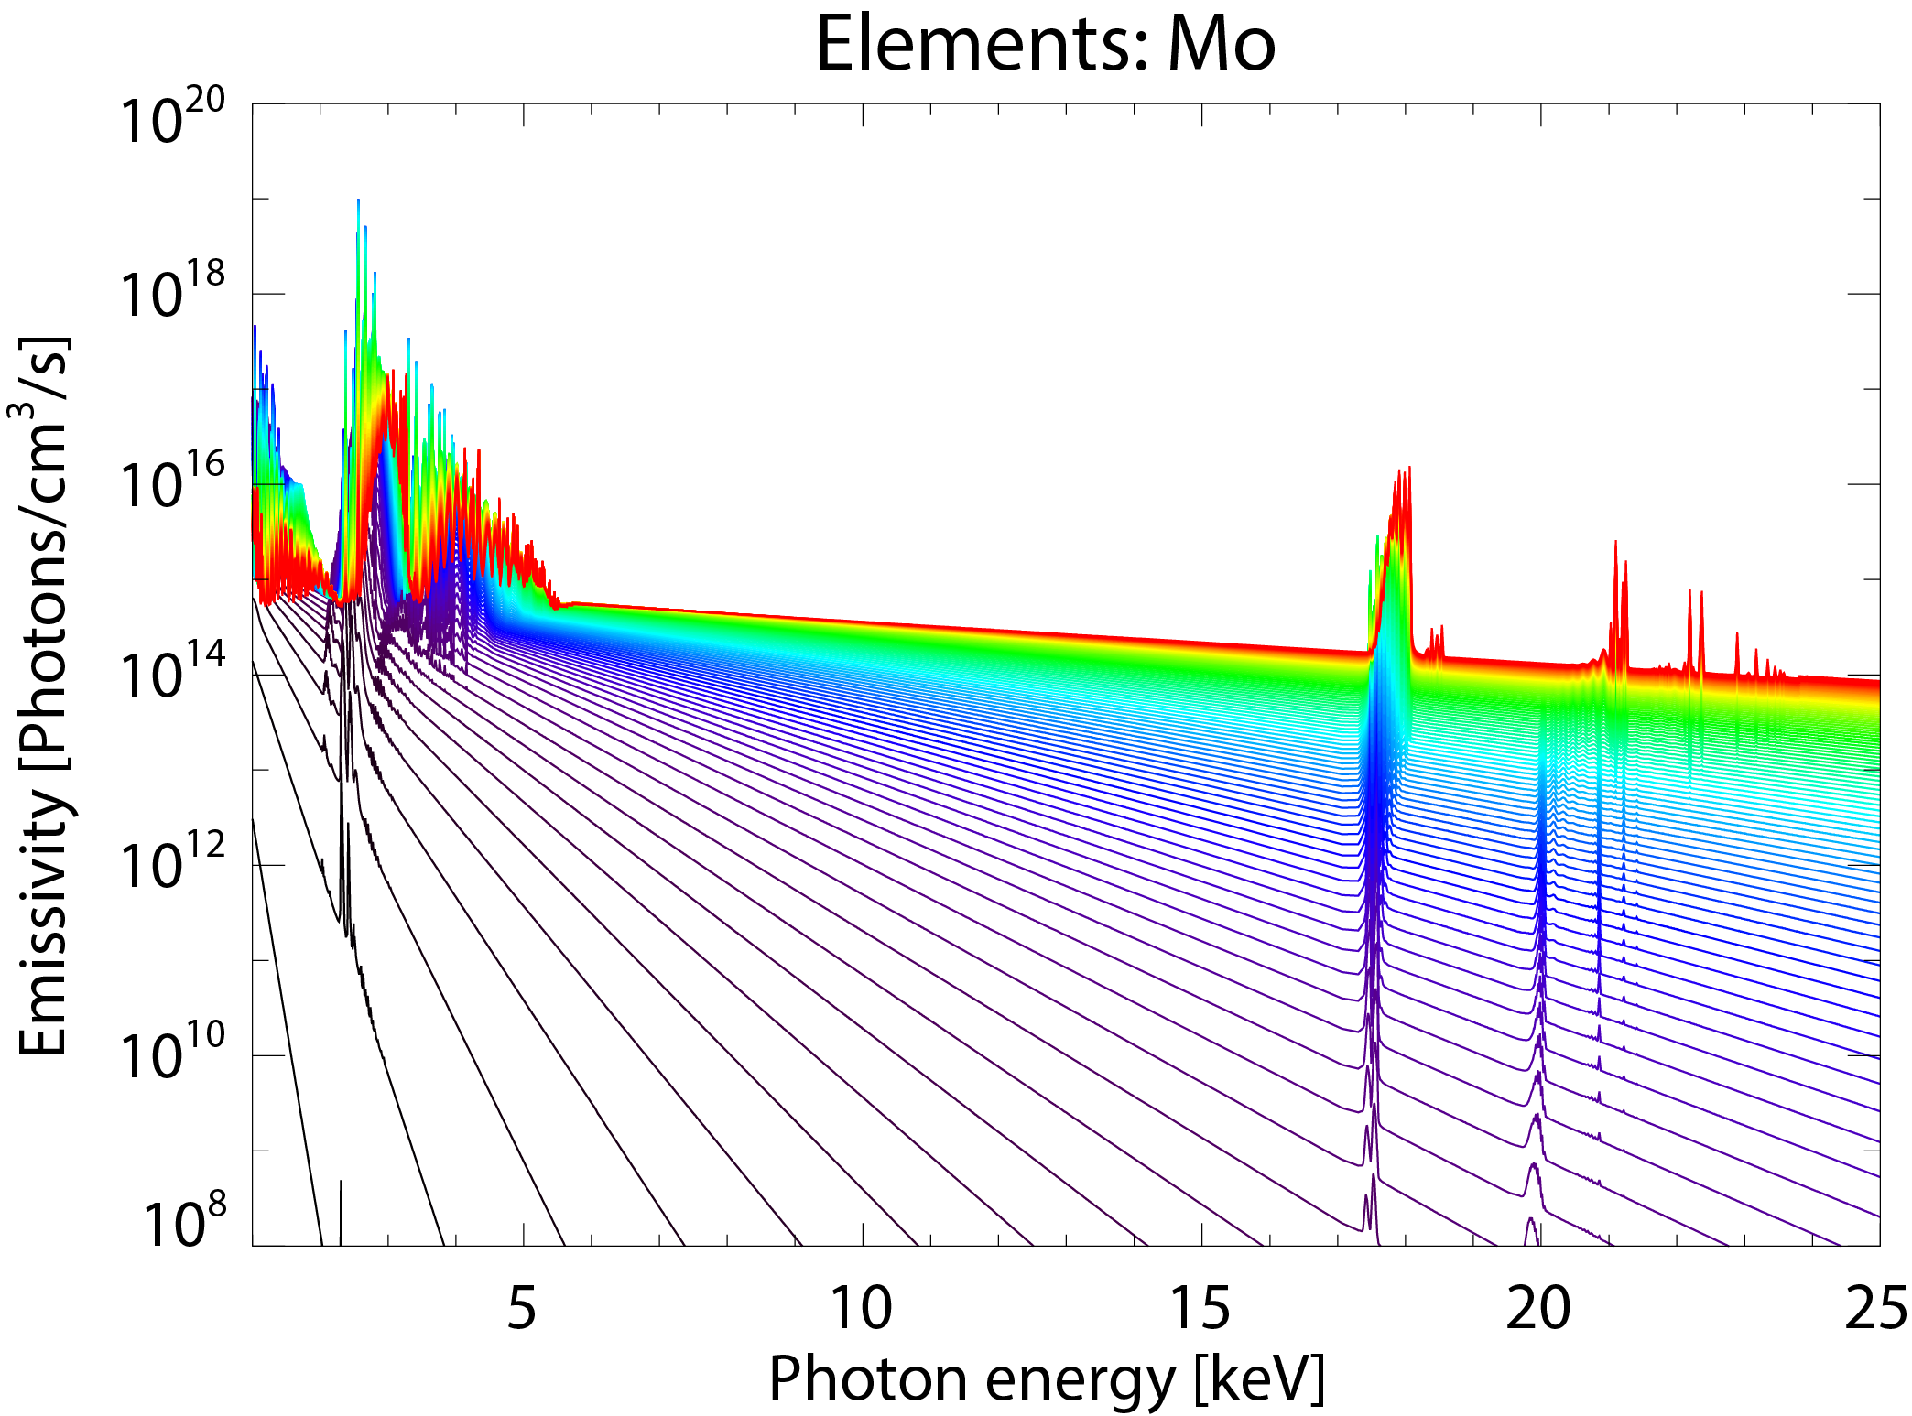
Radiation processes have to be calculated based on local plasma parameters [T_{e}, n_{e}, n_{Z}(R,t)]
Continuum and & line emission:
0.1
T_{e} [keV]
10
Bremsstrahlung (ff):
Line-emission:
∝n_{Al}
Continuum:
exp(-hν/k_{B}T_{e})
Radiative recombination (fb):
Line emission (bb):
∝n_{Mo}
Continuum:
exp(-hν/k_{B}T_{e})
∝n_{Mo}
Visible/UV/x-ray tomography:
Emmisivity is a flux-surface function
Emmisivity is not a flux-surface function
Inversion (E=M⁻¹xB)

Slide 35
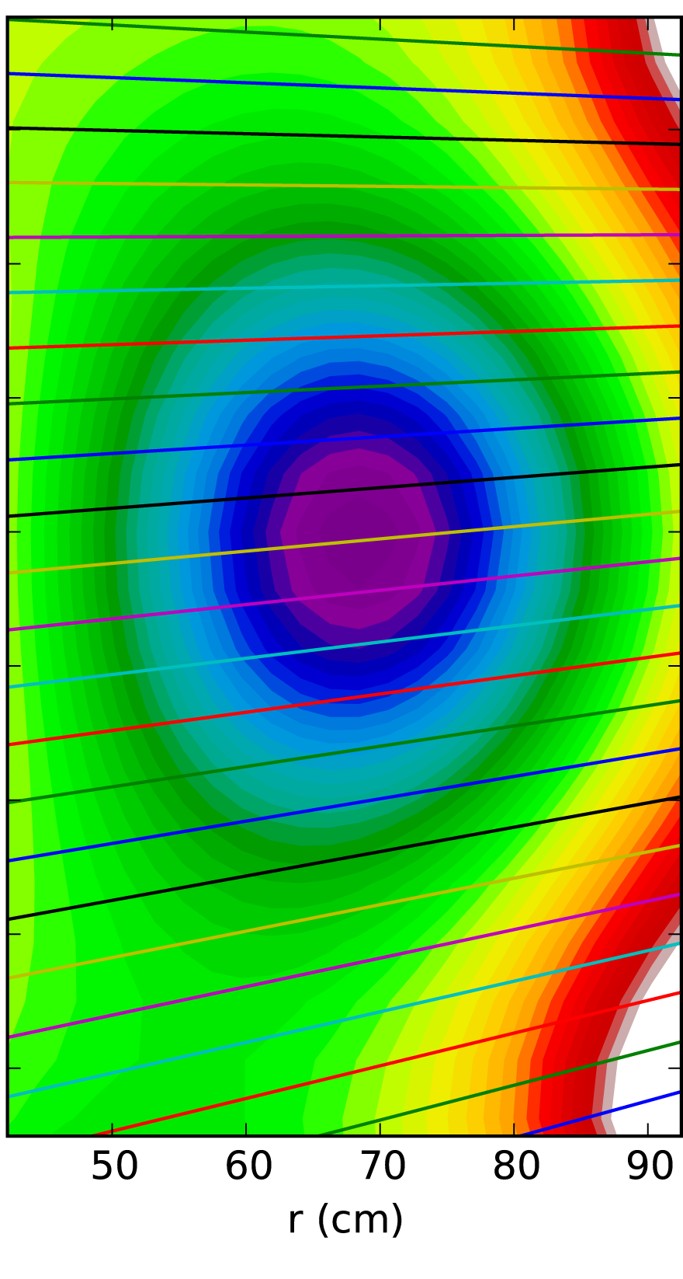
Radiation processes have to be calculated based on local plasma parameters [T_{e}, n_{e}, n_{Z}(R,t)]
Continuum and & line emission:
Bremsstrahlung (ff):
Radiative recombination (fb):
Line emission (bb):
Visible/UV/x-ray tomography:
Emmisivity is a flux-surface function
Emmisivity is not a flux-surface function
Inversion (E=M⁻¹xB)

Slide 36
Coronal equilibrium (ionization balance)
Commonly used in fusion plasmas and in the solar corona
Assumes three body-recombination rate is small
Balance between electron-impact ionization and radiative recombination
Result: Ionization degree is independent of density
Charge state of ion increases with electron temperature
Low-Z ions (Be, B, C) are often fully stripped

Slide 37
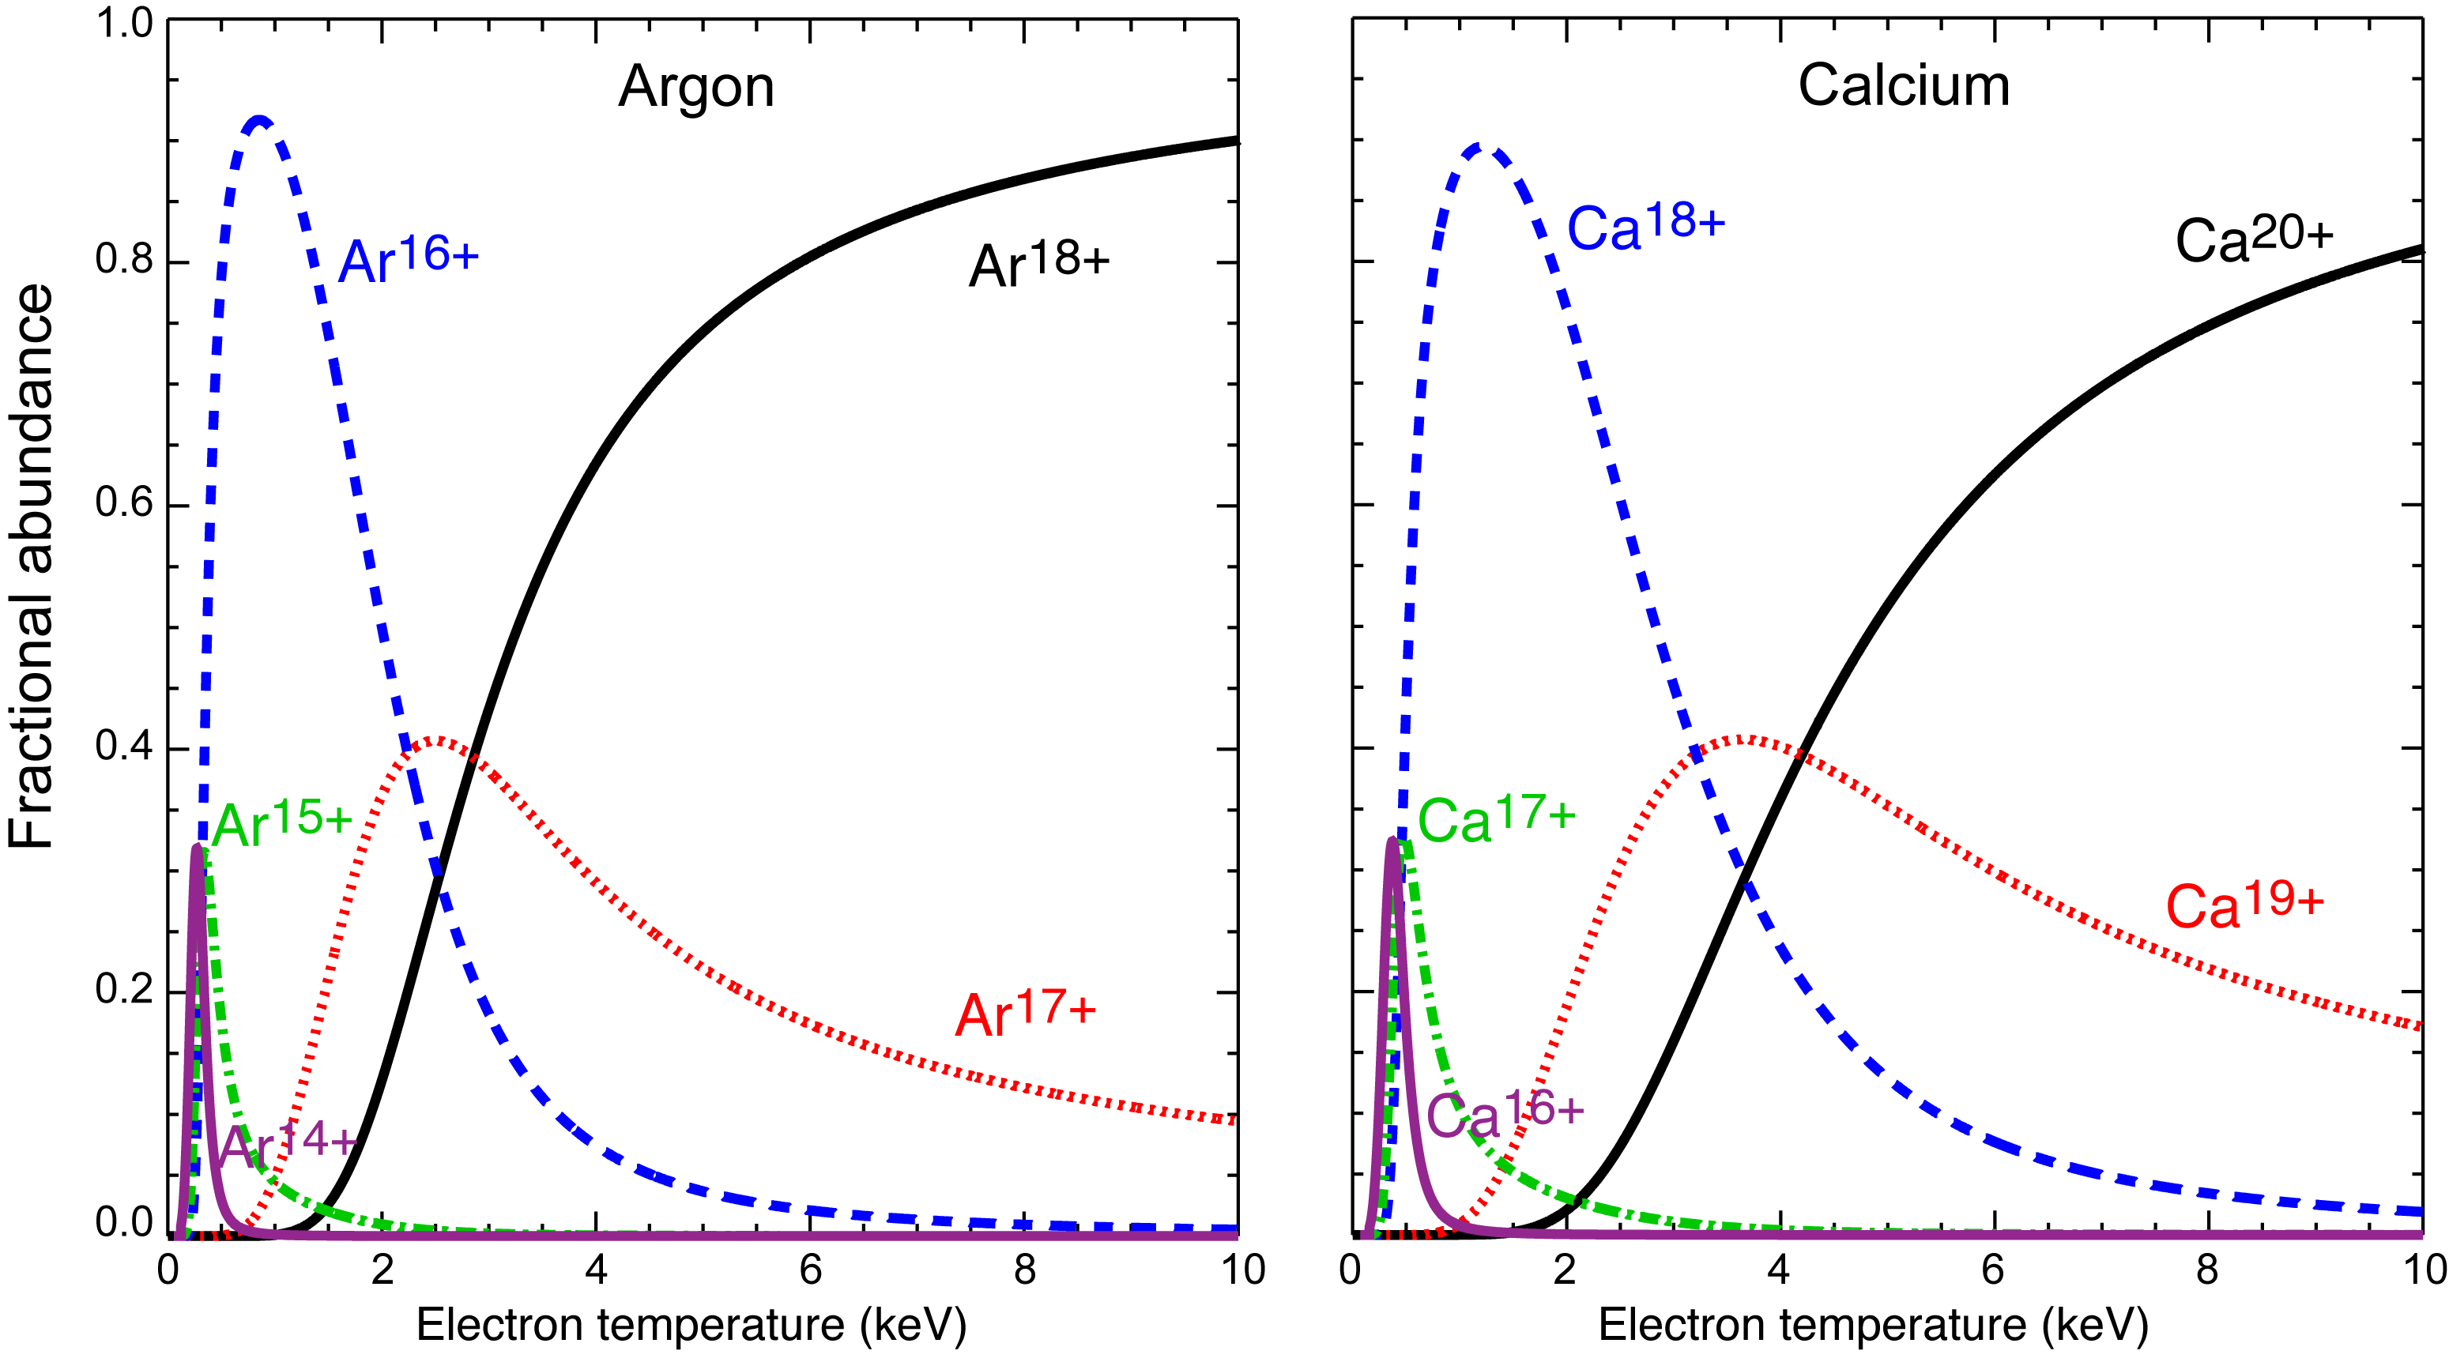
Fractional abundance calculations depend only on the local electron temperature
He-like
Fully
stripped
H-like

Slide 38
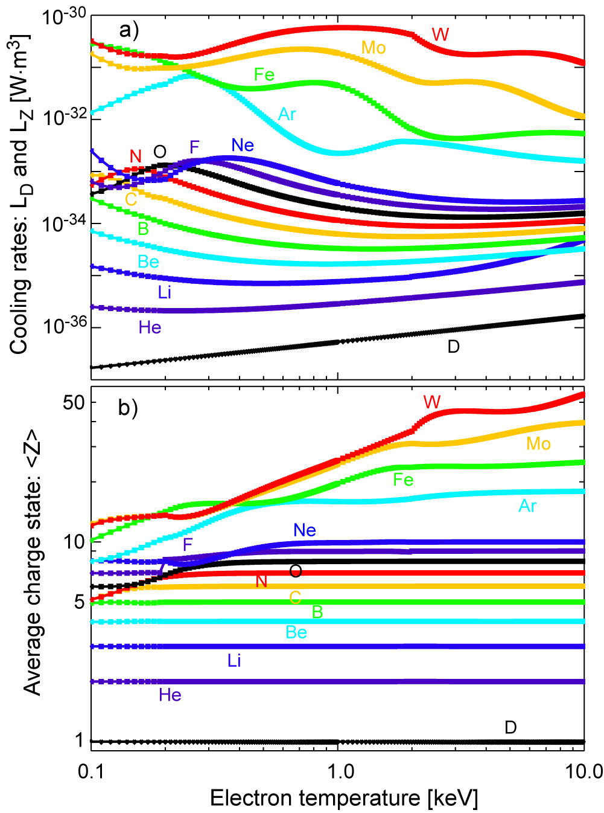
Radiative power densities (Vis/UV/x-ray) & <Z> can be obtained using coronal equilibrium
D. E. Post, et al., Atomic Data and Nuclear Data Tables, 20, 397-439, (1977).
Radiated power density can be easily calculated using the cooling rates
Parameterizing quasi-neutrality and Zeff

Slide 39

Radiative power densities (Vis/UV/x-ray) & <Z> can be obtained using coronal equilibrium
D. E. Post, et al., Atomic Data and Nuclear Data Tables, 20, 397-439, (1977).
Parameterizing equations of interest
for two-impurity plasma
Modern references for high-Z impurities include details of the electronic structure and excitation cross sections
L. Delgado-Aparicio, et al., to be submitted to PoP, (2018)

Slide 40

Summary 3: Charge state of ion increases with T_{e} and we should measure ff, fb & bb radiation
0.1
T_{e} [keV]
10
Continuum and & line emission:
Bremsstrahlung (ff)
Radiative recombination (fb)
Line emission (bb)
Line-emission:
∝n_{Ar}
Continuum:
exp(-hν/k_{B}T_{e})
∝n_{Mo}
Continuum:
exp(-hν/k_{B}T_{e})
∝n_{Mo}

Slide 41
Outline
Magnetically confined fusion (MCF) plasmas and the Z-challenge
Z-studies
Why radiation & spectroscopy?
Novel x-ray diagnostics
Summary

Slide 42
Why is important to measure x-rays emitted from tokamak and stellarator plasmas ?
A significant fraction of the power delivered to the plasma is lost in the form of radiation [even in an ideal pure H plasma].
A subset of P_{rad}: In real conditions could be as high as 90%.
X-rays are the most dominant source of radiation from hot plasmas: since hν~T_{e}:
Exercise: For 100 eV<T_{e}<20 keV ⇒ 0.5<λ<130 Å⇒ X-rays!
Measurement of power losses in the x-ray range enable the characterization of parameters such as, n_{e}, n_{Z}, T_{e}, T_{i}, v_{φ}, v_{θ}, to be used in describing/studying:
  MHD and reconection events (from hot core to cold edge).
  Transport coefficients (e.g. diffusivity and pinch velocity).
  Radial electric field (E_{r})
  Magnetic flux-surface reconstructions: T_{e}(ψ)⇒ J and q

Slide 43




THE X-RAY CASE: …how to diagnose x-rays from thermonuclear plasmas @ ~300million C?
Nearly 90% of the radiated power in ITER will be
in the x-ray range:
SXR: 1<E<20 keV
HXR: 20<E<400 keV

Slide 44
Three options in the x-ray range
Conventional broadband x-ray measurements
(e.g. SXR tomography=>confinement, MHD, equilibrium).
Doppler line-radiation x-ray measurements
(e.g. n_{Z}, T_{e}, T_{i}, v_{φ}, v_{θ}, => E_{r}).
Modern PHA & multi-energy measurements
(e.g. Z_{eff}, n_{Z}, T_{e}, n_{e,fast}).

Slide 45





Conventional SXR tomography consists of an array of diodes integrating the local emissivity
Essential elements:
Pinhole
Thin metallic filter
SXR/Bolo detector + Amplifier + DAQ
Thick filters will help discriminate between edge and core effects.
Individual diodes or diode arrays.
Current mode: use trans-impedance amplifiers with gain of 10⁴-10⁷ V/A.
What happens if we don’t
use a filter?
L. Delgado-Aparicio, et al., RSI, 81,10E303, (2010).

Slide 46




Conventional SXR tomography integrates in photon-energy using metal filter & diode arrays
DIRECT
EXAMPLES
(e.g. Si)
Example of spatially resolved x-ray spectra from ITER
AXUV-100
Conventional tomography integrate in energy-space
AXUV-20
EDGE
INDIRECT
EXAMPLE
(e.g. CsITl)
CORE
MIT
PSFC

Slide 47
Integration means also that it is very difficult to extract local parameters from the SXR emission
SXR tomographic systems measure the line-integrated continuum & line-emission from MCF plasmas
n_{e}: electron density
n_{i}: ion (H, D/T) density
n_{Z}: impurity density (He, B, C, O, Ar, Mo, W)
T_{e}: electron temperature
“Maxwellian” distributions f(E_{e}/k_{B}T_{e})
θ-asymmetries as F[v_{φ}: toroidal velocity, M_{Z}: ion mass]
(vertical or tangential views are needed)
L: Length of integration, θ: poloidal angle
(radial and poloidal coverage)
T_{filter}(E_{ph}): transmission function of filter
Detector response: S(E_{ph})
MIT
PSFC
Energy
response

Slide 48

However, conventional SXR tomography is still being used for stability, MHD & transport studies
a) Stability and MHD [e.g. (m,n) modes and sawteeth]
b) Impurity transport (e.g. using gas injection or LBO)
MIT
PSFC

Slide 49
Three options in the x-ray range
Conventional broadband x-ray measurements
(e.g. SXR tomography=>confinement, MHD, equilibrium).
Doppler line-radiation x-ray measurements
(e.g. n_{Z}, T_{e}, T_{i}, v_{φ}, v_{θ}, => E_{r}).
Modern PHA & multi-energy measurements
(e.g. Z_{eff}, n_{Z}, T_{e}, n_{e,fast}).
Extract local plasma information !!!

Slide 50
How do we extract physics information from narrow and/or wider SXR energy bands ?
Narrow energy bands
Doppler spectroscopy
High-resolution spectrometers
E/ΔE~10000-20000
Probes mainly the ion-channel
T_{i}, V_{φ,θ}, n_{Z}
Obtain T_{e} using line-ratio
Example of spatially resolved x-ray spectra from ITER
Narrow bands
Wider
band
Wider energy bands
Multi-energy spectroscopy
Low-resolution spectrometers
E/ΔE~10
Probes electron and ion channels
T_{e}, n_{Z}, ΔZ_{eff}, Z_{eff}
n_{e,fast} (e.g. LHCD, runaways)

Slide 51
Three options in the x-ray range
Conventional broadband x-ray measurements
(e.g. SXR tomography=>confinement, MHD, equilibrium).
Doppler line-radiation x-ray measurements
(e.g. n_{Z}, T_{e}, T_{i}, v_{φ}, v_{θ}, => E_{r}).
Modern PHA & multi-energy measurements
(e.g. Z_{eff}, n_{Z}, T_{e}, n_{e,fast}).
Extract local plasma information !!!

Slide 52
Motivation for developing and using new x-ray crystal imaging spectrometers
Measurement of ion-temperature (T_{i}), toroidal velocity (v_{φ}) and impurity density (n_{Z}) are important for understanding and optimizing confinement:
  ∇T_{i} driven turbulence (ITG) is a leading candidate for explaining anomalous ion thermal transport.
  b) V_{φ} and dV_{φ}/dr play important roles in the H-mode transition, ITB-formation, and RWM-stabilization.
  c) Z-transport/accumulation needs to be studied & controlled/avoided
Not all reactor concepts will consider NBI. Spontaneous rotation may provide the solution for stabilization.
∴ Spatially resolving x-ray crystal spectrometer enables T_{i}, v_{φ} and n_{Z} measurements via Doppler broadening & line shifts.

Slide 53

Choosing the appropriate (non-perturbative) extrinsic impurity to do x-ray spectroscopy
Fractional abundance / charge state distribution
For the temperature range of interest between 0.5 and 5 keV, He and Ne are fully stripped except in the relatively cool edge region.

Slide 54
Choosing the appropriate (non-perturbative) extrinsic impurity to do x-ray spectroscopy
Fractional abundance / charge state distribution
For the temperature range of interest between 0.5 and 5 keV, He and Ne are fully stripped except in the relatively cool edge region.
Argon H- and He-like charge states are dominant between 0.5 and 5 keV
Kr or Xe could be used for diagnosing the core, but because they are more “perturbative” than Ar for the same absolute density.

Slide 55


X-ray crystal imaging spectrometers revolutionized our field with T_{i} and V_{φ,θ} profile measurements
Ne-like Mo and H-like Ar fall in the spectrum
He-like Ar
detectors
He-like Ar
Crystal
H-like Ar detector sees also Mo-lines
H-like Ar Crystal
(sometimes replaced by He- or H-like Ca
and now by Ne-like Xe)
Similar systems have been installed in NSTX, KSTAR, EAST, LHD, W7 and in the future, NSTX-U, WEST, JT60SA & ITER

Slide 56


How crystals help us achieving high-spectral resolution (E/ΔE>10⁴)
Bragg diffraction:
Assuming a constant “d”, the observed relative wavelength shift (DS: Doppler shift) is given by:
The value of Δθ can be constrained by the Johann error, which is given by:
Resolving power:
For lc~5 cm (crystal length), Rc~2.7 m, θ=54º, λ/Δλ~40000 !!!

Slide 57




Pilatus detectors enable breakthrough of 100k pixels (min.) at single/multiple energy ranges
Operates in single photon counting mode
Thanks to important advances in the x-ray detector technology it is now possible to simultaneously record high resolution images of x-ray photons at single OR multiple energy ranges through direct x-ray detection.
100K to 12M pixels
(PILATUS: 172 μm, EIGER: 75 μm)
CMOS hybrid pixel technology
developed originally for synchrotrons
(CERN + PSI + DECTRIS)
10⁶ CPS/p
Si-sensor
2D array pn diodes
PILATUS3 900K-IPP in-vacuum detector for x-ray plasma spectroscopy
CMOS
readout chip
In
balls
PILATUS 100K

Slide 58


Pilatus detectors enable breakthrough of 100k pixels (min.) at single/multiple energy ranges
Operates in single photon counting mode
Photon counting circuit in each pixel
digital
CMOS hybrid pixel technology
developed originally for synchrotrons
(CERN + PSI + DECTRIS)
New maximum frame rate of 500 Hz (1ms integration + 1 ms readout).
New 10⁷ CPS/p for PILATUS3
The comparator voltage of the readout chip (V_{cmp}) controls the global threshold energy.
The threshold energy can be individually refined/trimmed using a built-in 6-bits DAC (V_{trim}).
10⁶ CPS/p
Si-sensor
2D array pn diodes
CMOS
readout chip
In
balls
PILATUS 100K

Slide 59


He-like Ar spectra is available from the cold plasma edge to the hot core
Too cold at the edge ⇒ no excitation of dielectronic satelites.
H-like Ar diffuse outward and recombine to produce the He-like ions.
Very narrow lines⇒low T_{i} as well.
Enough to produce the resonant-like excitation of dielectronic satellites.
Intensity of resonant w-line is f(T_{e}).
Much wider Doppler widh⇒higher T_{i}

Slide 60

Ion temperature profiles have been obtain in a variety of physics scenarios (L, H- and i-Mode)

Slide 61


Electron temperature T_{e}-profiles can also be obtained using line-ratios
He-like Ar
spectra
(L. Delgado-Aparicio, un-published)
Te-measurements based on the ratio of the resonance line-w and the dielectronic satellites “n=3” and “k”
Technique applicable to Alcator C-Mod, NSTX-U, KSTAR, EAST, WEST, LHD and JT60SA.
Considered to be a secondary diagnostic technique for the electron temperature (T_{e}) in ITER.

Slide 62
Three options in the x-ray range
Conventional broadband x-ray measurements
(e.g. SXR tomography=>confinement, MHD, equilibrium).
Doppler line-radiation x-ray measurements
(e.g. n_{Z}, T_{e}, T_{i}, v_{φ}, v_{θ}, => E_{r}).
Modern PHA & multi-energy measurements
(e.g. Z_{eff}, n_{Z}, T_{e}, n_{e,fast}).
Extract local plasma information !!!

Slide 63


New technology for developing multi-energy soft x-ray diagnostics is now available
Thanks to important advances in the x-ray detector technology it is now possible to simultaneously record high resolution images of x-ray photons at single OR multiple energy ranges through direct x-ray detection.
CMOS hybrid pixel technology with excellent efficiency
T_{e} [keV]
10
EXAMPLE: no line-emission
Continuum: exp(-hν/k_{B}T_{e})
Continuum: exp(-hν/k_{B}T_{e})
0.1

Slide 64

New technology for developing multi-energy soft x-ray diagnostics is now available
Thanks to important advances in the x-ray detector technology it is now possible to simultaneously record high resolution images of x-ray photons at single OR multiple energy ranges through direct x-ray detection.
CMOS hybrid pixel technology with excellent efficiency
T_{e} [keV]
10
Line-emission:
∝n_{Si}
Line-emission:
∝n_{Ar}
Continuum:
exp(-hν/k_{B}T_{e})
Continuum:
exp(-hν/k_{B}T_{e})
0.1

Slide 65
New technology for developing multi-energy soft x-ray diagnostics is now available
EXAMPLE: MOLYBDENUM
Mo-emission (Ne-, He- & H-like) between 2-5 and 17-22 keV ranges can be radially resolved
SOURCES: Mo/TZM (PFCs), Z-injector or LBO
CMOS hybrid pixel technology with excellent efficiency
T_{e} [keV]
Line-emission:
∝n_{Mo}
10
GOALS:
Obtain n_{Z} & ΔZ_{eff} by sample or bracket line-radiation
Obtain T_{e}, Z_{eff}, & n_{e,fast} by sample the continuum-radiation
Line-emission:
∝n_{Mo}
Continuum:
exp(-hν/k_{B}T_{e})
0.1

Slide 66



Motivation: Develop ME-SXR imaging for MCF plasmas with a unique capability
A unique opportunity of measuring, simultaneously, a variety of important plasma properties:
a) central electron temperature (T_{e,0}) and profiles (T_{e}(R,t))
b) medium- to high-Z impurity concentrations (Z_{eff}, n_{Z} =>ΔZ_{eff})
c) the birth of suprathermal e⁻ (n_{e,fast})
d) plasma position (R₀, Z₀)
Especially applicable for:
Spherical tokamaks: No T_{e} ECE-measurements in STs due to low-B_{φ}
Burning plasmas: Complement other techniques such as TS and ECE
NSTX’s 60 Hz Multi-point Thomson Scattering
Tore Supra fast ECE data
Δt~16 ms
Δt~16 ms

Slide 67

Motivation: Develop ME-SXR imaging for MCF plasmas with a unique capability
A unique opportunity of measuring, simultaneously, a variety of important plasma properties:
a) central electron temperature (T_{e,0}) and profiles (T_{e}(R,t))
b) medium- to high-Z impurity concentrations (Z_{eff}, n_{Z} =>ΔZ_{eff})
c) the birth of suprathermal e⁻ (n_{e,fast})
d) plasma position (R₀, Z₀)
Think large: JT60SA,
ITER & DEMO!
This technique should be explored also as a burning plasma diagnostic in-view of its simplicity and robustness.
e) T_{e}(R,Z) => Ψ, J & q

Slide 68




Photon counting ME-SXR systems use Si(Li), HgI₂, Si-Ge-CdTe diodes and SDDs
Detectors in photon-counting mode
(<T_{e}>, <Z_{eff}>, <n_{e,fast}>, <n_{Z}>)
    Pulse height analysis (PHA)
    Good energy resolution (100-200 eV)
    Slow time-response (20-50 ms)
    Low efficiency at high-energies
    Very poor profile definition
    Still used in our community
    (HT7, TCV, HL-2A)
Single-chord spectrometers
few 10⁴ CPS
K. W. Hill, et. al., RSI ’85, NF’86
One spectrum per instrument
E. H. Silver-RSI’82, J. E. Rice-PRA’82
Y. Shi-RSI’04, Z. Y Chen - NIMA’04, PST’05, T. Madeira-EPS’05, P. Xu-PST’09, Y. Zhang-RSI’09, A. DuBois- RSI’15
10⁶ CPS
Ketek
Amptek

Slide 69

ME-SXR concepts in current mode used various filters, scintillators+PMTs, Si-diodes
Multi-foil arrays in current-mode
(T_{e} and n_{Z} profiles)
    Better profile definition:
- Line integrated measurements
- Tomographic reconstructions
- Tangential view is preferable
    Fast time-response (1 ms to 1 μs)
    Low efficiency at high-energies
    Easy to avoid low-Z emission.
    Poor energy resolution (1-5 keV)
    Still, good T_{e} measurements!
    WARNING: Difficult to interpret in the presence of medium- to high-Z impurities (e.g. Al, Fe, Mo, W)
L. Delgado-Aparicio, et. al., JAP’07, PPCF’07,’11, NF’09, ’11
L. Delgado-Aparicio, et. al., RSI,’10, NF’11

Slide 70



ME-SXR & Thomson Scattering “combo” provided fast T_{e}(R,t) measurements in NSTX
2 MW
2 MW
“Fast” SXR temperature measurements done in:
Steady state in Ohmic and NBI-heated scenarios
(L. Delgado-Aparicio, et al., PPCF’07, D. J. Clayton, PPCF’13)
RF heated plasmas using HHFW waves (L. Delgado-Aparicio, et al., JAP’07)
Plasmas with slow MHD [e.g. RWMs (L. Delgado-Aparicio, et al., PPCF’10)]

Slide 71









ME-SXR diode-based systems have been deployed in tokamaks and stellarators
RFX/MST-RFPs, Core
P. Franz, et al., NF’01, RSI’04, NF’13
M. McGarry, RSI’10, M. Galante, NF’15
NSTX, Egde ME-SXR system
K. Tritz, et. al., RSI’12
EAST, Edge ME-SXR system
Y. L. Li, K. Tritz, et. al., RSI’16
MST
NSTX-U, Core & Edge ME system
K. Tritz, et. al., HTPD, 2014
TJII, Core ME-SXR system
D. Baiao, et. al., RSI’12, ‘12
CTH, Core, J. L. Herfindal,
G. J. Hartwell, et al., RSI’14

Slide 72
Pilatus detectors enable breakthrough of 100k pixels (min.) at single/multiple energy ranges
Operates in single photon counting mode
Photon counting circuit in each pixel
digital
CMOS hybrid pixel technology
developed originally for synchrotrons
(CERN + PSI + DECTRIS)
New maximum frame rate of 500 Hz (1ms integration + 1 ms readout).
New 10⁷ CPS/p for PILATUS3
The comparator voltage of the readout chip (V_{cmp}) controls the global threshold energy.
The threshold energy can be individually refined/trimmed using a built-in 6-bits DAC (V_{trim}).
10⁶ CPS/p
Si-sensor
2D array pn diodes
CMOS
readout chip
In
balls
PILATUS 100K

Slide 73



V_{comp} and V_{trim} allows individual coarse & fine tuning of energy range (per-pix): E_{width}~500 eV
Photon counting circuit in each pixel
J. Maddox, N. Pablant,
L. Delgado-Aparicio, et al., RSI, 87, 11E320, (2016).
E_{W}~500 eV
digital
“Constant” width of electronic response is a great improvement over the use of filters
Filters:
N. Pablant, L. Delgado-Aparicio, et al., RSI., 83, 10E526, (2012).
L. Delgado-Aparicio, et. al., RSI,’10, NF’11

Slide 74

New ME-SXR imaging concept combined the best features from PHA & multi-foil methods
Settings are repeated
every
2.236 mm
L. Delgado-Aparicio, et al., RSI, 87, 11E204, (2016).

Slide 75

From sampling the continuum radiation from Ar & Mo one can measure T_{e} & n_{e}²Z_{eff}
FLYCHK code, NIST
FLYCHK code, NIST

Slide 76


Goals #1&2: T_{e}^{SXR} profiles can be obtained using during Ohmic, ICRH & LHCD scenarios
ICRH heats up ions & electrons.
EEDF function is still Maxwellian
Applicable to L or H-modes (including use of error fields)
LHCD drives current and heat e⁻
LHCD present challenges for ECE
Thin Si detectors are sensitive only to Maxwellian part of the EEDF
Ohmic

Slide 77

Goal #3: separate dynamic evolution of T_{e}(R,t) from transient LBO contributions during LHCD
ME-SXR inferred T_{e}(r,t)
Tungsten density fraction
Low
SNR
Estimate n_{Z}/n_{e} using other diagnostics and compare
Test Mo and W impurity transport in inductive & non-inductive scenarios

Slide 78


Summary 4: Modern diagnostics can help us resolve n_{Z}, T_{e,i}, V_{φ,θ}, Z_{eff} & n_{e,fast} profiles
CXIS
ME-SXR

Slide 79









New core diagnostic systems will be installed in NSTX-U, MST, DIII-D, WEST, JT60SA to ITER
JT60SA
ITER
DEMO
Notes:
Investigate physics which underlies the limit

Slide 80
Summary
With the selection of W for the divertor in ITER, understanding the sources, transport and confinement of high-Z impurities is crucial to ITER success.
Avoid high-Z accumulation in the core is necessary to achieve and maintain high fusion performance in the presence of metal PFCs.
Reviewed the impact that low- to high-Z impurities have on the average plasma charge (Z_{eff}), resistivity and radiated power density (P_{rad}), and hence on transport, MHD instabilities and density limits.
A significant fraction of the power delivered to the plasma is lost in the form of radiation [even in an ideal pure H plasma].
In the x-ray range (subset of P_{rad}) could be as high as 90%.
Modern diagnostics in the visible, UV and x-ray range allow us to probe n_{Z}, T_{e,i}, V_{φ,θ}, Z_{eff} & n_{e,fast} and their profiles!

