Slide 1
Welcome to the 2020 PPPL Graduate Summer School
Presenters: Jason TenBarge, Walter Guttenfelder, Ammar Hakim, Arthur Dogariu, Igor Kaganovich, Jose Lopez, Yevgeny Raitses
Hosted by: Arturo Dominguez and the Science Education Department

Slide 2
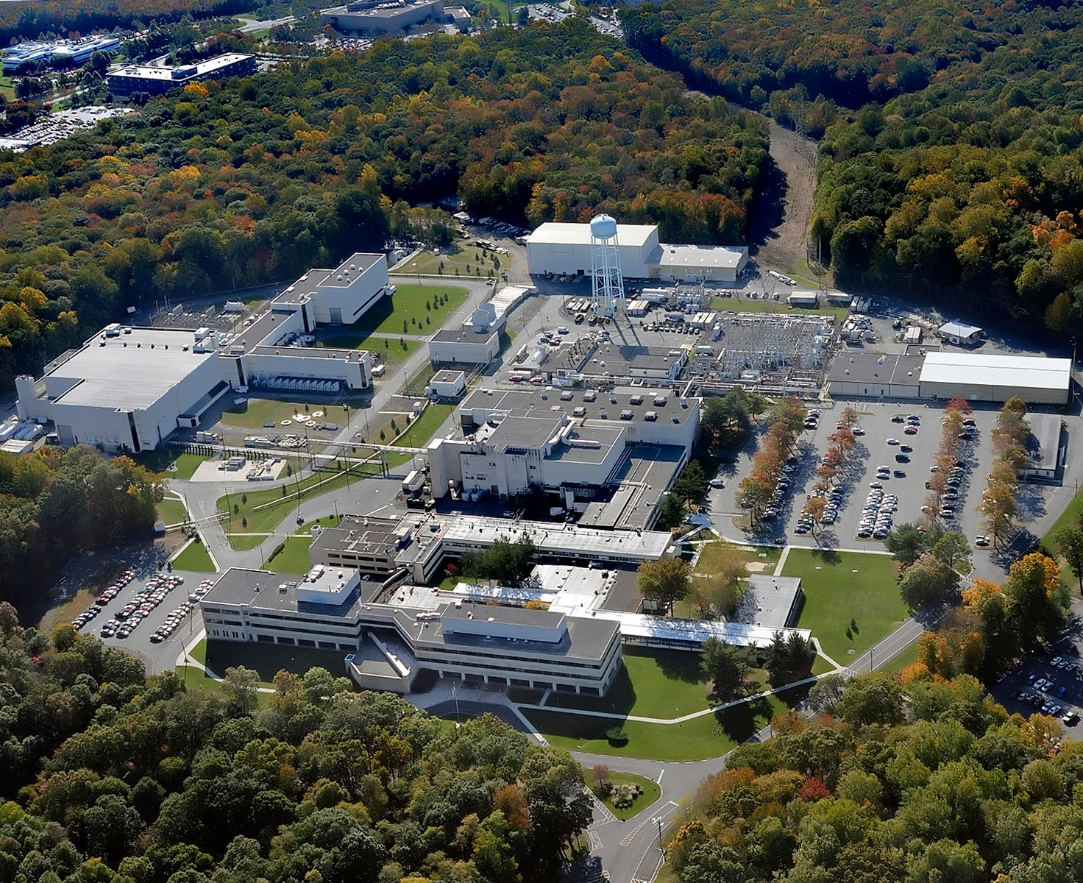
Target audience of the PPPL GSS
While there are several plasma “summer schools” they are usually focused on advanced topics in plasma physics (e.g. Sherwood conference, Michigan HEDP, etc,).
The PPPL Summer School is intended for a broad plasma physics and fusion sciences audience.
Target audience is students who are early in their graduate careers and may use the content to guide their research.

Slide 3
The GSS features 3 mini-courses (4 lectures each)
Computational Plasma
Turbulence
Dr. Jason
TenBarge
Dr. Ammar
Hakim
Dr. Walter
Guttenfelder
Low Temperature Plasmas
Dr. Arthur
Dogariu
Dr. Yevgeny
Raitses
Dr. Igor
Kaganovich
Prof. Jose
Lopez

Slide 4
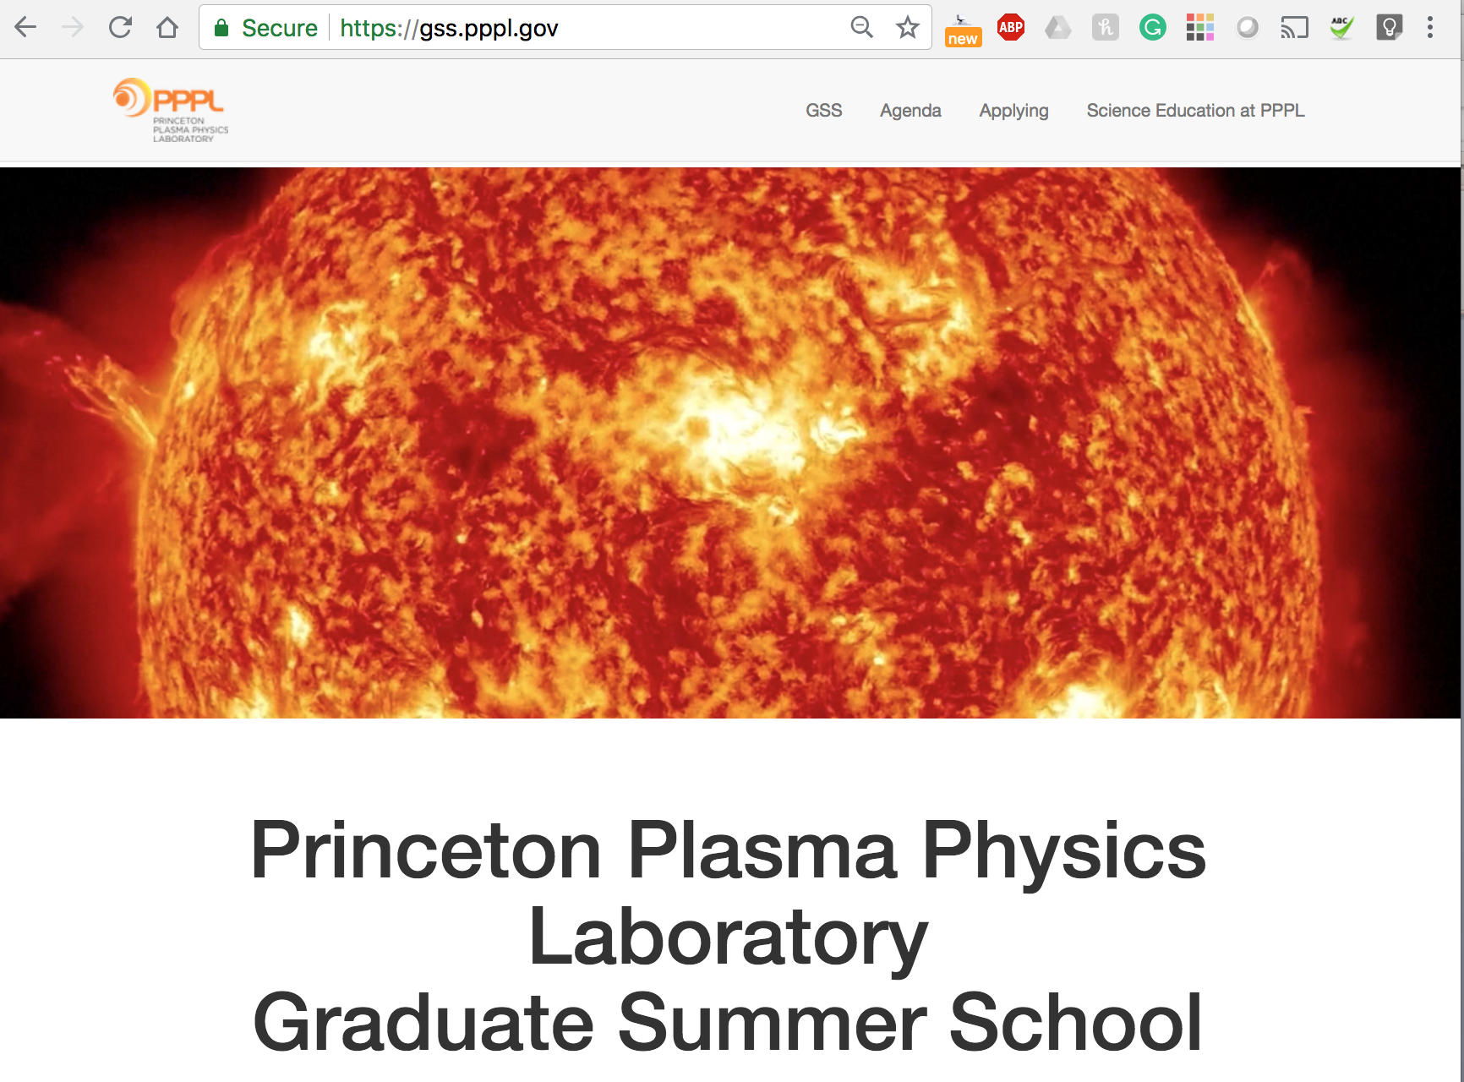
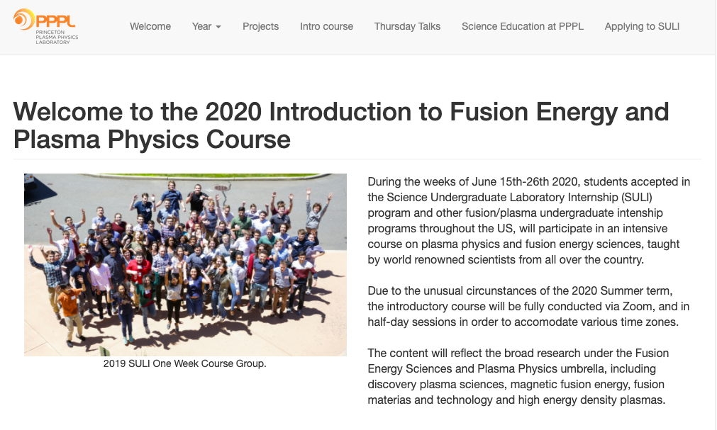
Streaming and archiving
All talks will be streamed on the GSS website, open to everyone: https://gss.pppl.gov/
They will become available later to view on the site.
This follows the model of the PPPL intro to fusion/plasma intro course: https://suli.pppl.gov/
GSS site
Intro to fusion/plasma site

Slide 5
2020 is an unprecedented year
While we’ve streamed all lectures since the first year of the summer school (2018), this year it is fully remote.
While there’s no substitute to the in-person experience, the remote format expands the reach of the course
We received >270 applications from all over the world
38 students from 31 US graduate institution + 2 international ones are enrolled
The ”small” size is meant to enable personalized attention

Slide 6
Beyond the mini-courses
Participants will have a networking session with PPPL graduate students Monday at 4pmET
Some students will give oral presentations on their research during the week.
On Wednesday, participants will attend the PPPL HS and undergraduate poster session.
Participants will present on their research / group’s research Thursday morning.

Slide 7
Continue the conversation online
With the 2020 Intro course, we created a server in the communication platform Discord: “Fusion/Plasma Undegrads Grads”.
With over 450 members, the server was widely used during the intro course and during the summer.
A ”Graduate Summer School” category was created for GSS-specific conversations.
We welcome the speakers, enrollees and anyone watching to join the conversation!
Join here: https://discord.gg/cuBGTc7

Slide 8
These are not normal times and we should acknowledge this
The reason the course is remote is because we are living during a pandemic.
All talks are recorded and will be posted, so practice self-care. Take rests, sit out when you’re exhausted, stretch, stay hydrated, etc.
YOUR HEALTH AND WELL BEING ARE THE PRIORITY!

Slide 9
Code of conduct
Since this is a public forum we ask speakers and participants to:
Make participation in our community a harassment-free experience for everyone
Act in ways that contribute to an open, welcoming, diverse, inclusive, and healthy community
We align with the Contributor Covenant Code of Conduct

Slide 10
Code of conduct: Unacceptable Behaviors
The use of sexualized language or imagery, and sexual attention or advances of any kind
Trolling, insulting or derogatory comments, and personal attacks
Public or private harassment
Other conduct which could reasonably be considered inappropriate in a professional setting

Slide 11
Code of conduct: Positive Behaviors
Demonstrating empathy and kindness
Being respectful of differing opinions and experiences
Giving and gracefully accepting constructive feedback
Accepting responsibility and apologizing to those affected by our mistakes, and learning from the experience

Slide 12
Code of conduct: Positive Behaviors
Respect the pronouns of others
Recognize that intent is not equal to impact
Self-Care is revolutionary!

Slide 13
Make the most of the GSS
Ultimately, the PPPL GSS is a chance for graduate students from all across the country (and the world) in different fields of plasma physics to come together and meet the scientists and students in the field.
Take this opportunity to practice your presentation skills in a friendly setting.
Explore fields of plasma physics you’re unfamiliar with.
Ask lots of questions!

