Slide 1
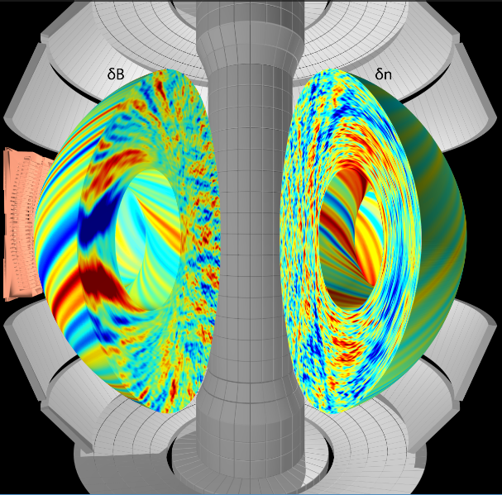
Toroidal magnetized plasma turbulence & transport
Walter Guttenfelder
Graduate Summer School 2020

Slide 2
Categorization of turbulence lectures this week
3D hydrodynamic turbulence (Lectures #1/2)
  Neutral fluid, incompressible Euler equations (continuity + Navier-Stokes)
  Nonlinear energy cascade in inertial range (between forcing and dissipation scales) → Kolmogorov spectrum
3D MHD turbulence (Lectures #2/4)
  Alfven waves in presence of guiding B field → anisotropy, additional linear term
  Derived in single-fluid MHD limit
  Assumed uniform field and plasma (no background gradients ∇B, ∇n, ∇T)
2D drift wave turbulence (Lecture #3, today)
  Strong anisotropy due to strong background magnetic field
  Driven by cross-field background thermal gradients (∇⊥F_{M} → ∇⊥n, ∇⊥T) → additional linear term, source of instability turbulence to relax gradients
  Inhomogeneous B gives rise to ∇B & curvature drifts and particle trapping → additional dynamics for instability
  Derived in two-fluid (or two-species kinetic) limit

Slide 3
Concepts of turbulence to remember
Turbulence is deterministic yet unpredictable (chaotic), appears random
  Turbulence is not a property of the fluid / plasma, it’s a feature of the flow
  We often treat & diagnose statistically, but also rely on first-principles direct numerical simulation (DNS)
Turbulence spans a wide range of spatial & temporal
  Re >>> 1 for neutral fluids, L_{forcing} / l_{dissipation} ~ (Re)^{3/4}
  Or in the case of hot, low-collisionality plasma, a wide range of scales in 6D phase-space (x,v)
Turbulence causes increased mixing, transport larger than collisional transport
  Transport is the key application of why we care about turbulence (e.g. fusion gain ~ nTτ_{E}, energy confinement time τ_{E} set by turbulence)
It’s cool! “Turbulence is the most important unsolved problem in classical physics” (~Feynman)

Slide 4
Turbulent transport is an advective process
Transport a result of finite average 2nd order correlation between perturbed drift velocity (δv) and perturbed fluid moments (δn, δT, δv)
  Particle flux, Γ = ⟨δvδn⟩
  Heat flux, Q = 3/2n₀⟨δvδT⟩ + 3/2T₀⟨δvδn⟩
  Momentum flux, Π ~ ⟨δvδv⟩ (“Reynolds stress”)
Electrostatic turbulence often most relevant in tokamaks → E×B drift from potential perturbations: δv_{E}=B×∇(δϕ)/B² ~ k_{θ}(δϕ)/B
Can also have magnetic contributions at high beta, δv_{B}~v||(δB_{r}/B) (magnetic “flutter” transport)

Slide 5
Implications of a strong toroidal magnetic field

Slide 6
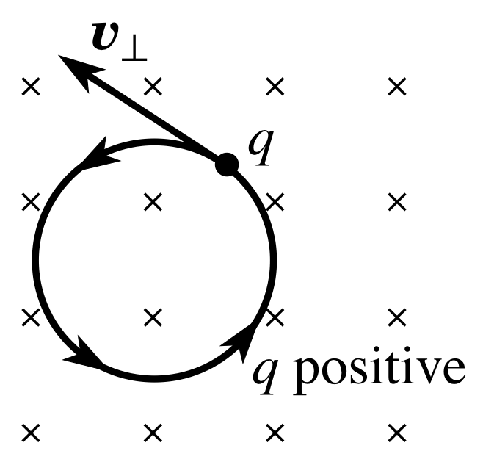
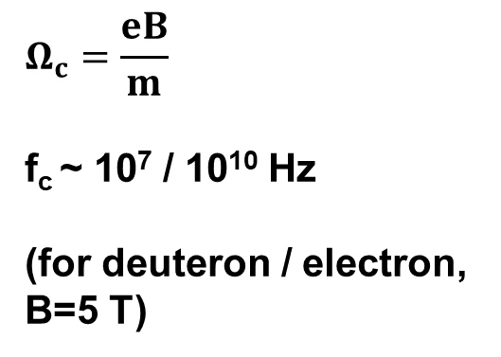
Charged particles experience Lorentz force in a magnetic field → gyro-orbits
Magnetic force acts perpendicular to direction of particle
→Particles follow circular gyro-orbits
B field into plane
$$Ω_{c}=\frac{eB}{m}$$
f_{c} ~ 10⁷ / 10¹⁰ Hz
(for deuteron / electron, B=5 T)

Slide 7
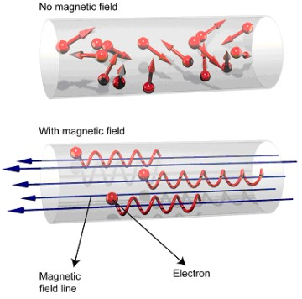

Magnetic field confines particles away from boundaries, leads to strong anisotropy
gyroradius: $ρ=\frac{v_{T}}{Ω_{c}}$
B ≈ 5 T
T ≈ 10 keV
ρ_{i} ~ 3 mm
ρ_{e} ~ 0.05 mm
<<
1-2 meter
device size
Low collision frequency ν~n/T^{3/2}
λ_{MFP}~ km’s >> device size
λ_{MFP} / ρ_{i} ~ 10⁶
χ||/χ⊥ ~ (λ_{mfp}/ρ)² ~ 10¹² → strong anisotropy

Slide 8
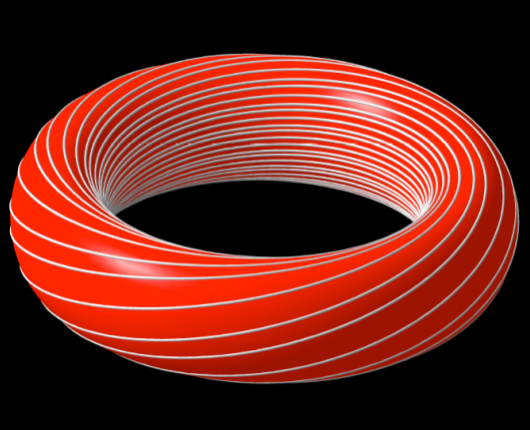
Particles easily lost from ends → bend into a torus

Slide 9

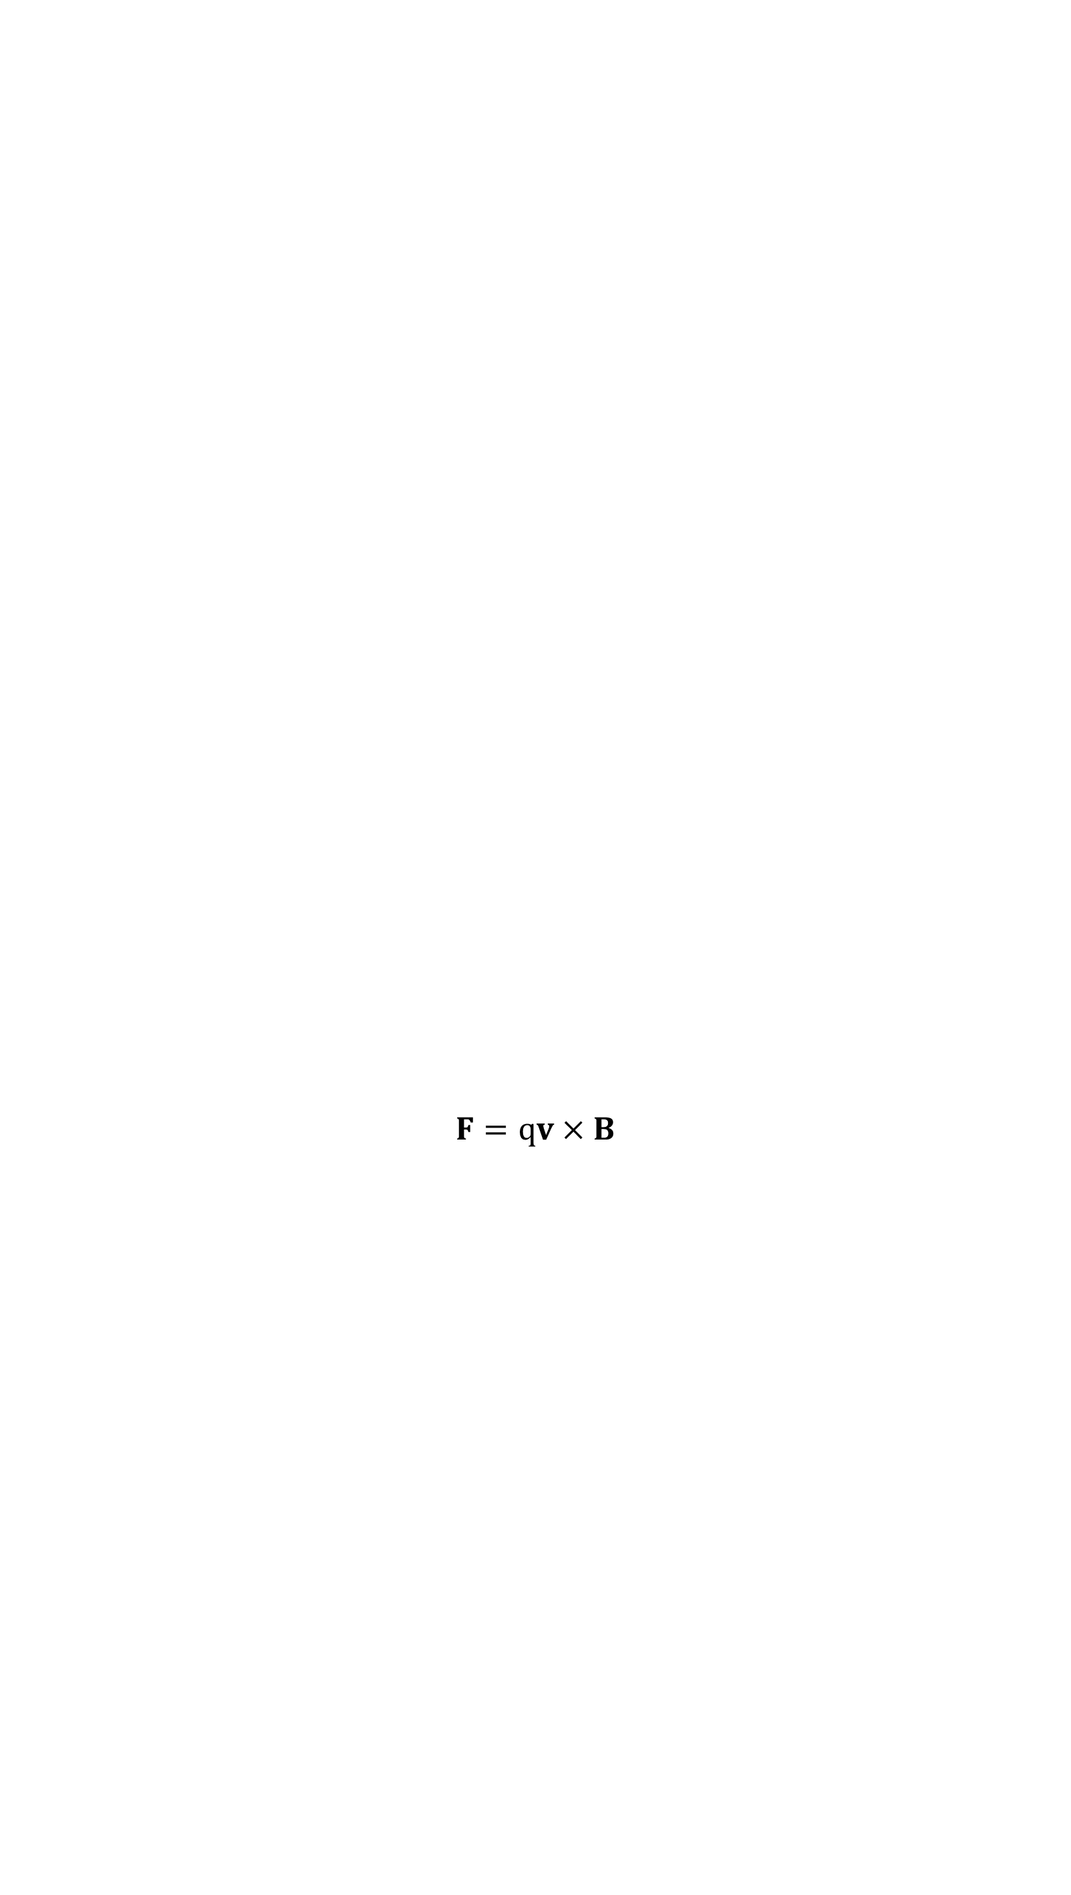
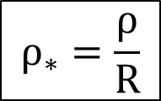
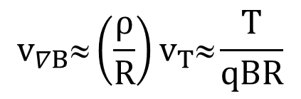
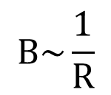
But toroidicity leads to vertical drifts from ∇B & curvature
$$B\sim \frac{1}{R}$$
B
$$F=qv×B$$
$$v_{∇B}≈\left(\frac{ρ}{R}\right)v_{T}≈\frac{T}{qBR}$$
+
-
τ_{loss} ~ 5 ms from vertical drifts (B~5 T, R~5 m, T~15 keV)
$$ρ_{∗}=\frac{ρ}{R}$$
Key parameter in magnetized confinement

Slide 10

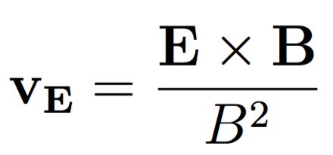
Even worse, charge separation leads to faster E×B drifts out to the walls
z
ɸ
B_{toroidal}
+
+
+
+
Ion
drift
E
Electron
drift
-
-
-
-
τ_{loss} ~ μs from E×B drifts (due to charge separation from vertical drifts)

Slide 11

Solution: need a helical magnetic field for confined (closed) particle orbits
R
a
R=major radius
a=minor radius
Notes:
How do you make a magnetic field like this?
Wrap wire around a nail to make your own electromagnetic
Then think about bending the nail into a circle, remove the nail, expand, replace with a vacuum chamber

Slide 12
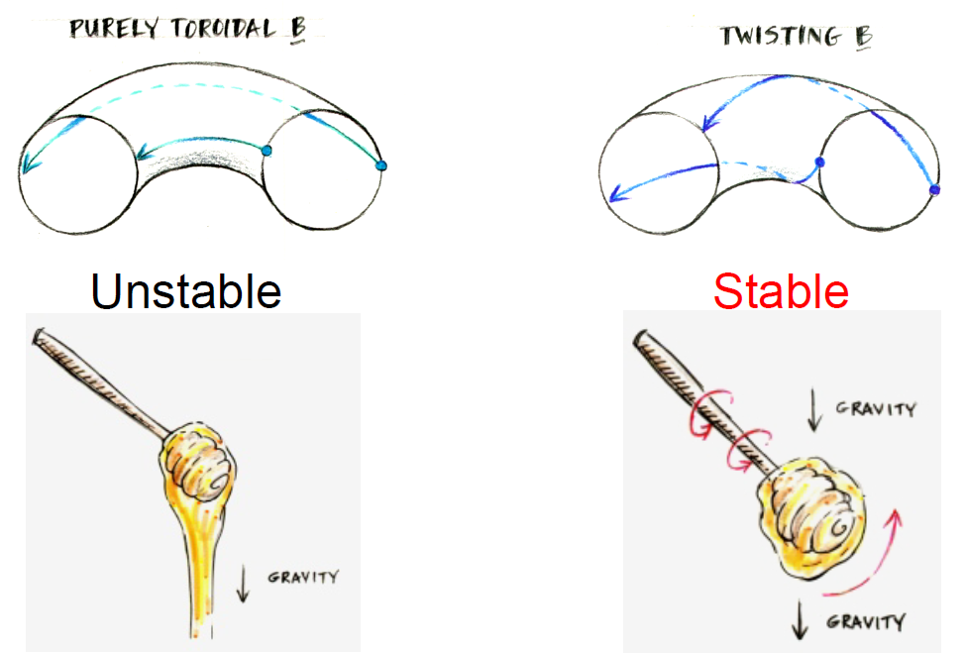
Helical B field carries plasma from “bad curvature” region to “good curvature” region
Similar to how honey dipper prevents honey from dripping

Slide 13
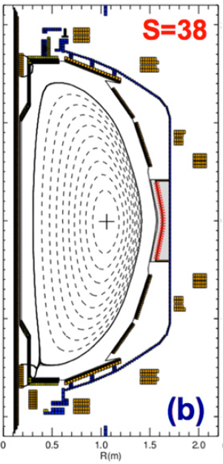
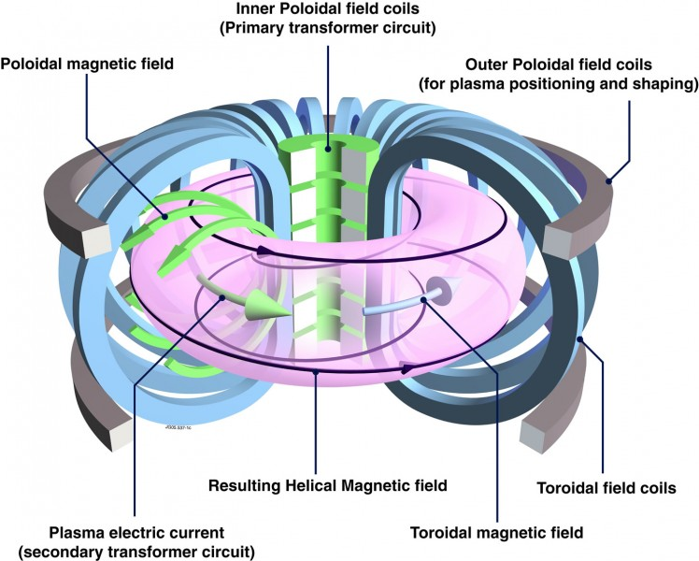
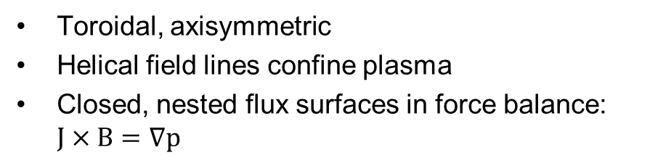
Tokamaks
NSTX
Toroidal, axisymmetric
Helical field lines confine plasma
Closed, nested flux surfaces in force balance: $J×B=∇p$
Notes:
Remember anistropy → typically assume background n & T are constant on a flux surface

Slide 14
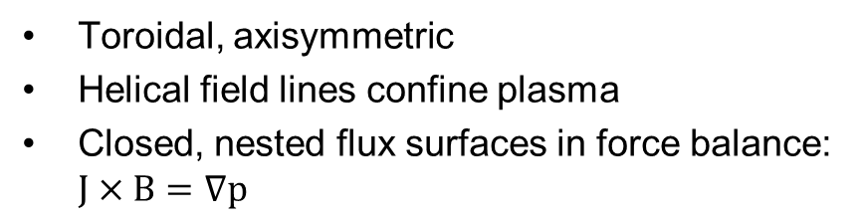
Tokamaks
NSTX
Toroidal, axisymmetric
Helical field lines confine plasma
Closed, nested flux surfaces in force balance: $J×B=∇p$
Heat
loss

Slide 15
Turbulence characteristics in tokamaks

Slide 16
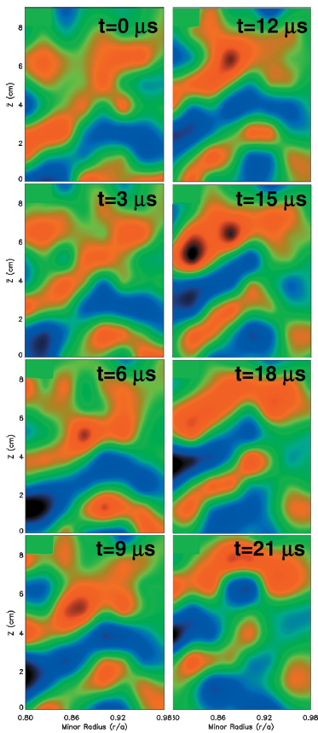
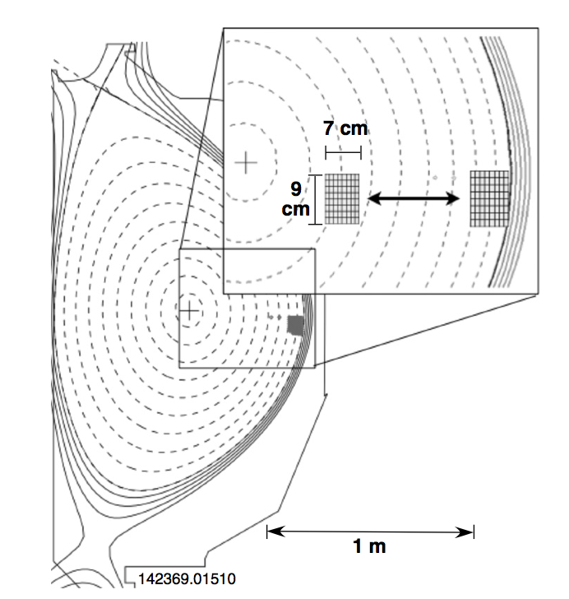
Spectroscopic imaging provides a 2D picture of turbulence in tokamaks: cm spatial scales, μs time scales, <1% amplitude
Beam Emission Spectroscopy (UW-Madison) measures Doppler shifted D_{α} from neutral beam heating to infer plasma density
DIII-D tokamak (General Atomics)
Movies at: https://fusion.gat.com/global/BESMovies
Notes:
Perpendicular cross section size
Turbulence is transporting energy and particles from hot core to cooler edge, mixing them together

Slide 17
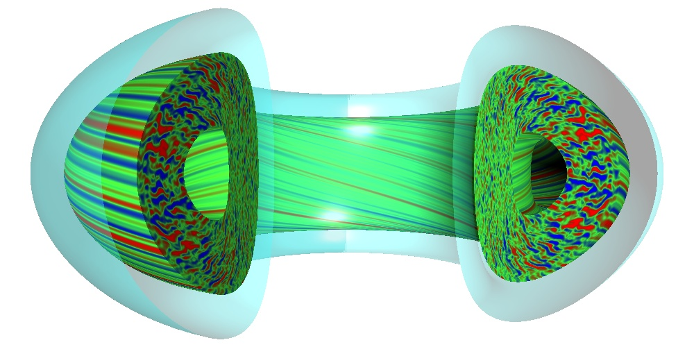
Simulations provide detailed prediction of expected turbulence characteristics
GYRO simulation (Candy, Waltz – General Atomics)

Slide 18
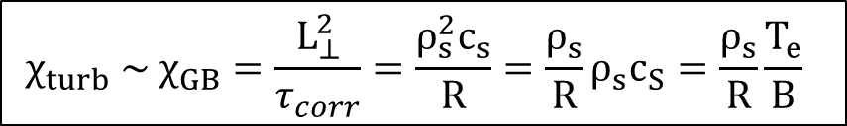
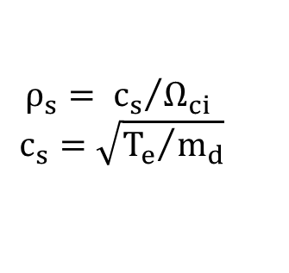

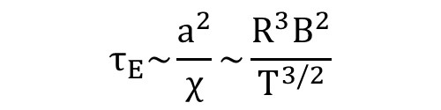
Transport is of order the Gyrobohm diffusivity
Although turbulence is advective, can estimate order of transport due to drift waves as a diffusive process, χ_{turb} ~ ⟨Δx²⟩/⟨Δt⟩ ~ (L_{⊥,corr})² / τ_{corr}
L_{⊥,corr} ~ few ρ_{s} (~ cm’s)
τ_{corr}⁻¹ ~ c_{s}/R (~10⁵ 1/s)
τ_{E} improves with field strength (B) and machine size (R)
$$ρ_{s}= {c_{s}}/{Ω_{ci}}$$
$$c_{s}=\sqrt{{T_{e}}/{m_{d}}}$$
gyroBohm diffusivity
$${χ_{turb} \sim χ}_{GB}=\frac{L_{⊥}^{2}}{τ_{corr}}=\frac{ρ_{s}^{2}c_{s}}{R}=\frac{ρ_{s}}{R}ρ_{s}c_{S}=\frac{ρ_{s}}{R}\frac{T_{e}}{B}$$
Bohm diffusivity $≈\frac{1}{16}\frac{T_{e}}{B}$
ρ*
$$τ_{E}\sim \frac{a^{2}}{χ}\sim \frac{R^{3}B^{2}}{T^{3/2}}$$
τ_{E} ~ 0.1 sec for current devices
τ_{E} ~ 1+ sec for fusion gain (ITER)

Slide 19

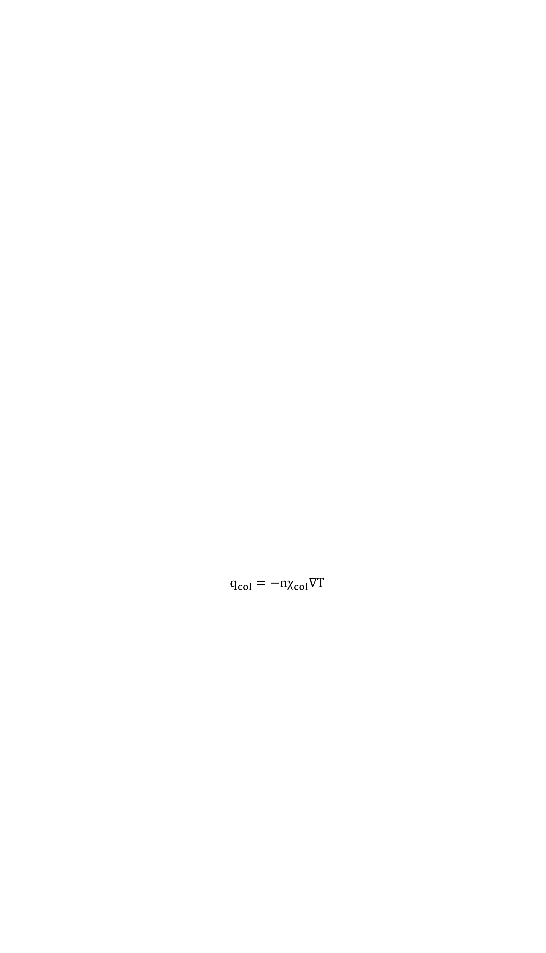
Tokamak turbulence has a threshold gradient for onset, transport tied to linear stability and nonlinear saturation
diffusion
+
turbulence
$$q_{turb}=−nχ_{GB}\left[∇T−∇T_{crit}\right]F\left(⋅⋅⋅\right)$$
Heat flux ~ heating power
collisional
diffusion
$$q_{col}=−nχ_{col}∇T$$
Temperature gradient (-∇T)
GyroBohm scaling important, but liner threshold and scaling also matters
We must discuss linear drift wave and micro-stability in tokamaks as part of the turbulent transport problem (enter gyrokinetic theory)

Slide 20
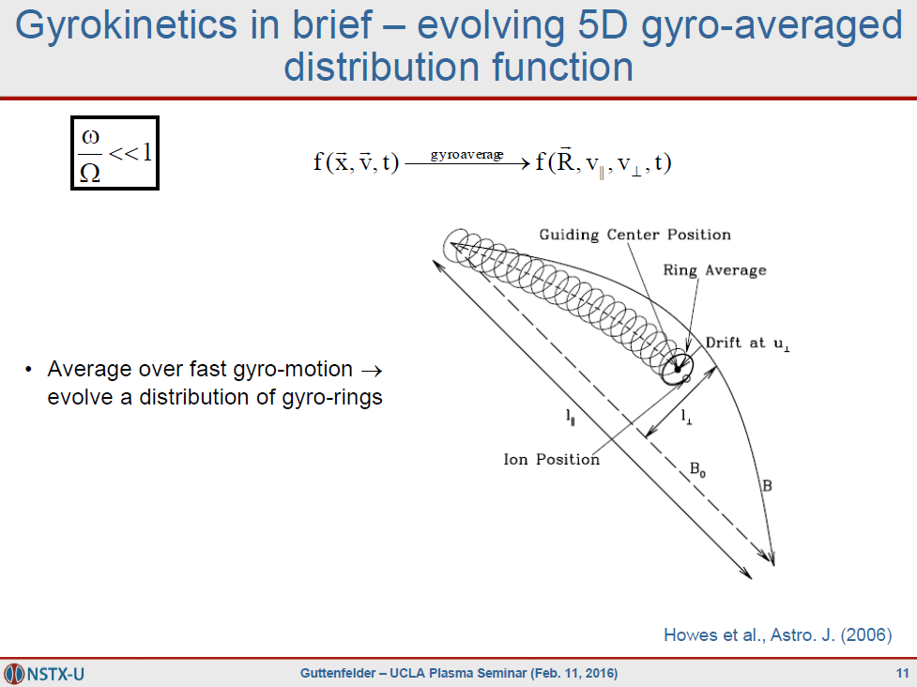

$\sim \frac{10^{5}}{10^{7}}$ for ions
(for each species)

Slide 21
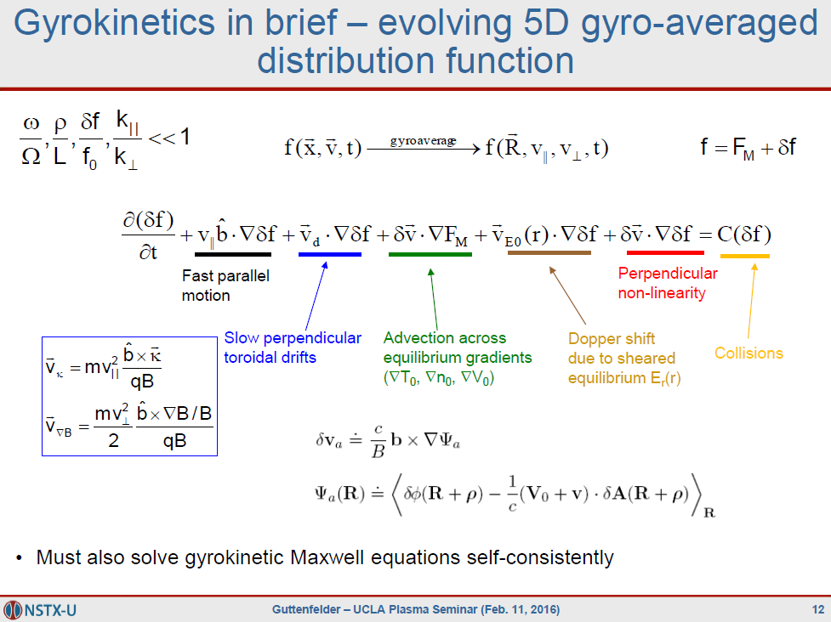
to obtain δϕ, δB

Slide 22
Drift waves

Slide 23
40+ years of theory predicts turbulence in magnetized plasma should often be drift wave in nature
General predicted drift wave characteristics:
Finite-frequency drifting waves, ω(k_{θ})~ω*~k_{θ}V*~(k_{θ}ρ)v_{T}/L_{n}
  Driven by ∇n, ∇T (1/L_{n} = -1/n⋅∇n)
Quasi-2D, elongated along the field lines (L||>>L⊥, k|| << k ⊥)
  Particles can rapidly move along field lines to smooth out perturbations
  Perpendicular sizes linked to local gyroradius, L⊥~ρ_{i,e} or k⊥ρ_{i,e}~1
In a tokamak expected to be “ballooning”, i.e. stronger on outboard side
  Due to “bad curvature”/”effective gravity” pointing outwards from symmetry axis
Transport has gyrobohm scaling, χ_{GB}=ρ_{i}²v_{Ti}/R
  But other factors important like threshold and stiffness: χ_{turb} ~ χ_{GB}⋅F(⋅⋅⋅)⋅[R/L_{T}-R/L_{T,crit}]

Slide 24
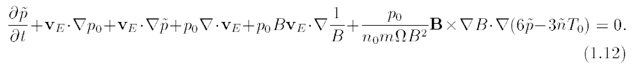
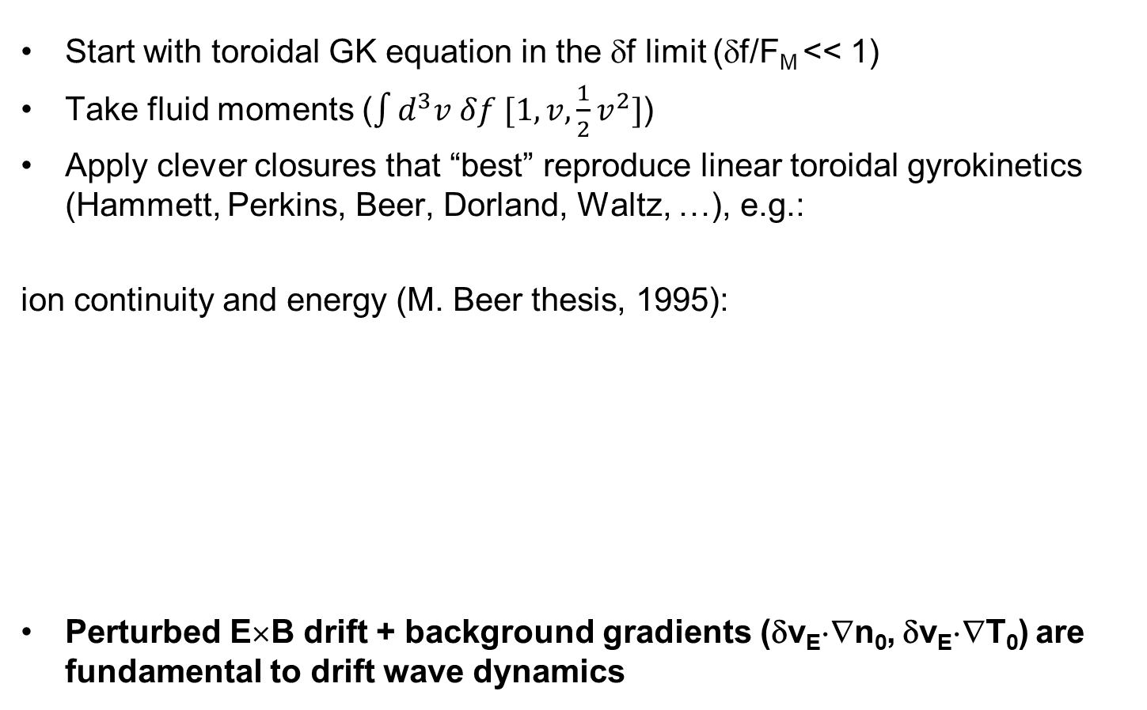
Can identify key terms in “gyrofluid” equations responsible for drift wave dynamics
Start with toroidal GK equation in the δf limit (δf/F_{M} << 1)
Take fluid moments ($\int{d^{3}v δf [1,v,{\frac{1}{2}v}^{2}]}$)
Apply clever closures that “best” reproduce linear toroidal gyrokinetics (Hammett, Perkins, Beer, Dorland, Waltz, …), e.g.:
ion continuity and energy (M. Beer thesis, 1995):
Perturbed E×B drift + background gradients (δv_{E}⋅∇n₀, δv_{E}⋅∇T₀) are fundamental to drift wave dynamics

Slide 25
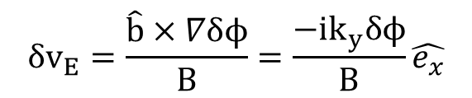


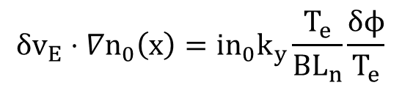
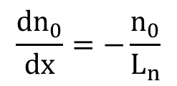
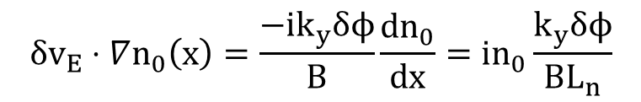
Simple classic electron drift wave in a magnetic slab (B=B_{Z})
Assume cool ions (v_{Ti} << ω/k||), isothermal electrons, no temperature gradients, no toroidicity, electrostatic (β→0), no nonlinear term
$\frac{∂}{∂t}{δn}_{i}+δv_{E}⋅∇n_{0}\left(x\right)=0$ ion continuity
$$δv_{E}=\frac{\hat{b}×∇δϕ}{B}=\frac{{−ik}_{y}δϕ}{B}\hat{e_{x}}$$
$$δϕ\sim exp\left(i\vec{k}⋅\vec{x}−iωt\right)$$
Gradient scale length (L_{n})
$$δv_{E}⋅∇n_{0}\left(x\right)=\frac{{−ik}_{y}δϕ}{B}\frac{{dn}_{0}}{dx}=in_{0}\frac{k_{y}δϕ}{{BL}_{n}}$$
$$\frac{{dn}_{0}}{dx}=−\frac{n_{0}}{L_{n}}$$
$$δv_{E}⋅∇n_{0}\left(x\right)=in_{0}k_{y}\frac{T_{e}}{BL_{n}}\frac{δϕ}{T_{e}}$$

Slide 26
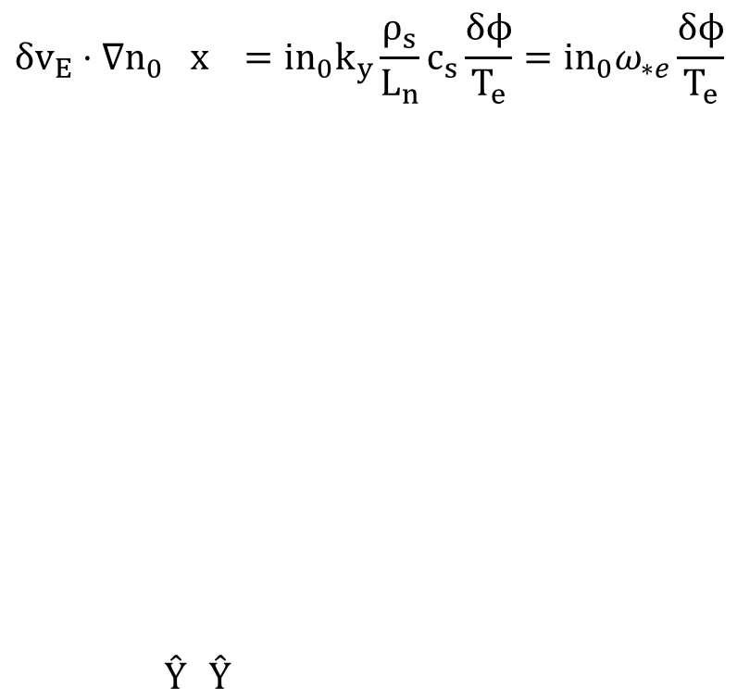
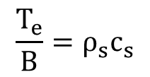

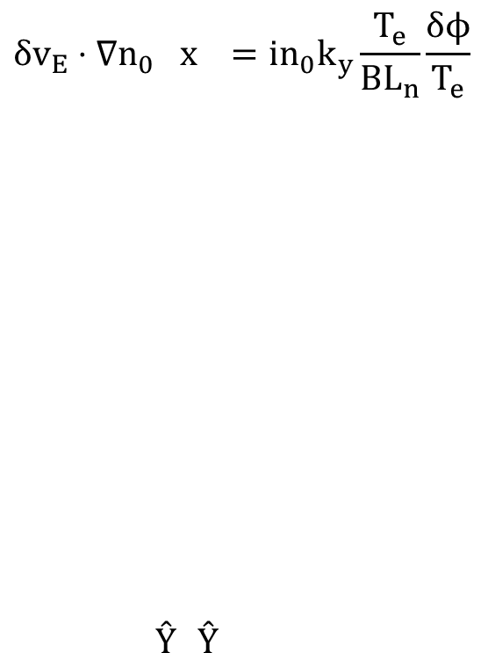
With some algebra we obtain a diamagnetic drift velocity & frequency
$$δv_{E}⋅∇n_{0}\left(x\right)=in_{0}k_{y}\frac{T_{e}}{BL_{n}}\frac{δϕ}{T_{e}}$$
$$\frac{T_{e}}{B}=ρ_{s}c_{s}$$
$$δv_{E}⋅∇n_{0}\left(x\right)=in_{0}k_{y}\frac{ρ_{s}}{L_{n}}c_{s}\frac{δϕ}{T_{e}}={in}_{0}ω_{∗e}\frac{δϕ}{T_{e}}$$
$ω_{∗e}=k_{y}V_{∗e }$ $V_{∗e}=\frac{ρ_{s}}{L_{n}}c_{s}$
Electron diamagnetic drift velocity & frequency (a fluid drift, not a particle drift)
ρ* like parameter

Slide 27
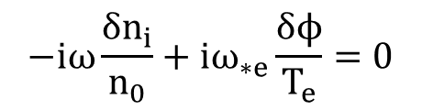
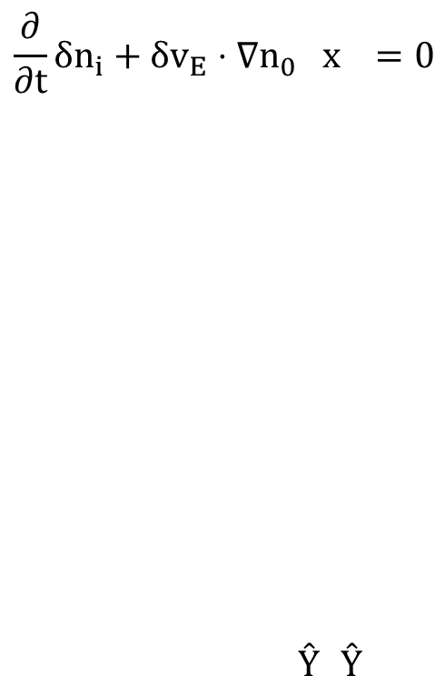
Simplified ion continuity equation
$$\frac{∂}{∂t}{δn}_{i}+δv_{E}⋅∇n_{0}\left(x\right)=0$$
$$−iω\frac{δn_{i}}{n_{0}}+iω_{∗e}\frac{δϕ}{T_{e}}=0$$
Expect characteristic frequency ~ ω_{*e} ~ (k_{y}ρ_{s})⋅c_{s}/L_{n}

Slide 28

Dynamics Must Satisfy Quasi-neutrality;
Rapid parallel electron motion gives Boltzmann distribution
Quasi-neutrality (Poisson equation, k⊥²λ_{D}²<<1) requires
For characteristic drift wave frequency, parallel electron motion is very rapid -- from parallel electron momentum eq, assuming isothermal T_{e}:
Electrons (approximately) maintain a Boltzmann distribution
$$ω<k_{||}v_{Te} → 0=−T_{e}∇_{||}{\tilde{n}}_{e}+n_{e}e∇_{||}\tilde{ϕ}$$

Slide 29
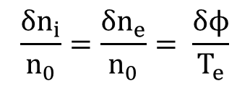
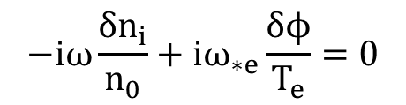

Ion continuity + quasi-neutrality + Boltzmann electron = electron drift wave (linear, slab, cold ions)
$$−iω\frac{δn_{i}}{n_{0}}+iω_{∗e}\frac{δϕ}{T_{e}}=0$$
$$ω=ω_{∗e}=k_{y}V_{∗e}$$
$$\frac{δn_{i}}{n_{0}}=\frac{δn_{e}}{n_{0}}= \frac{δϕ}{T_{e}}$$
Density and potential wave perturbations propagating perpendicular to B_{Z} and ∇n₀
  δv_{E}⋅∇n₀ gives δn 90° out-of-phase with initial δn perturbation
Simple linear dispersion relation (will change with polarization drift / finite Larmor radius effects, toroidicity, other gradients)
No mechanism to drive instability (collisions, temperature gradient, toroidicity / trapped particles, …)

Slide 30
Linear stability analysis of toroidal Ion Temperature Gradient (ITG) micro-instability (expected to dominate in ITER)

Slide 31
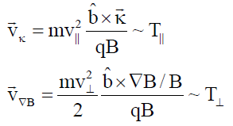
Toroidicity Leads To Inhomogeneity in |B|, gives ∇B and curvature (κ) drifts
What happens when there are small perturbations in T||, T⊥? ⇒ Linear stability analysis…
∇B, curvature (κ)
Z
Z
R
R

Slide 32

Temperature perturbation (δT) leads to compression (∇⋅v_{di}), density perturbation – 90° out-of-phase with δT
∇B, curvature
T⁺
T⁻
T+
T-
T+
T-
Fourier decompose perturbations in space (k_{θ}ρ_{i}≤1)
Assume small δT perturbation
n⁻
n⁺
n-
n+
n-
∇B
n
T
∇T
Notes:
Compressibility important for toroidal drift waves.

Slide 33
Dynamics Must Satisfy Quasi-neutrality;
Rapid parallel electron motion gives Boltzmann distribution
Quasi-neutrality (Poisson equation, k⊥²λ_{D}²<<1) requires
For characteristic drift wave frequency, parallel electron motion is very rapid (from parallel electron momentum eq, assuming isothermal T_{e}:)
Electrons (approximately) maintain a Boltzmann distribution
$$ω<k_{||}v_{Te} → 0=−T_{e}∇_{||}{\tilde{n}}_{e}+n_{e}e∇_{||}\tilde{ϕ}$$

Slide 34

Perturbed Potential Creates E×B Advection
Advection occurs in the radial direction
∇B, curvature
~Boltzmann e’s
T⁺
T⁻
T+
T-
T+
T-
n⁻
n⁺
n-
n+
n-
ϕ⁻
ϕ⁺
ϕ-
ϕ+
ϕ-
E_{θ}
E_{θ}
E_{θ}
E_{θ}
∇B
n
T
∇T

Slide 35
Background Temperature Gradient Reinforces Perturbation ⇒ Instability
∇T
T⁺
T⁻
T+
T-
T+
T-
This simple cartoon gives a purely growing “interchange” like mode (coarse derivation in backup slides). The complete derivation (all drifts, gradients) will give a real frequency dispersion, i.e. ω_{r}=ω_{r}(k_{θ})

Slide 36
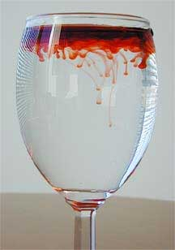
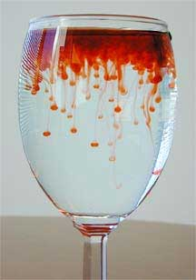
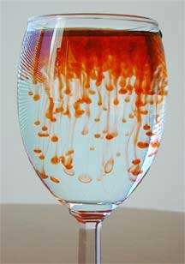
Analogy for turbulence in tokamaks – Rayleigh-Taylor instability
Higher density on top of lower density, with gravity acting downwards
gravity
density/pressure

Slide 37
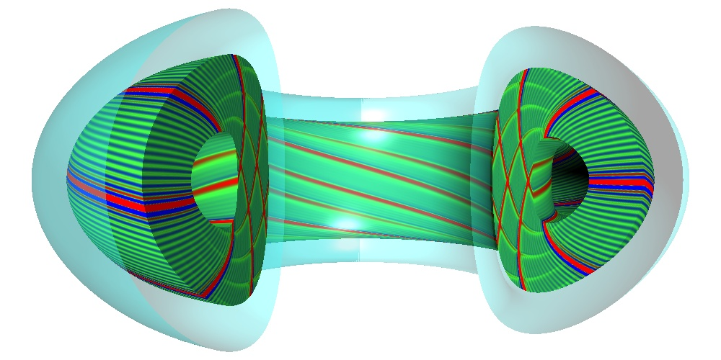
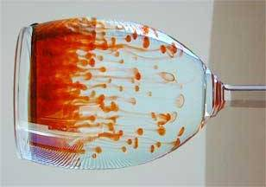
Inertial force in toroidal field acts like an effective gravity
centrifugal force
→effective gravity
gravity
pressure
pressure
Unstable in the outer region
GYRO code
https://fusion.gat.com/theory/Gyro

Slide 38
Same Dynamics Occur On Inboard Side But Now Temperature Gradient Is Stabilizing
Advection with ∇T counteracts perturbations on inboard side – “good” curvature region
“good” curvature
“bad” curvature
∇T
∇T
∇B
T⁺
T⁻
T+
T-
T+
T-
T⁺
T⁻
T+
T-
T+
T-
n
T
∇T
∇T
Notes:
Analogy to inverted pendulum (outboard side) and pendulum (inboard side).

Slide 39
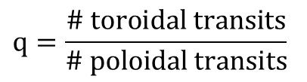
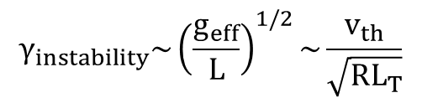
Fast Parallel Motion Along Helical Field Line Connects Good & Bad Curvature Regions
$$γ_{instability}\sim {\left(\frac{g_{eff}}{L}\right)}^{1/2}\sim \frac{v_{th}}{\sqrt{RL_{T}}}$$
Approximate growth rate on outboard side
effective gravity: g_{eff} = v_{th}²/R
gradient scale length: 1/L_{T} = -1/T⋅∇T
Parallel transit time along helical field line with “safety factor” q
Expect instability if γ_{instability} > γ_{parallel} , or
$$q=\frac{\# toroidal transits}{\# poloidal transits}$$

Slide 40
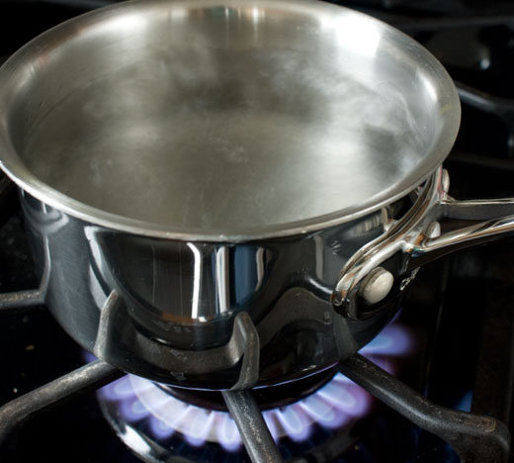
Threshold-like behavior analogous to Rayleigh-Benard instability
Analogous to convective transport when heating a fluid from below … boiling water (before the boiling)
Heat flux ~ heating power
diffusion
+
turbulence
collisional
diffusion
Temperature gradient
(T_{hot} - T_{cold})
Rayleigh, Benard, early 1900’s
Notes:
Rayleigh-benard, water expands (less dense) as temperature increases (buoyancy), will thermally diffuse to balance, plus viscosity will impede fluid motions until threshold surpassed

Slide 41
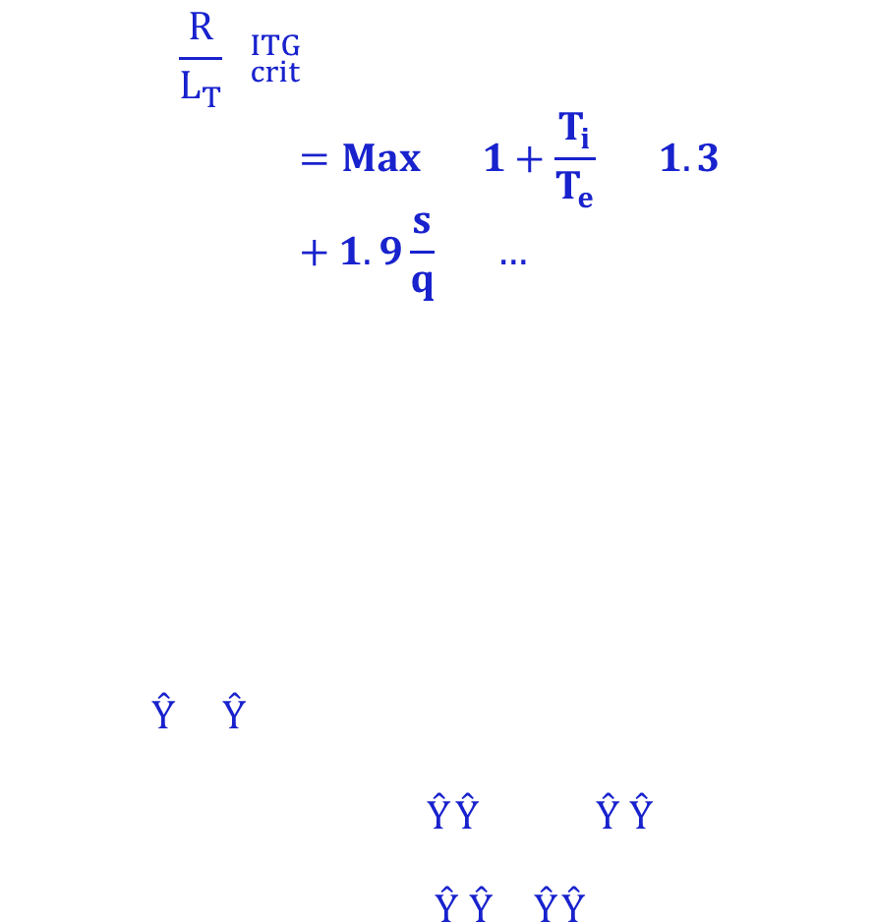
Critical gradient for ITG determined from theory + linear gyrokinetic simulations
$${\left(\frac{R}{L_{T}}\right)}_{crit}^{ITG}=Max\left[\left(1+\frac{T_{i}}{T_{e}}\right)\left(1.3+1.9\frac{s}{q}\right)\left(…\right)\right]$$
Jenko (2001)
Hahm (1989)
Romanelli (1989)
R/L_{T} = -R/T⋅∇T is the normalized temperature gradient
Natural way to normalize gradients for toroidal drift waves, i.e. ratio of diamagnetic-to-toroidal drift frequencies:
  ω_{*T} = k_{y}(B×∇p) / nqB² → (k_{θ}ρ_{i})v_{T}/L_{T}
  ω_{D} = k_{y}(B×mv⊥²∇B/2B) / qB² → (k_{θ}ρ_{i})v_{T}/R
→ ω_{*T}/ω_{D} = R/L_{T}

Slide 42
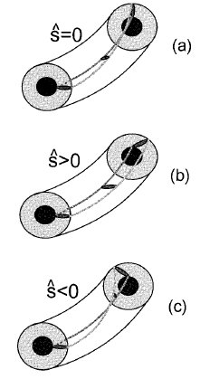
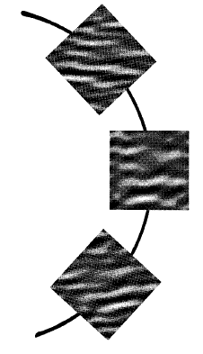
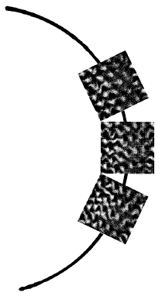
With physical understanding, can try to manipulate/optimize microstability
E.g., magnetic shear influences stability by twisting radially-elongated instability to better align (or misalign) with bad curvature drive
Antoneson

Slide 43
How does magnetized turbulence saturate?
What sets spatial scales (drive vs. dissipation)?

Slide 44



Spectrum shape / distribution governed by nonlinear (2D perpendicular) three-wave interactions
Linearly unstable modes grow:
At large amplitude, interact via nonlinear advection, δv_{E}⋅∇δf
i.e. “three-wave” coupling in (2D perpendicular) wavenumber space
Energy gets distributed across k space (& velocity space) until damped by stable modes (& collisions) → saturation
  Local (in k) 2D cascades
  Non-local (in k) interactions drive “zonal flows” that also mediate turbulence
$$δϕ\left(k\right)\sim exp \left[ik⋅x+iω\left(k\right)t+γ\left(k\right)t\right]$$
$\frac{∂}{∂t}δf \sim δv_{E}⋅∇δ$f
$$\frac{∂}{∂t}δf_{k_{⊥3}} \sim \sum_{\begin{aligned}k_{⊥1},k_{⊥2} \\ k_{⊥3}=k_{⊥1}+k_{⊥2}\end{aligned}}{\left(b×k_{⊥1}δϕ_{k_{⊥1}}\right)⋅k_{⊥2}δf_{k_{⊥2}}}$$

Slide 45


Energy cascade in 2D turbulence is different than 3D
Change in non-linear conservation properties → energy and vorticity is conserved
  Inverse energy cascade E(k) ~ k^{-5/3}
  Forward enstrophy [ω²~(∇×v)²] cascade E(k)~k⁻³
  Non-local wavenumber interactions can couple over larger range in k-space (e.g. to zonal flows)
Quasi-2D turbulence exists in many places
Geophysical flows like ocean currents, tropical cyclones, polar vortex, chemical mixing in polar stratosphere (→ ozone hole)
Soap films →
Liu et al., PRL (2016)

Slide 46



Energy drive can occur across large range of scales, but turbulent spectra still exhibit decay
2D energy & enstrophy cascades remain important → nonlinear spectra often downshifted in k_{θ} (w.r.t. linear growth rates)
Both drive and damping can overlap over wide range of k⊥ (very distinct from neutral fluid turbulence)
Linear growth rates
Nonlinear density power spectra
Nonlinear heat flux spectra
Howard, PoP & NF (2016)

Slide 47

Additional effects proposed to model turbulence saturation & dissipation

Slide 48



Nonlinearly-generated “zonal flows” also impact saturation
Potential perturbations uniform on flux surfaces (k_{y}=0) → marginally stable, do not cause transport
Turbulence can condense to system size → ZF driven largely by non-local (in k) NL interactions (k >> k_{ZF})
Linear instability stage demonstrates structure of fastest growing modes
Large flow shear from instability cause perpendicular “zonal flows”
Zonal flows help moderate the turbulence
(potential contours → stream functions)
Rayleigh-Taylor like instability driving Kelvin-Helmholtz-like instability

Slide 49


Slide 50

Generation of zonal flows in tokamaks similar to “Kelvin-Helmotz” instability found throughout nature
Variation of flows in one direction…
leads to instability, flows in another direction

Slide 51
Zonal flows can saturate at relatively large amplitude for toroidal ITG turbulence
Regulates saturation via (i) shear decorrelation of eddies, (ii) energy sink into marginal (non-transport-causing) modes
Typically have distinct k_{x} spectra (overall 2D spectra anisotropic in k_{x},k_{y})
Marginally stable zonal modes (k_{y}=0)
E_{ϕ}(k)
Transport causing (finite-k_{y}) modes
k_{y}=0
k_{y}

Slide 52



Large scale equilibrium sheared flows also influence saturation
Large scale background flow shear distorts eddies → reduces radial correlation length, fluctuation strength, cross-phases and transport
Turbulent transport expected to be reduced as the mean flow shear rate (ω_{s}~dU₀/dy) approaches the turbulence decorrelation rate (Δω_{D})
Biglari, Diamond, Terry 1990

Slide 53


In neutral fluids, sheared flows are often a source of free energy to drive turbulence
Thin (quasi-2D) atmosphere in axisymmetric geometry of rotating planets similar to tokamak plasma turbulence → can also suppress transport
Stratospheric ash from Mt. Pinatubo eruption (1991) spread rapidly around equator, but confined in latitude by flow shear
Aerosol concentration
Large shear in stratospheric equatorial jet
(Trepte, 1993)
Notes:
Sheared flows in neutral fluids are usually a drive for turbulence, not a suppression mechanism
However, another example of sheared flows suppressing turbulent mixing is found in atmospheric turbulence (Terry, 2000; Trepte, 1993)
Eruption of Mt. Pinatubo (Philippines) in 1991???? (15 N, 120 E), spewed ash into the stratosphere, spreads in latitude to +/- 20 degree but large gradient persists for months, large shear in stratospheric equatorial jet at same position [in contrast to lower altitude troposphere]

Slide 54
Beyond general characteristics, there are many theoretical “flavors” of drift waves possible in tokamak core & edge
Usually think of drift waves as gradient driven (∇T_{i}, ∇T_{e}, ∇n)
  Often exhibit threshold in one or more of these parameters
Different theoretical “flavors” exhibit different parametric dependencies, predicted in various limits, depending on gradients, T_{e}/T_{i}, ν, β, geometry, location in plasma…
  Electrostatic, ion scale (k_{θ}ρ_{i}≤1)
    Ion temperature gradient (ITG) – driven by ∇T_{i}, weakened by ∇n
    Trapped electron mode (TEM) – driven by ∇T_{e} & ∇n_{e}, weakened by ν_{e}
    Parallel velocity gradient (PVG) – driven by R∇Ω (like Kelvin-Helmholtz)
  Electrostatic, electron scale (k_{θ}ρ_{e}≤1)
    Electron temperature gradient (ETG) - driven by ∇T_{e}, weakened by ∇n
  Electromagnetic, ion scale (k_{θ}ρ_{i}≤1)
    Kinetic ballooning mode (KBM) - driven by ∇β_{pol} ~ α_{MHD}
    Microtearing mode (MTM) – driven by ∇T_{e}, at sufficient β_{e}

Slide 55
Some additional sources & references
Greg Hammett has a lot of great introductory material to fusion, tokamaks, drift waves, ITG turbulence, gyrokinetics, etc… (w3.pppl.gov/~hammett)
See the following for broader reviews and thousands of useful references
Transport & Turbulence reviews:
  Liewer, Nuclear Fusion (1985)
  Wootton, Phys. Fluids B (1990)
  Carreras, IEEE Trans. Plasma Science (1997)
  Wolf, PPCF (2003)
  Tynan, PPCF (2009)
  ITER Physics Basis (IPB), Nuclear Fusion (1999)
  Progress in ITER Physics Basis (PIPB), Nuclear Fusion (2007)
Drift wave reviews:
  Horton, Rev. Modern Physics (1999)
  Tang, Nuclear Fusion (1978)
Gyrokinetic simulation review:
  Garbet, Nuclear Fusion (2010)
Zonal flow/GAM reviews:
  Diamond et al., PPCF (2005)
  Fujisawa, Nuclear Fusion (2009)
Measurement techniques:
  Bretz, RSI (1997)

Slide 56
THE END

Slide 57

Threshold-like behavior observed experimentally
Experimentally inferred threshold varies with equilibrium, plasma rotation, ...
Stiffness (~dQ/d∇T above threshold) also varies
χ = -Q/n∇T highly nonlinear (also use perturbative experiments to probe stiffness)
JET
Mantica, PRL (2011)

Slide 58

Reverse magnetic shear can lead to internal transport barriers (ITBs)
ITBs established on numerous devices
Used to achieve “equivalent” Q_{DT,eq}~1.25 in JT-60U (in D-D plasma)
χ_{i}~χ_{i,NC} in ITB region (complete suppression of ion scale turbulence)
JT-60U
Ishida, NF (1999)

Slide 59
2 slide summary of some turbulent transport concepts in magnetized fusion plasmas (1)
For fusion gain Q~nTτ_{E} (& 100% non-inductive tokamak operation) we need excellent energy confinement, τ_{E}
Energy confinement depends on turbulence (τ_{E}~a²/χ_{turb})
  As does particle, impurity & momentum transport
Core turbulence generally accepted to be drift wave in nature
  Quasi-2D (L⊥~ρ_{i}, ρ_{e} << L||~qR)
  Driven by ∇T & ∇n
  Frequencies ~ diamagnetic drift frequency (ω ~ ω* ~ k_{θ}ρ_{i} ⋅ c_{s}/L_{n,T})
  Drift wave transport generally follows gyroBohm scaling χ_{turb} ~ χ_{GB} ~ ρ_{i}²v_{Ti}/a, however…
  Thresholds and stiffness are critical, i.e. χ_{turb}~χ_{GB}⋅F(…)⋅(∇T-∇T_{crit})
Toroidal ion temperature gradient (ITG) drift wave is a key instability for controlling confinement in current tokamaks
  Unstable due to interchange-like toroidal drifts, analogous to Rayleigh-Taylor instability
  Threshold influenced by magnetic equilibrium (q, s) and other parameters
  Nonlinear saturated transport depends on zonal flows & perpendicular E×B sheared flow

Slide 60
2 slide summary of some turbulent transport concepts in magnetized fusion plasmas (2)
Reduced models are constructed by quasi-linear calculations + “mixing-length” estimates for nonlinear saturation
  We rely heavily on direct numerical simulation using gyrokinetic codes to guide model development
  Reasonably predict confinement scaling and core profiles
Many other flavors of turbulence exist (TEM, ETG, PVG, MTM, KBM)
  ρ_{i} or ρ_{e} scale
  Electrostatic or electromagnetic (at increasing beta)
  Different physical drives, parametric dependencies, & influence on transport channels (Γ vs. Q vs. Π)
Things get more complicated for edge / boundary turbulence
  Changing topology (closed flux surfaces → X-point (poloidal field null) → open field lines & sheaths at physical boundary)
  Larger gyroradius / banana widths, ρ_{banana}/Δ_{ped}~1 → orbit losses & non-local effects
  Large amplitude fluctuations, δn/n₀~1 (delta-f → full-F simulations)
  Neutral particles, radiation, other atomic physics…

Slide 61
Very simple growth rate derivation of previous toroidal ITG cartoon picture

Slide 62
Can identify key terms in “gyrofluid” equations responsible for toroidal ITG instability
Start with toroidal GK equation in the δf limit (δf/F_{M} << 1)
Take fluid moments
Apply clever closures that “best” reproduce linear toroidal gyrokinetics (Hammett, Perkins, Beer, Dorland, Waltz, …)
Ion continuity and energy (M. Beer thesis, 1995):

Slide 63

Temperature perturbation (δT) leads to compression (∇⋅v_{di}), density perturbation – 90° out-of-phase with δT
dn/dt + ∇⋅(nv)=0
-iωδn from -n₀∇⋅δv_{d} ~ -n₀∇⋅(δT⊥ b×∇B/B)/B ~ -n₀ ik_{y}δT / BR
-iω(δn/n₀) ~ -ik_{y}(δT/T₀) T/BR ~ -i(k_{y}V_{D}) (δT/T₀) ~ -iω_{D} (δT/T₀)
-i(ω_{r}+iγ)(δn/n₀) = -iω_{D} (δT/T₀)

Slide 64

Background Temperature Gradient Reinforces Perturbation ⇒ Instability
-iωδT from -δv_{E}⋅∇T₀ ~ -(b×∇δϕ/B)∇T₀ ~ ik_{y}δϕ/B⋅∇T₀ ~ ik_{y}δϕ(T/B)/L_{T}
-iω(δT/T) ~ ik_{y}(δϕ/T)T/BL_{T} ~ i(k_{y}V_{*T})(δϕ/T) ~ iω_{*T}(δϕ/T)
-i(ω_{r}+iγ)(δT/T) = iω_{*T}(δϕ/T)

Slide 65
Simplest dispersion from these 3 terms
(1) Compression from toroidal drifts
ω(δn_{i}/n₀) = ω_{Di} (δT_{i}/T_{i0})
(2) Quasi-neutrality + Boltzmann electron response
(δn_{i}/n₀) = (δn_{e}/n₀) = (δϕ/T_{e0}) = (δϕ/T_{i0})(T_{i}/T_{e})
(3) E×B advection of background gradient
-ω(δT_{i}/T_{i0}) = ω_{*T}(δϕ/T_{i})
(1)+(2): ω(T_{i}/T_{e})(δϕ/T_{i0}) = ω_{Di} (δT_{i}/T_{i0})
(+3): ω(T_{i}/T_{e}) = -ω_{Di} ω_{*T} / ω
ω² = -(k_{y}ρ_{i})²v_{Ti}² / RL_{T} (assume T_{e}=T_{i})
ω = +/- i (k_{y}ρ_{i})v_{Ti} / (RL_{T})^{1/2}

Slide 66


Finite gyroradius effects limit characteristic size to ion-gyroradius (k⊥ρ_{i}~1)
Drift velocity increases with smaller wavelength (larger k⊥ρ_{i})
If wavelength approaches ion gyroradius (k⊥ρ_{i})≥1, average electric field experienced over fast ion-gyromotion is reduced:
⟨∇ϕ⟩_{gyro-average} ~ ∇ϕ ⟨∇ϕ⟩_{gyro-average} ~ ∇ϕ[1-(k⊥ρ_{i})²]
Maximum growth rates (and typical turbulence scale sizes) occur for (k⊥ρ_{i}) ≤ 1
$${\vec{v}}_{E}=\frac{\hat{b}×∇φ}{B}=−ik_{⊥}\frac{φ}{B}=−ik_{⊥}\left(\frac{φ}{T_{i}}\right)\left(\frac{T_{i}}{B}\right)=−i\left(k_{⊥}ρ_{i}\right)\left(\frac{φ}{T_{i}}\right)v_{Ti}$$

Slide 67
Mixing length estimate of fluctuation amplitude

Slide 68
Mixing length estimate for fluctuation amplitude
In the presence of an equilibrium gradient, ∇n₀, turbulence with radial correlation L_{r} will mix regions of high and low density
instantaneous
temperature
or density
time-averaged
temperature or density
∇n₀
L_{r}~1/k_{r}
turbulent eddy (~mm-cm)
core
boundary
1-2 m

Slide 69
Mixing length estimate for fluctuation amplitude
In the presence of an equilibrium gradient, ∇n₀, turbulence with radial correlation L_{r} will mix regions of high and low density
Leads to fluctuation δn
instantaneous
temperature
or density
time-averaged
temperature or density
∇n₀
L_{r}~1/k_{r}
δn
turbulent eddy (~mm-cm)
core
boundary
1-2 m

Slide 70

Mixing length estimate for fluctuation amplitude
In the presence of an equilibrium gradient, ∇n₀, turbulence with radial correlation L_{r} will mix regions of high and low density
Leads to fluctuation δn
Another interpretation: local, instantaneous gradient limited to equilibrium gradient
instantaneous
temperature
or density
time-averaged
temperature or density
∇n₀
core
boundary
1-2 m

Slide 71
Mixing length estimate for fluctuation amplitude
Expect δn/n₀ ~ ρ_{s}/L ~ ρ*

Slide 72
Low aspect ratio equilibrium can stabilize electrostatic drift waves, minimize transport
(i.e. one motivation for NSTX-U at PPPL)

Slide 73

Aspect ratio is an important free parameter, can try to make more compact devices (i.e. hopefully cheaper)
Aspect ratio A = R / a
Elongation κ = b / a
R = major radius, a = minor radius, b = vertical ½ height
b
a
R
a
But smaller R = larger curvature, ∇B (~1/R) -- isn’t this terrible for “bad curvature” driven instabilities?!?!?!

Slide 74

Many elements of ST are stabilizing to toroidal, electrostatic ITG/TEM drift waves
Short connection length → smaller average bad curvature
bad curvature
good curvature
Notes:
Something about general toroidal, ballooning drift wave instabilities
Then, how ST configuration is so beneficial, but new instabilities develop (quite different from traditional tokamak discussions)
Add more refs here? Progression slides in backup

Slide 75

Many elements of ST are stabilizing to toroidal, electrostatic ITG/TEM drift waves
Short connection length → smaller average bad curvature
Quasi-isodynamic (~constant B) at high β → grad-B drifts stabilizing [Peng & Strickler, NF 1986]
bad curvature
good curvature
θ (rad)
Notes:
Something about general toroidal, ballooning drift wave instabilities
Then, how ST configuration is so beneficial, but new instabilities develop (quite different from traditional tokamak discussions)
Add more refs here? Progression slides in backup

Slide 76


Many elements of ST are stabilizing to toroidal, electrostatic ITG/TEM drift waves
Short connection length → smaller average bad curvature
Quasi-isodynamic (~constant B) at high β → grad-B drifts stabilizing [Peng & Strickler, NF 1986]
Large fraction of trapped electrons, BUT precession weaker at low A → reduced TEM drive [Rewoldt, Phys. Plasmas 1996]
Orbit-averaged drift of trapped particle
Notes:
Something about general toroidal, ballooning drift wave instabilities
Then, how ST configuration is so beneficial, but new instabilities develop (quite different from traditional tokamak discussions)
Add more refs here? Progression slides in backup

Slide 77

Many elements of ST are stabilizing to toroidal, electrostatic ITG/TEM drift waves
Short connection length → smaller average bad curvature
Quasi-isodynamic (~constant B) at high β → grad-B drifts stabilizing [Peng & Strickler, NF 1986]
Large fraction of trapped electrons, BUT precession weaker at low A → reduced TEM drive [Rewoldt, Phys. Plasmas 1996]
Strong coupling to δB⊥~δA|| at high β → stabilizing to ES-ITG
ITG growth rate
Kim, Horton, Dong, PoFB (1993)
β
Notes:
Something about general toroidal, ballooning drift wave instabilities
Then, how ST configuration is so beneficial, but new instabilities develop (quite different from traditional tokamak discussions)
Add more refs here? Progression slides in backup

Slide 78
Many elements of ST are stabilizing to toroidal, electrostatic ITG/TEM drift waves
Short connection length → smaller average bad curvature
Quasi-isodynamic (~constant B) at high β → grad-B drifts stabilizing [Peng & Strickler, NF 1986]
Large fraction of trapped electrons, BUT precession weaker at low A → reduced TEM drive [Rewoldt, Phys. Plasmas 1996]
Strong coupling to δB⊥~δA|| at high β → stabilizing to ES-ITG
Small inertia (nmR²) with uni-directional NBI heating gives strong toroidal flow & flow shear → E×B shear stabilization (dv⊥/dr)
Biglari, Diamond, Terry, PoFB (1990)
Notes:
Something about general toroidal, ballooning drift wave instabilities
Then, how ST configuration is so beneficial, but new instabilities develop (quite different from traditional tokamak discussions)
Add more refs here? Progression slides in backup

Slide 79
Many elements of ST are stabilizing to toroidal, electrostatic ITG/TEM drift waves
Short connection length → smaller average bad curvature
Quasi-isodynamic (~constant B) at high β → grad-B drifts stabilizing [Peng & Strickler, NF 1986]
Large fraction of trapped electrons, BUT precession weaker at low A → reduced TEM drive [Rewoldt, Phys. Plasmas 1996]
Strong coupling to δB⊥~δA|| at high β → stabilizing to ES-ITG
Small inertia (nmR²) with uni-directional NBI heating gives strong toroidal flow & flow shear → E×B shear stabilization (dv⊥/dr)
Not expecting strong ES ITG/TEM instability (much higher thresholds)
BUT
High beta drives EM instabilities: microtearing modes (MTM) ~ β_{e}⋅∇T_{e}, kinetic ballooning modes (KBM) ~ α_{MHD}~q²∇P/B²
Large shear in parallel velocity can drive Kelvin-Helmholtz-like instability ~dv||/dr
Notes:
Something about general toroidal, ballooning drift wave instabilities
Then, how ST configuration is so beneficial, but new instabilities develop (quite different from traditional tokamak discussions)
Add more refs here? Progression slides in backup

